Slide 1


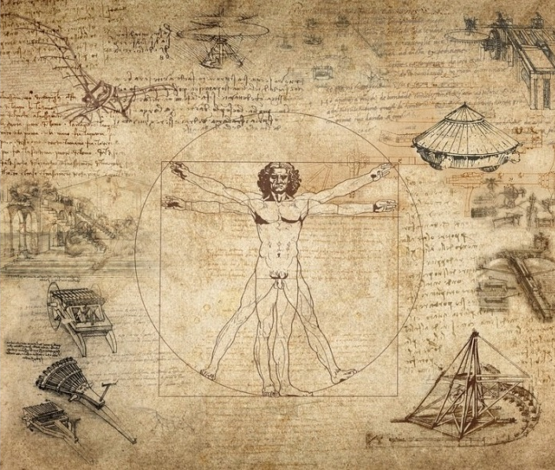





Science and Industry for Environment,
Health and Digital Society Technologies
26 June 2019
Scuola di Scienze
UNIVERSITÀ DEGLI STUDI DI BARI ALDO MORO
Dipartimento di Informatica - Via E. Orabona 4, Bari
PhD Programmes in:
- Chemical and Molecular Sciences
Computer Science and Mathematics
Geosciences
Physics
Advisory Committee
Maria F. Costabile
Domenico Di Bari
Giuseppe Iaselli
Massimo Moretti
Luisa Torsi
Industrial PhD day @ UNIBA
The purpose of the workshop is to review the experience of the industrial doctorate and to further strengthen the collaboration between UNIBA and companies of the Apulian territory. Some important joint projects will be presented.
Preliminary Programme
9.00 Registration
9.15 Welcome
9.45 Regional policies for innovation
10.15 The industrial PhD programme
10.45 Coffe break
11.00 Experiences from Apulian companies
13.00 Lunch
14.30 Research projects
17.30 Conclusion
Secretariat
Cinzia Balsamo
Ferdinando Lardo
e-mail:
cinzia.balsamo@uniba.it
Tel./fax +39 080 5442264
Info and registrations at: http://scuolascienzeetecnologie.uniba.it/industrialphd/
CON IL PATROCINIO DI:

