Slide 1
Complex and active fluids:
Phase separation, rheology and droplets dynamics
giuseppe Negro
TUTOR: Prof. G. Gonnella
A. Lamura (CNR Bari)
Presentazione attività di ricerca II anno XXXII ciclo

Slide 2
Summary
Complex and active fluids models
01
Phase separation of Liquid-Vapor systems
02
Active Fluids
03
Superfluidic and negative viscosity behavior
04
New modeling of active behavior of myosin contraction
05

Slide 3
Complex and active fluids
Fluids with internal structure and active components (bacteria suspended in passive fluids)‘’soft matter systems’’
Intermediate scales of organization continuous description with coarse grained fields
Continuity equation
Navier-Stokes
Stress Tensor
Convection-diffusion

Slide 4
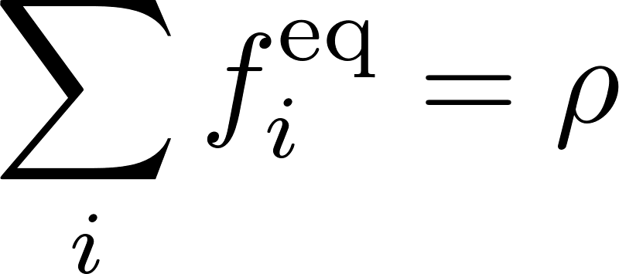
LB methods
Based on phase-space discretize form of the Boltzmann equation
Discretization both in real and velocity space: algorithm expressed in
terms of a set of discretized distribution functions
Mass and momentum density are defined as
D3Q15 geometry
The equilibrium distribution functions are expanded up to a given order in the fluid velocity u. The expansion coefficients are determined imposing the above constraints
Development and Implementation of a 3D LB scheme
Parallelization

Slide 5
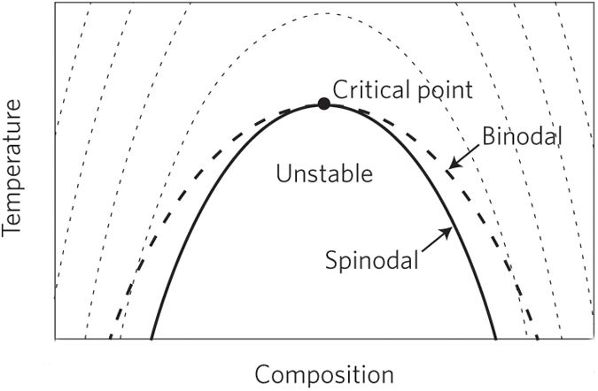
kinetics OF LIQUID-VAPOR PHASE SEPARATION
Quench
For binary mixtures different regimes can be derived
Viscous growth $l\sim t$ (Siggia)
Tubes of fluid are unstable to fluctuations of their interfaces and this results in pinch-off
Inertial growth $l\sim t^{2/3}$(Furukawa)
Curvature driven differences induce tangential pressure gradients and hence velocity field favours the smoothing of protuberances and dimples from interfaces
For Liquid-Vapor systems exponents are not known
but expected similar to binary mixtures
Few 2D numerical results (V. Sofonea 2009)

Slide 6
Liquid vapor phase separation
Growth driven by
Instability

Slide 7
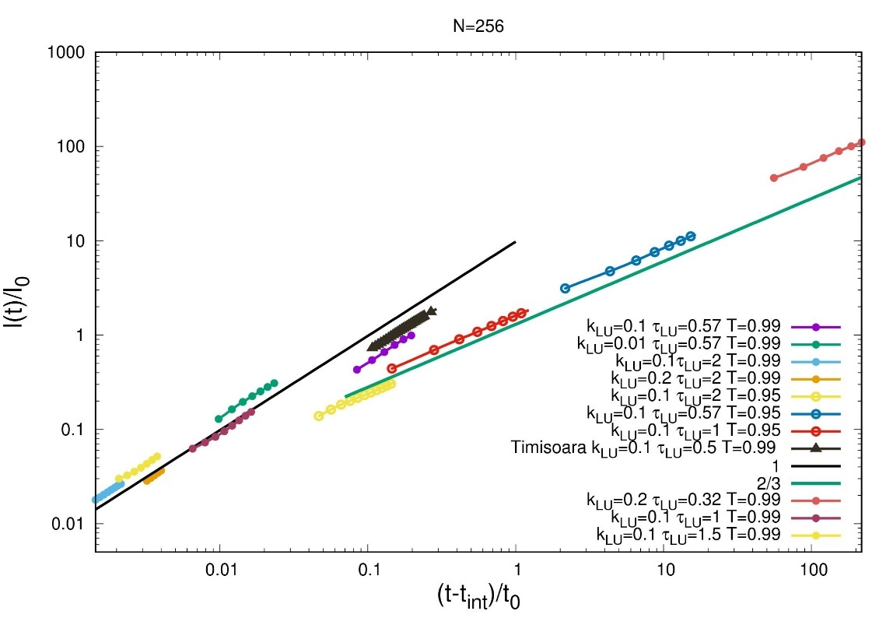
Liquid vapor phase separation in 3D
Evidence of 2/3 exponent and linear regime
Simulations on bigger systems (L=512) confirm the existence of
this linear regime
In collaboration with Prof. Sofonea West University of Timisoara. Work Presented at Tim18 Conference Timisoara

Slide 8
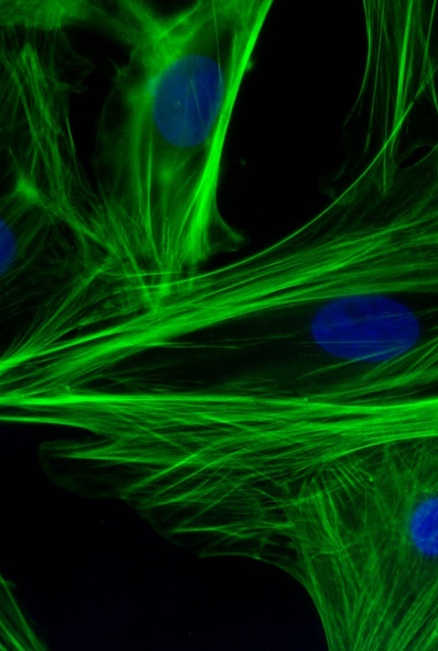
Active fluids

Slide 9
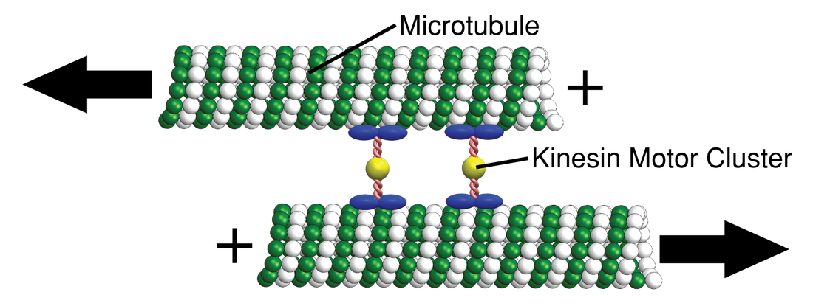
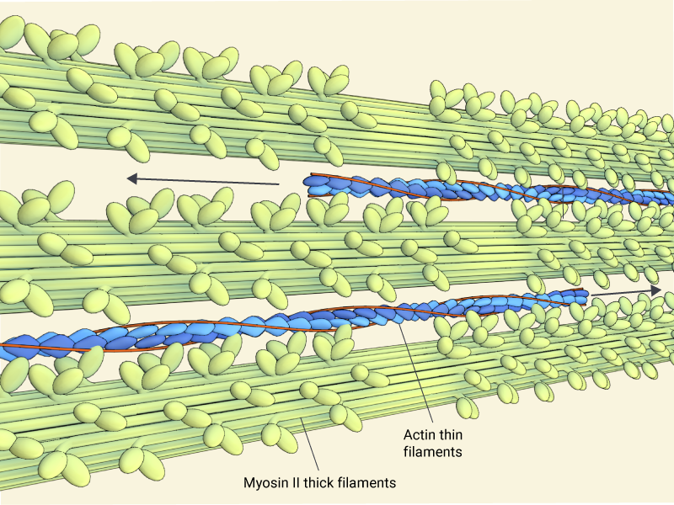
Active fluids
Extensile/pusher swimmer
www.stephenjdecamp.com
Contractile/puller swimmer
Active stress
www.mechanobio.info

Slide 10
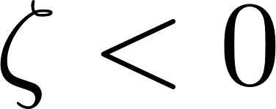
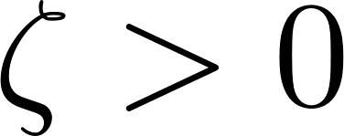
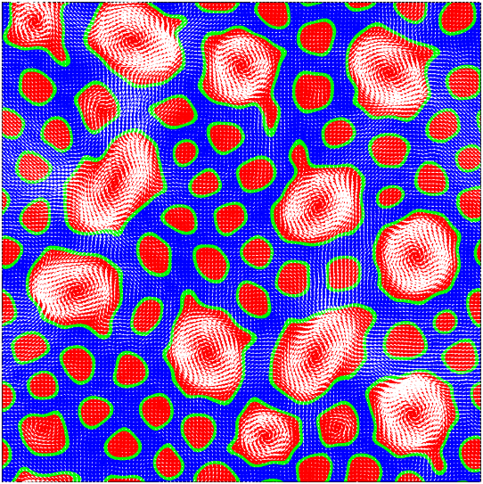
Active polar emulsions
Contractile
Extensile
Activity enhanced lamellar ordering
Big rotating droplets phase
G.Negro et al. Physica A: Statistical Mechanics and its applications 2018

Slide 11
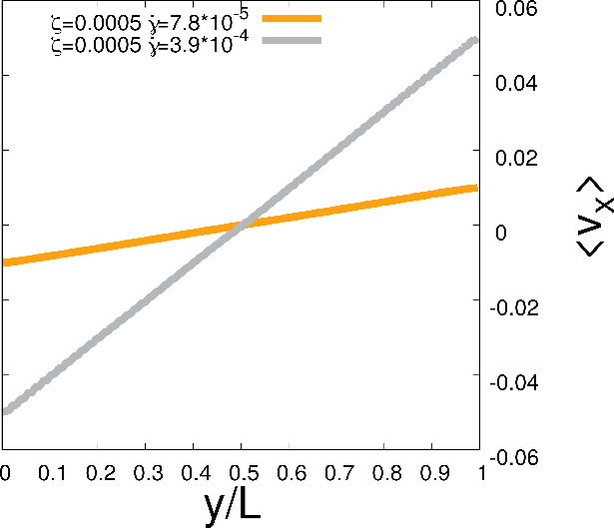
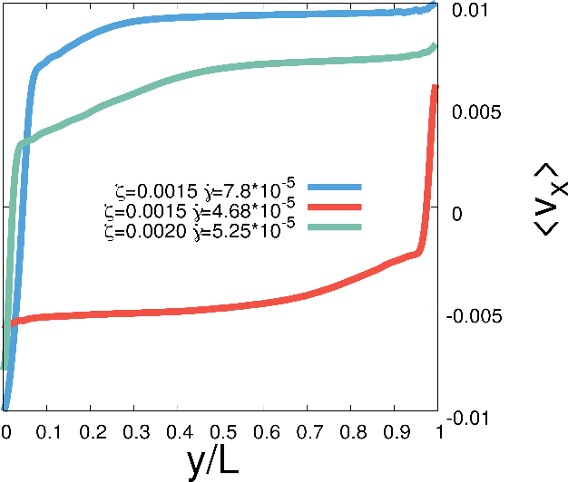
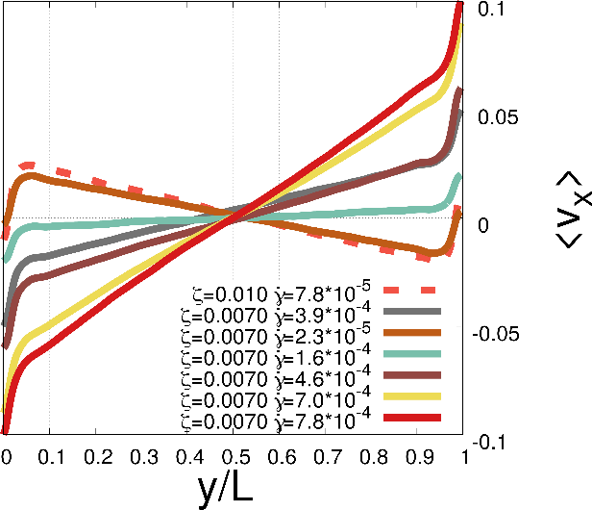
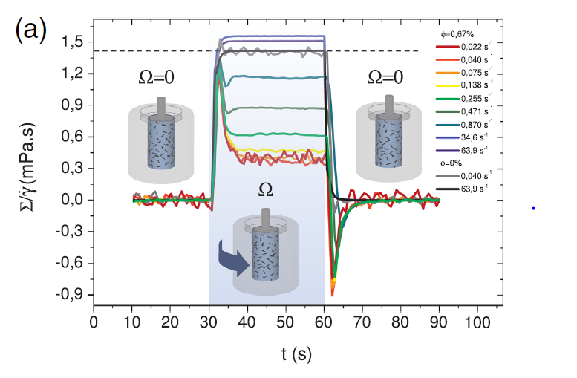
Unidirected motion and negative viscosity
Linear regime
Unidirected motion
Negative apparent viscsoty
We have been able to reproduce some recent experimental
results: Negative viscosity states (Lopez et al. PRL 2015)
Inverted velocity profiles (Guo et al. 2017)
Within our model it is possible to classify and investigate the
transition between different regimes and the mechanism
at their origin
Work Presented at DSFD 18 Conference, USA and will be
presented at APS conference in November
Paper in preparation

Slide 12
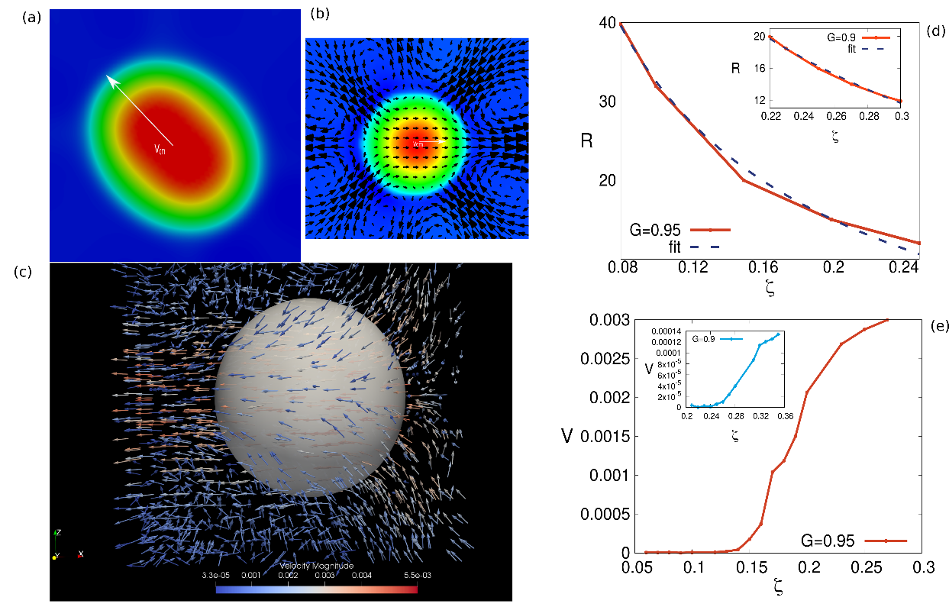
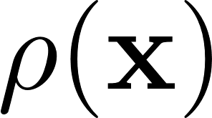
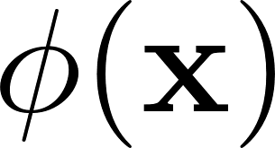
Myosin contraction based motility
Isotropic model for cell motility
Two scalar fields for myosin and actin
actin
myosin
A free energy is introduced to bind actin and
myosin
Active pressure to model myosin contraction
Our LB 2D and 3D simulations show that
Contractility alone is able to catch the origin
of cell motility
In collaboration with Prof. D. Marenduzzo, Edinburgh University. Research Paper submitted to EPL

Slide 13
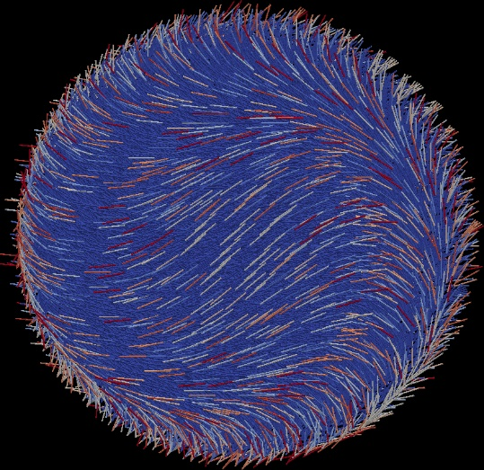
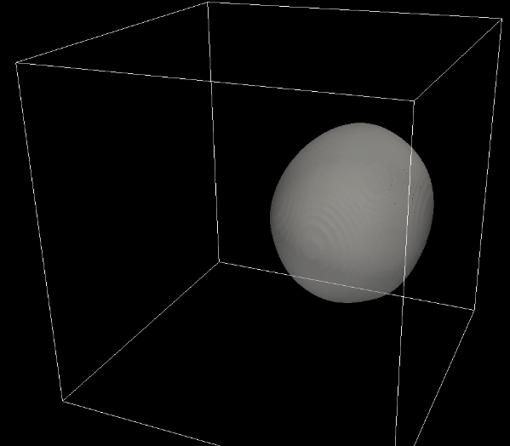
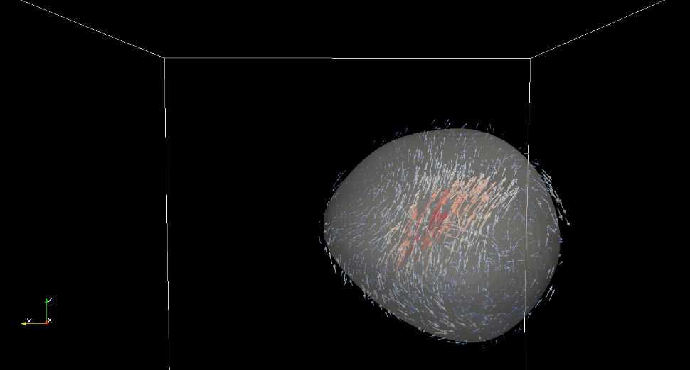
Perspectives
Many biological systems also display a local chirality[1-2]
Actin filaments, for example, are twisted in a right-ended direction so that myosin motors tends also
to rotate them while pulling, creating a torque dipole.
To incorporate this effect we are developing a model of cell motility based on
Active cholesteric droplets
[1] T.J. Pedley, PNAS 1992
[2] S. Zhou, PNAS 2014

Slide 14
Activities summary
Two months stay in Edimbutgh under the supervision of Prof. D. Marenduzzo
Winter School Active Matter Tel Aviv
TIM 18 Timisoara Conference
DSFD 18 Wochester MA, USA
G. Negro et al. Morphology and flow patterns in highly asymmetric
active polar emulsions, Physica A (2018)
G.Negro, G. Gonnella, A. Lamura et al.
Lattice Boltzmann methods and active fluids (submitted to EPJ)
G.Negro, G. Gonnella, A. Lamura, D. Marenduzzo
Recostruction of Myosin contraction based motility (submitted to EPL)
G. Negro et al. Kinetics of Liquid-Vapor phase separation in 3D ( in preparation)
G.Negro et al. Sheared active polar Emulsions (letter in preparation)

Slide 15
Thank you for your attention

