Slide 1
DIPARTIMENTO INTERATENEO DI FISICA «M. MERLIN» SCUOLA DI DOTTORATO DI RICERCA IN FISICA XXXIII CICLO Presentazione dell’attività di ricerca DEVELOPMENT OF INNOVATIVE PHOTOACOUSTIC SENSORS FOR INDUSTRIAL AND BIOMEDICAL APPLICATIONS Dottoranda: Arianna Elefante

Slide 2
SUMMARY
Motivations
Quartz Enhanced PhotoAcoustic Spectroscopy
Applications
External partners
Targets of the first year
Targets of the following years

Slide 3
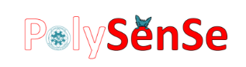
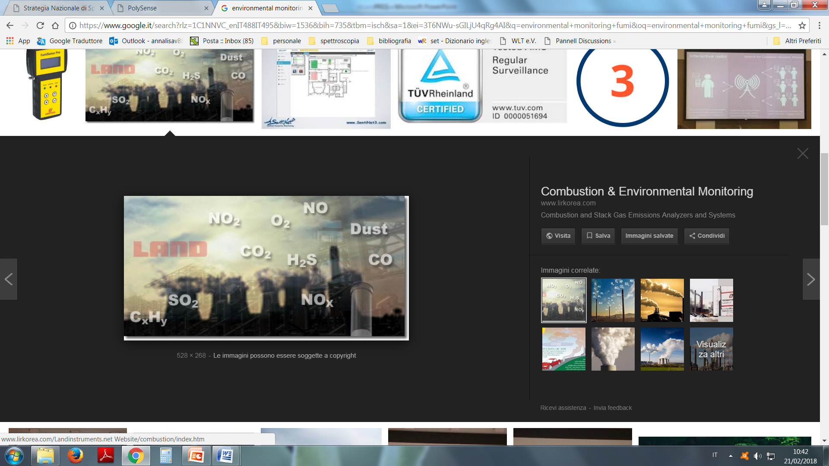
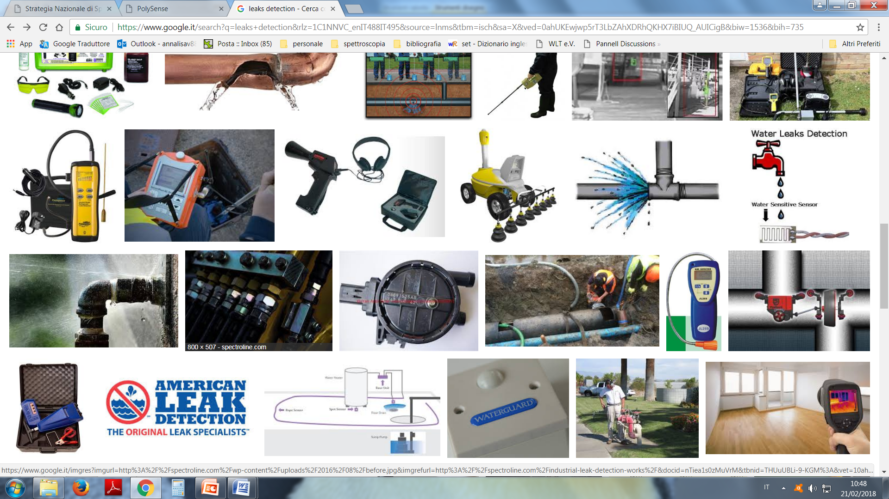
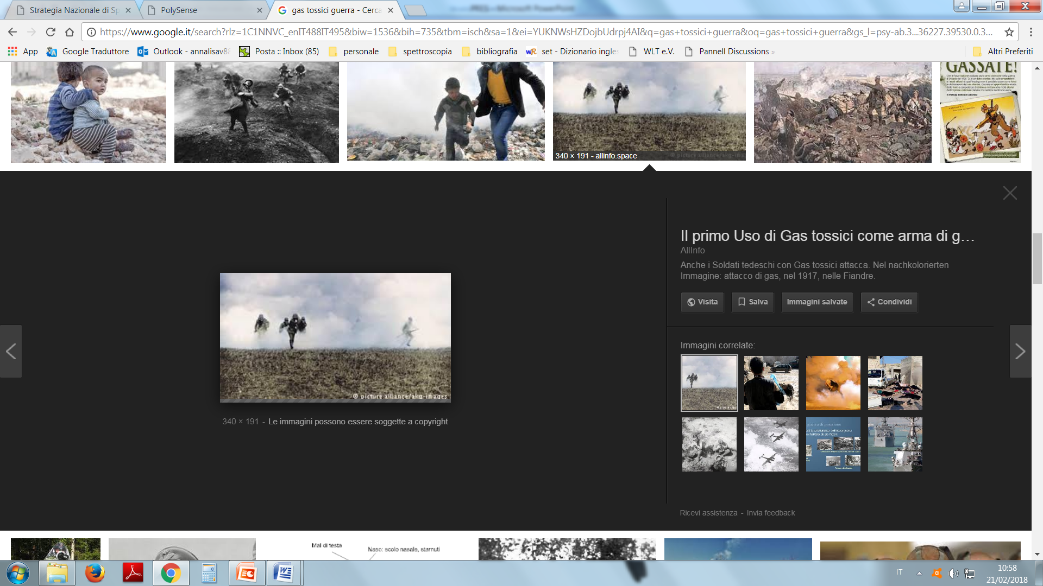
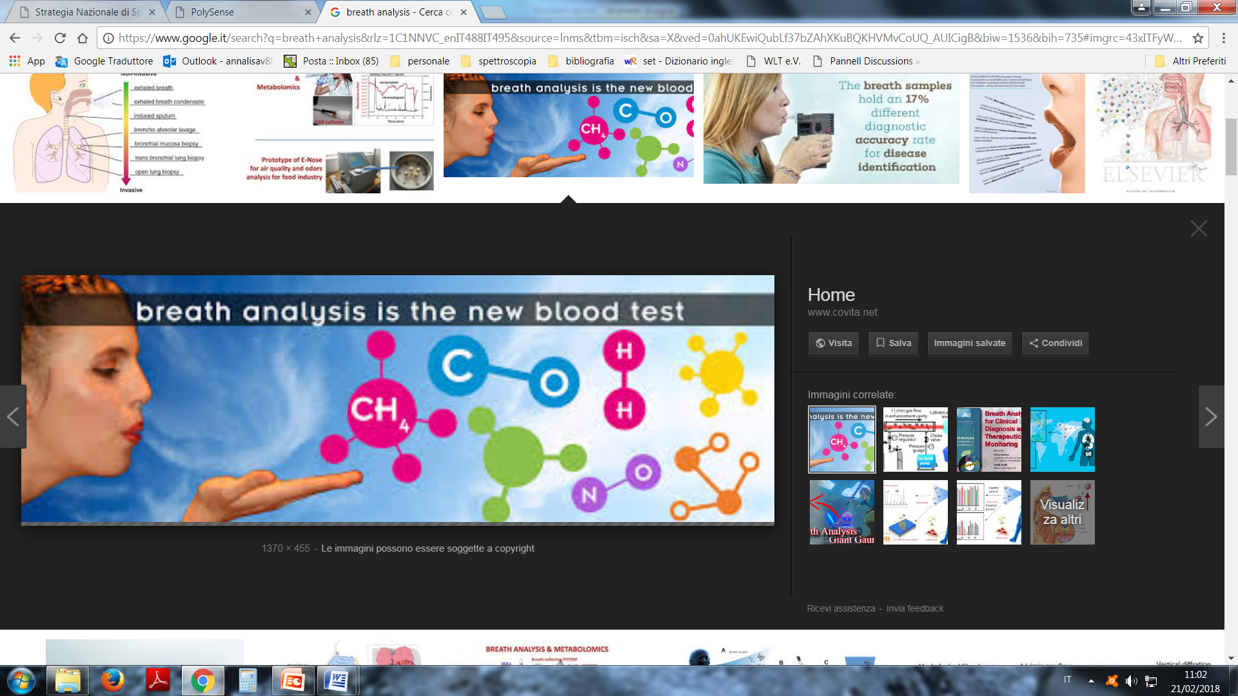
Motivation: detection and measurement of gas concentration
Environmental Monitoring
Industrial Process Control
Biomarker detection for non-invasive medical diagnostics
Detection of toxic gases and explosive precursor

Slide 4
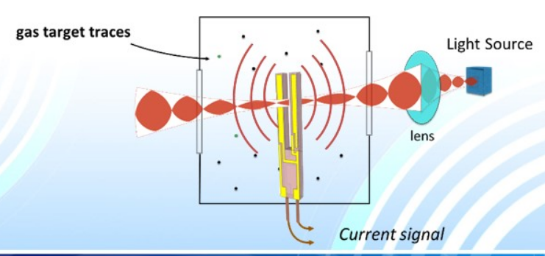
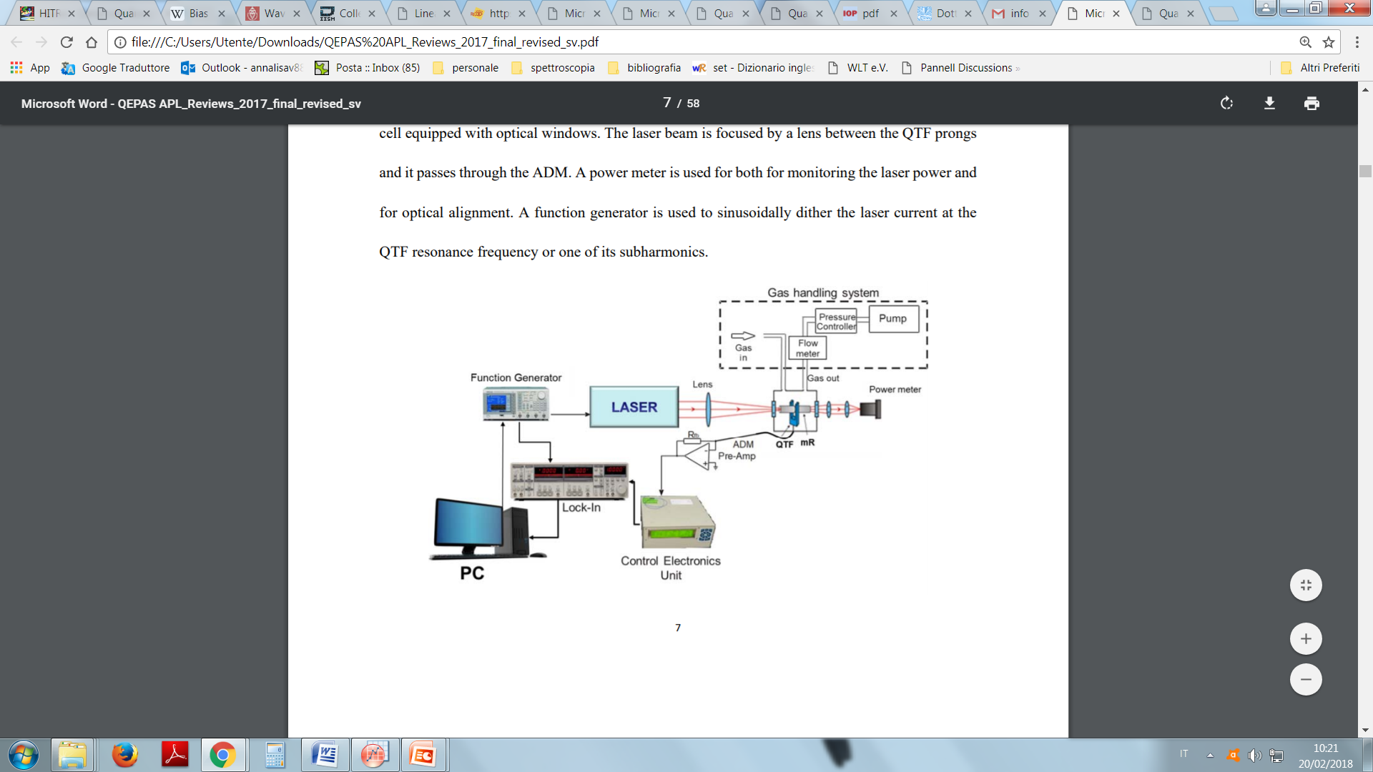
Quartz Enhanced PhotoAcoustic Spectroscopy
Excitation source:
Modulated laser light at λ= λass_molecola
Photoacoustic Spectroscopy: conversion of the energy absorbed by the molecules to thermal energy due to non radiative relaxation of the excited molecules
Photoacoustic Transducer:
Quartz tuning fork

Slide 5
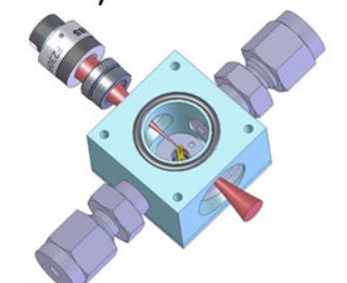
Quartz Enhanced PhotoAcoustic Spectroscopy
Sensor’s features:
Compactness
High sensibility and selectivity
Fast response time
Immunity to the environmental acoustic noise
In situ and real time monitoring
Recent highlights @PolySense
Record detection limit for QEPAS for SF6, 50 part per trillion in one second
First demonstration of QEPAS in the THz range
First demostration of simultaneous dual gas detection with QEPAS exploiting custom quartz tuning forks

Slide 6
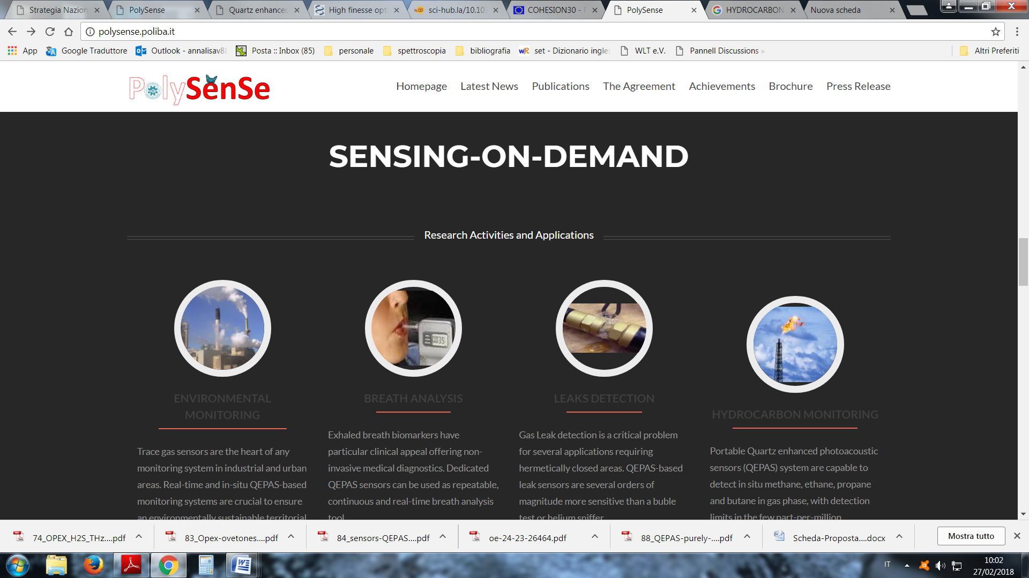
Applications in line with the Smart Specialisation Strategy S3
SECTION SMART INDUSTRY
SECTOIN HEALTH AND QUALITY OF LIFE
LEAKS DETECTION
Aim: implementation of a test station for the control of mechatronic systems like diesel injectors and sealed valves
Tracer gas: SF6
BREATH ANALYSIS
Aim: implementation of QEPAS sensor for the detection of ethylene in human breath
Tracer gas: C2H4

Slide 7
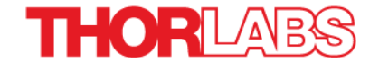
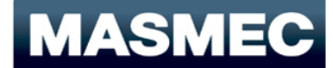
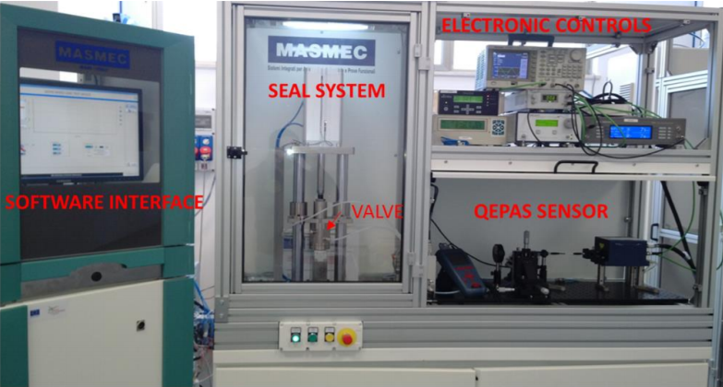
External Partners
Thorlabs is a vertically integrated manufacturer of photonics and optomechanic equipments for research, industrial, medical, and defense applications.
Within the PhD project they will collaborate in the development of compact QEPAS sensors for future commercialisation
Masmec is a company specializing in precision technology, robotics and mechatronics, applied to the automotive and biomedical sectors.
Within the PhD project they will collaborate in the implementation of leak sensors in the production line created for external costumers

Slide 8
Targets of the first year
Definition of the spectral range to be investigated and of the laser source to be used in accordance with the examined gas
Design, implementation and characterisation of compact detection modules based on custom QTF and on microresonator tubes
Development of a prototype of a compact QEPAS sensor for the detection of ethylene

Slide 9
Targets of the following years
SECOND YEAR at the research gourp THORLABS of Dachau in Germany
Optimization of the etylene sensor in terms of compactness for in situ application (integration of the electronic)
Study of the response of the etylene sensor for breath analyis application with gas matrices that simulate human breath
Development of a compact QEPAS sensor for the detection of SF6
THIRD YEAR(6 month at MASMEC)
@MASMEC Installation of the leak sensor in the test station and its validation in situ ( measure’s reliability, efficacy in the response time)
@POLYSENSE : Coupling of the sensor with a breath sampling system and preliminary test with real samples of human breath

