Slide 1
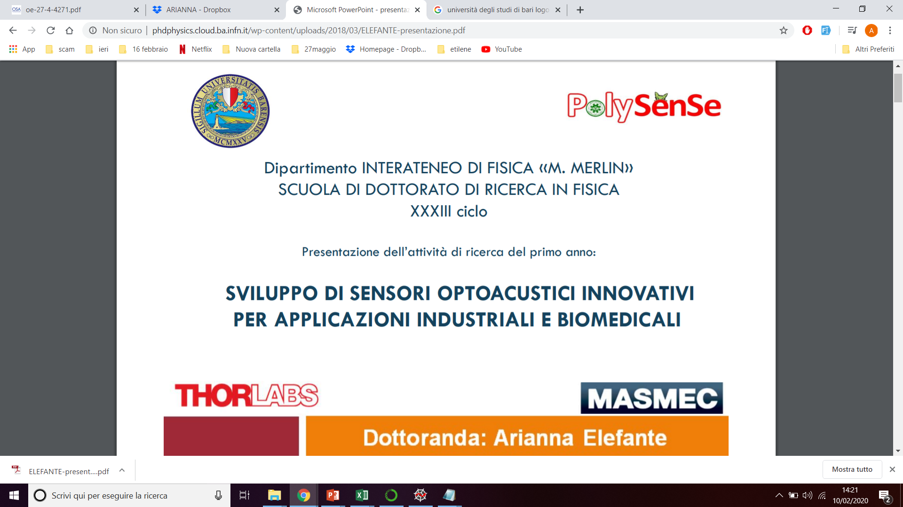
Dipartimento INTERATENEO DI FISICA <<M. MERLIN>>
PhD SCHOOL OF PHYSICS
XXXIII cycle
Second year report
DEVELOPMENT OF INNOVATIVE OPTO-ACOUSTIC SENSORS FOR INDUSTRIAL AND BIOMEDICAL APPLICATIONS
PhD Student: Arianna Elefante

Slide 2
OUTLINE
2° year PhD Research activities:
- Compact Quartz Enhanced Photoacoustic sensor for the detection of SF₆
- Design of an innovative Acoustic Detection Module with two Quarz Tuning Forks
- Study of the stability of a compact QEPAS sensor for the CH₄ detection
- Calibration of the CH₄ QEPAS sensor with the water vapor concentration
3° year PhD goals
Publications and conference proceedings

Slide 3
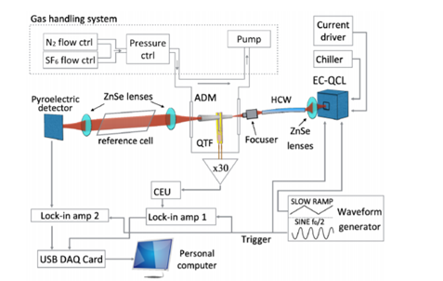
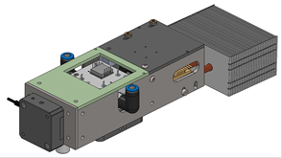
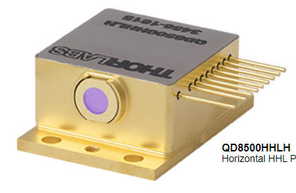
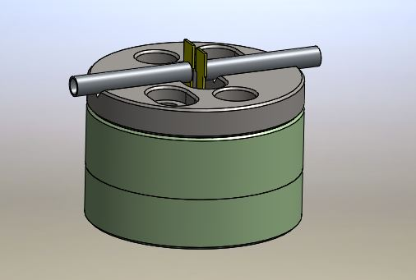
Compact Quartz Enhanced Photoacoustic sensor for the detection of SF₆
Motivation: development of a compact QEPAS sensor to be implemented in a test station for the leakage detection in mechatronic systems
1) Detection
LASER
DFB QCL
λ= 10.54 μm
+
+
LENS
f=50 mm
Acoustic Detection Module
QTF
L=9.4 mm
T=0.5 mm
S=0.8 mm
Microresonator Tubes
L=12.4 mm
ID=1.51 mm

Slide 4
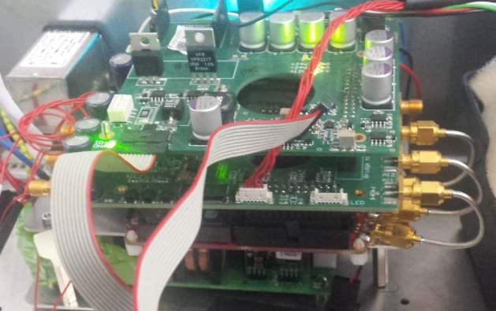
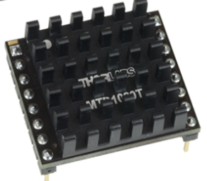
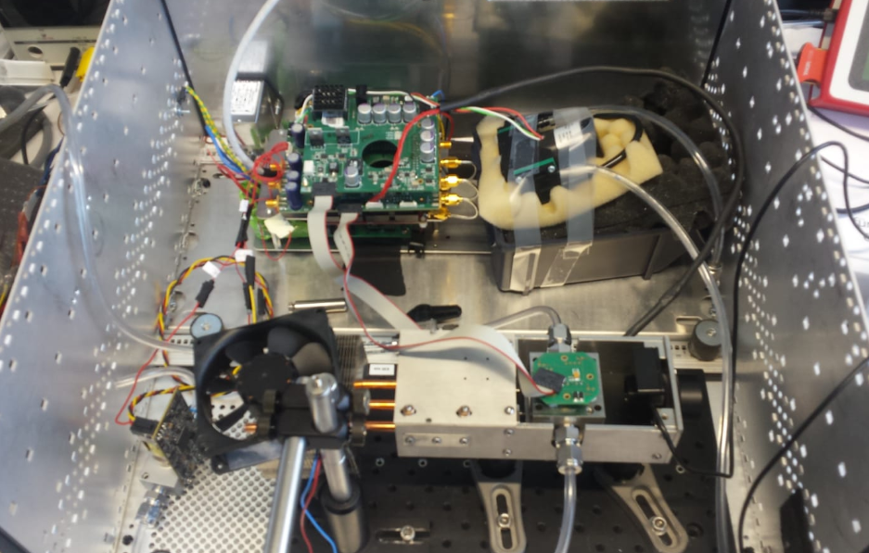
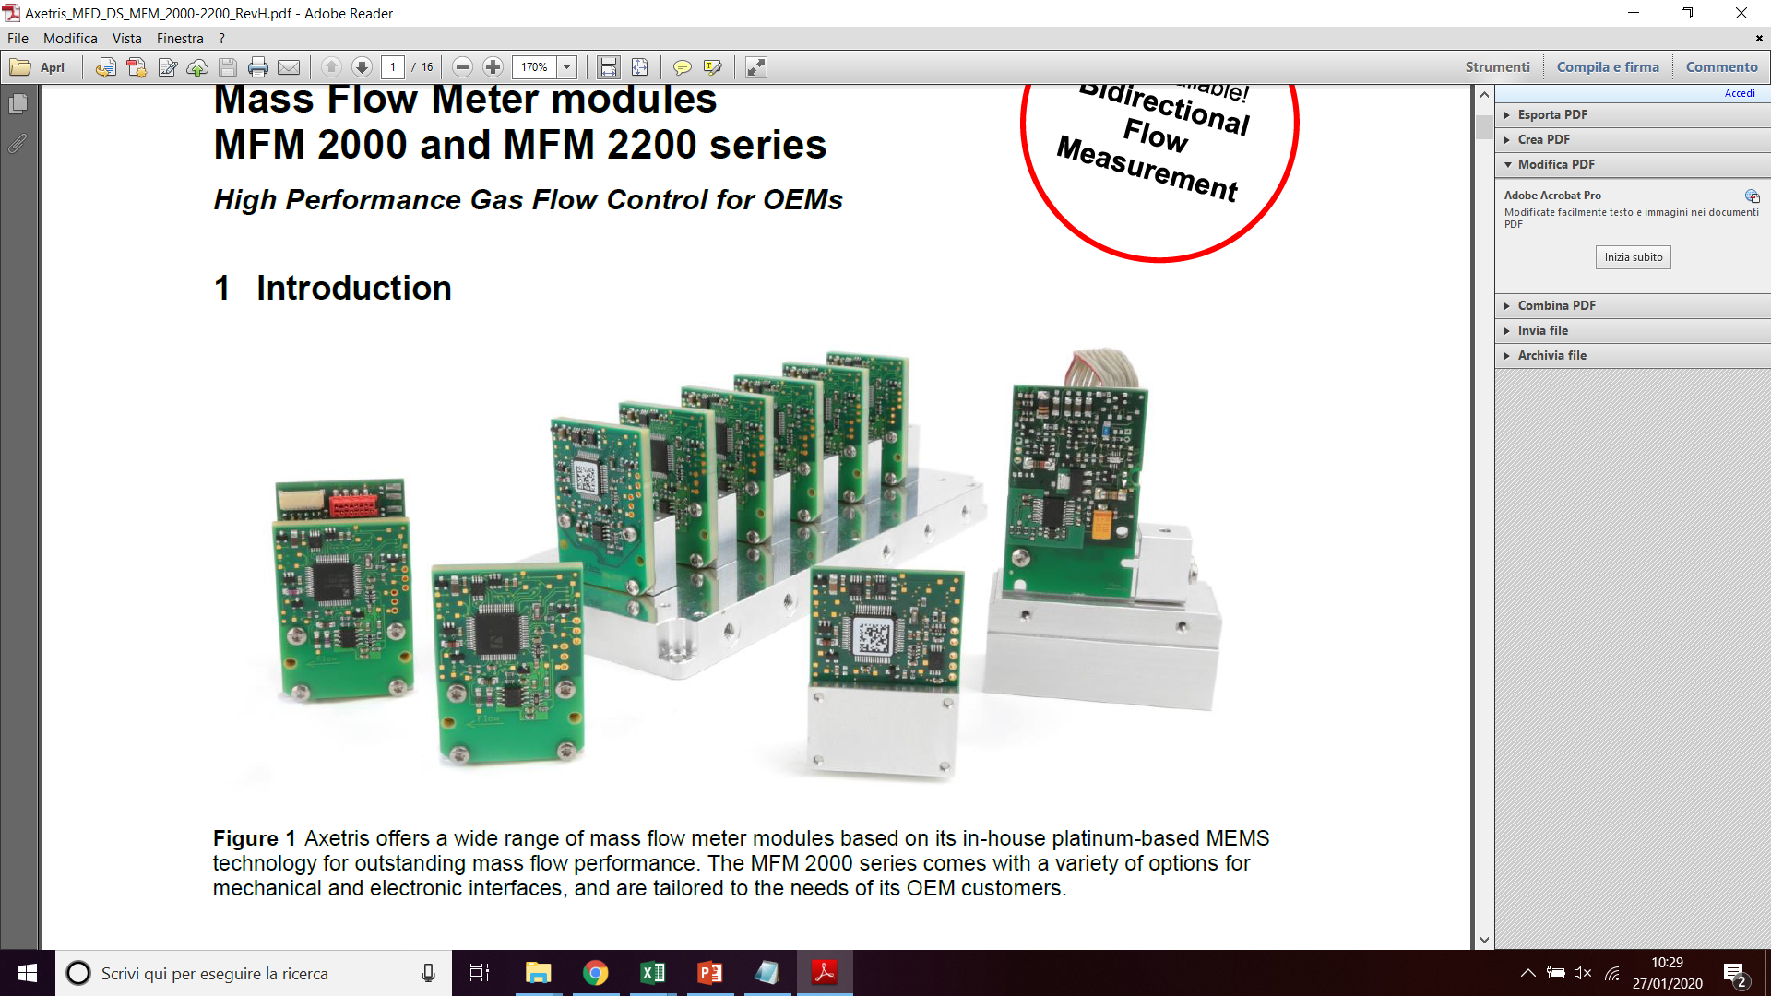
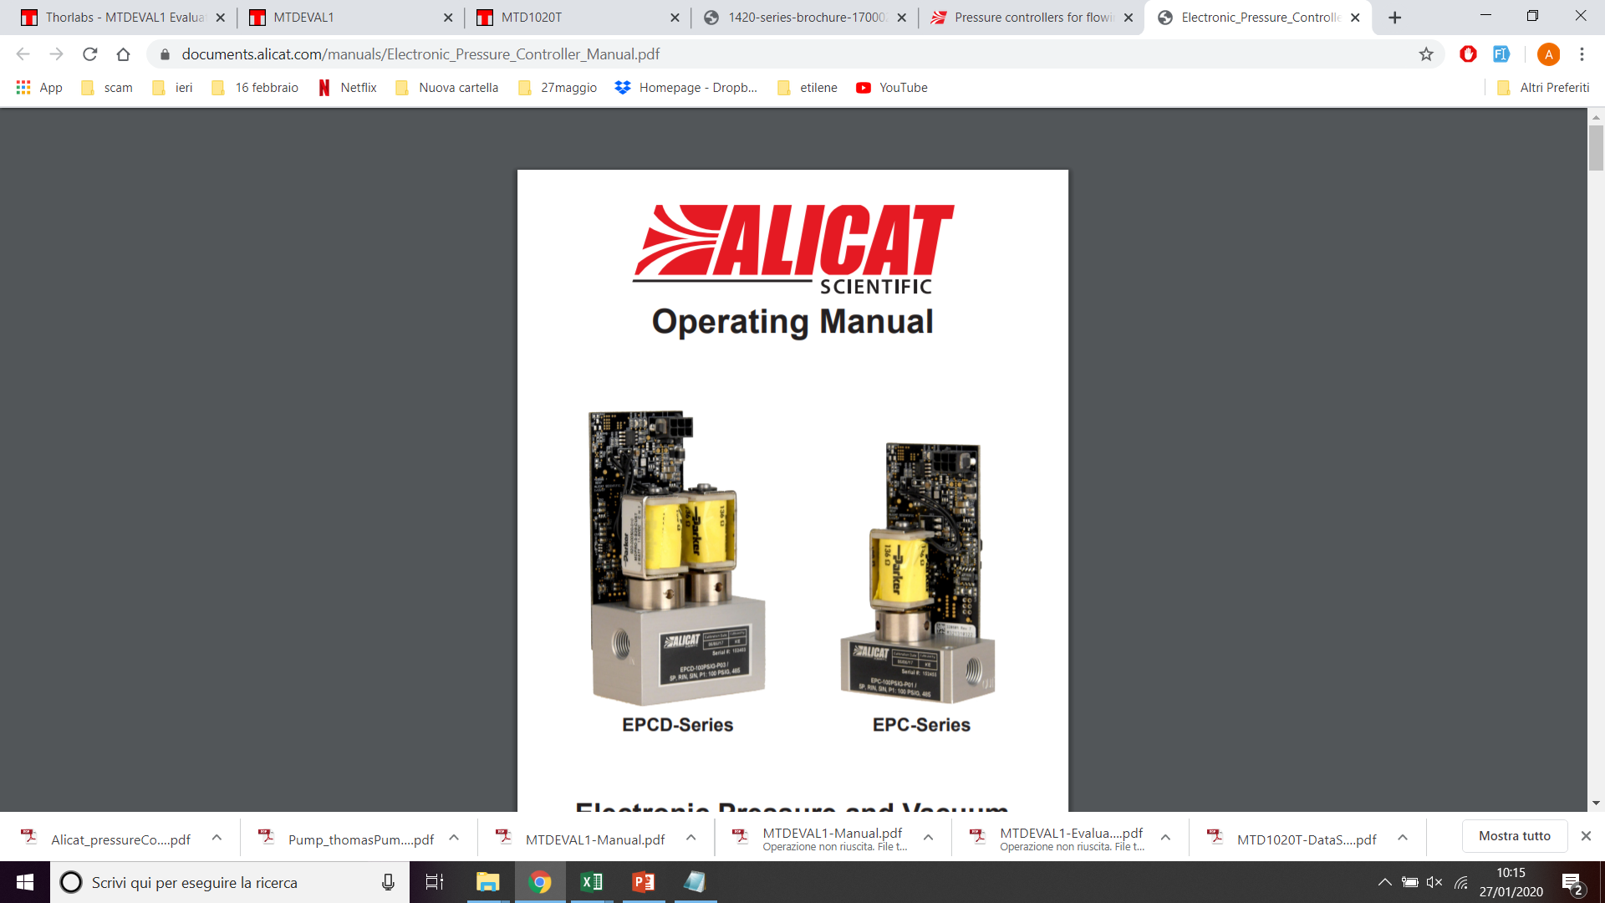
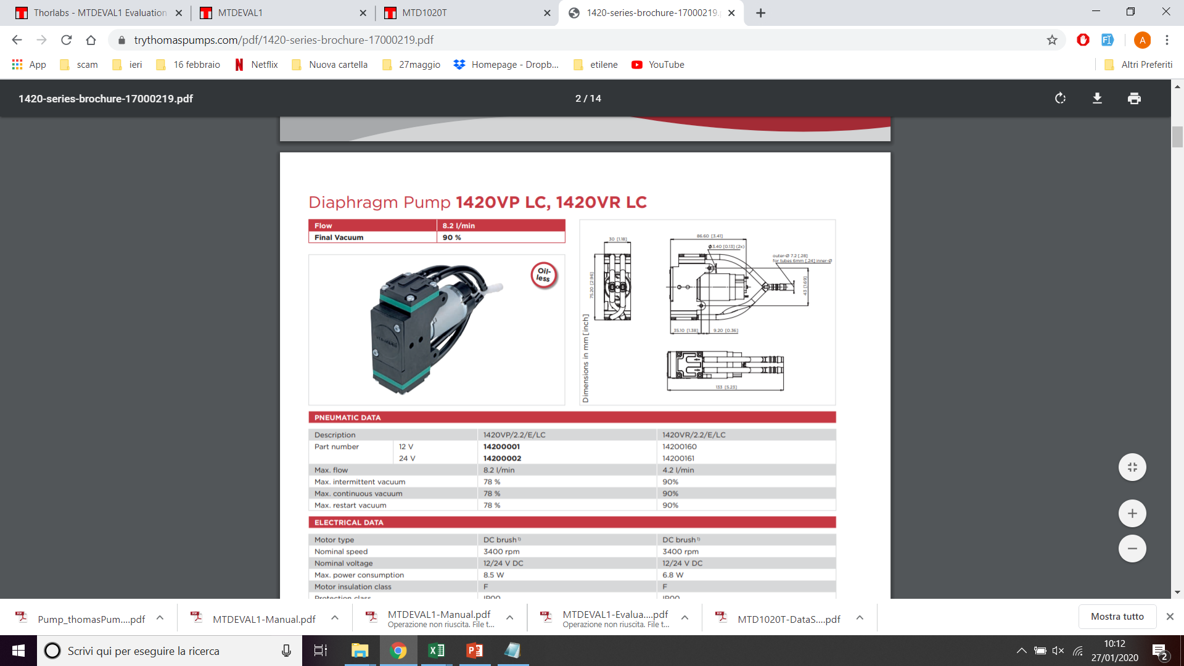
2) Laser Driver and TEC; Electronic for the acquisition and generation of the QEPAS signal
Laser driver + TEC
Main Board
RedPitaya
Power supply
3) Gas line
Flow meter Axetris
Pressure Controller Alicat
Thomas Pump
Manual valve
ADM

Slide 5
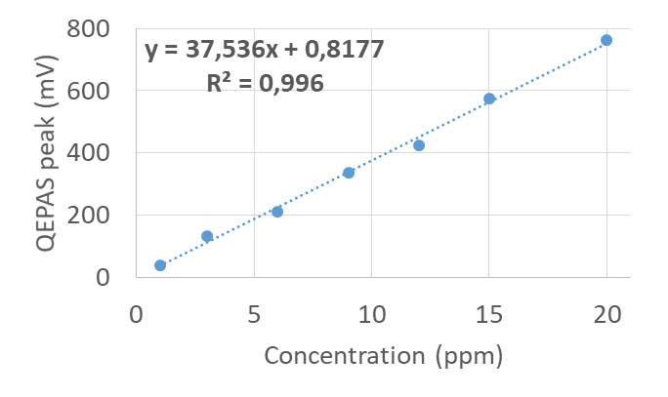
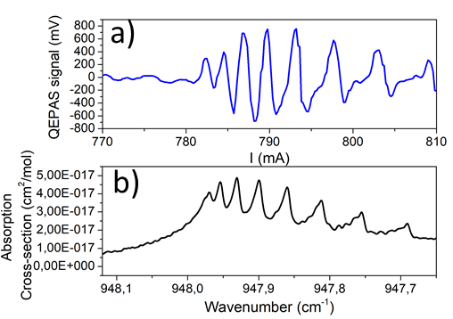
Compact Quartz Enhanced Photoacoustic sensor for the detection of SF₆
Hitran simulation of the absorption cross-section for pure SF₆ at 80 Torr
Calibration curve
QEPAS spectral scan measured for 20 ppm of SF₆ at 80 Torr
Minimum detection limit:
10 ppb at 8 ms integration time.

Slide 6
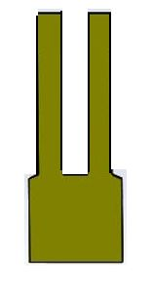
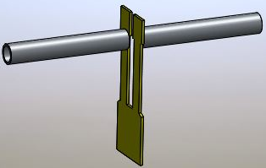
Dual QTF ADM
Motivation: analysis of mixtures with a wide dynamic range in concentration from few ppm to the percentage range
S1 : bare QTF
S2: QTF + AmR tubes
Non-linear effects:
Molecular relaxation dynamics
Speed of sound
High concentration measurement
Sensitive measurements of low concentration

Slide 7
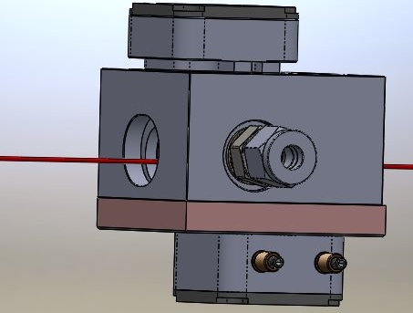
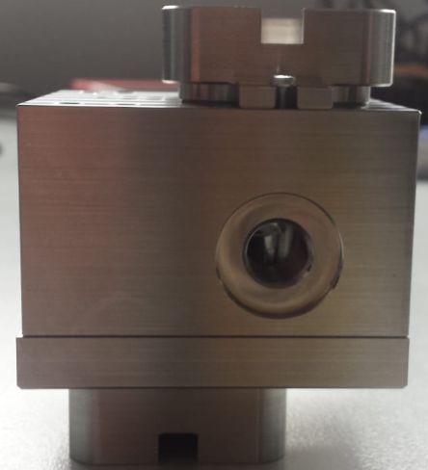
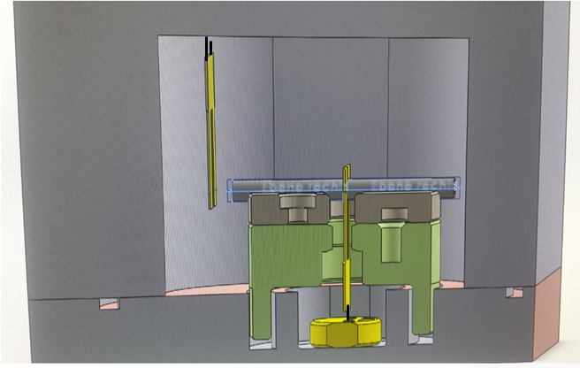
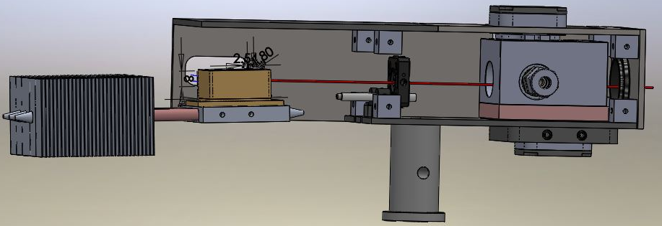
Dual QTF ADM
Adapter for the alignment of S1
55.6 x 50.6 x 32.6 mm
S1
5 mm
Alignment of S2
228 mm
S2

Slide 8
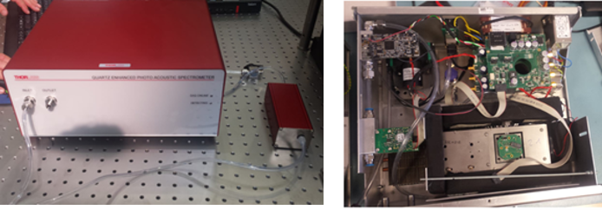
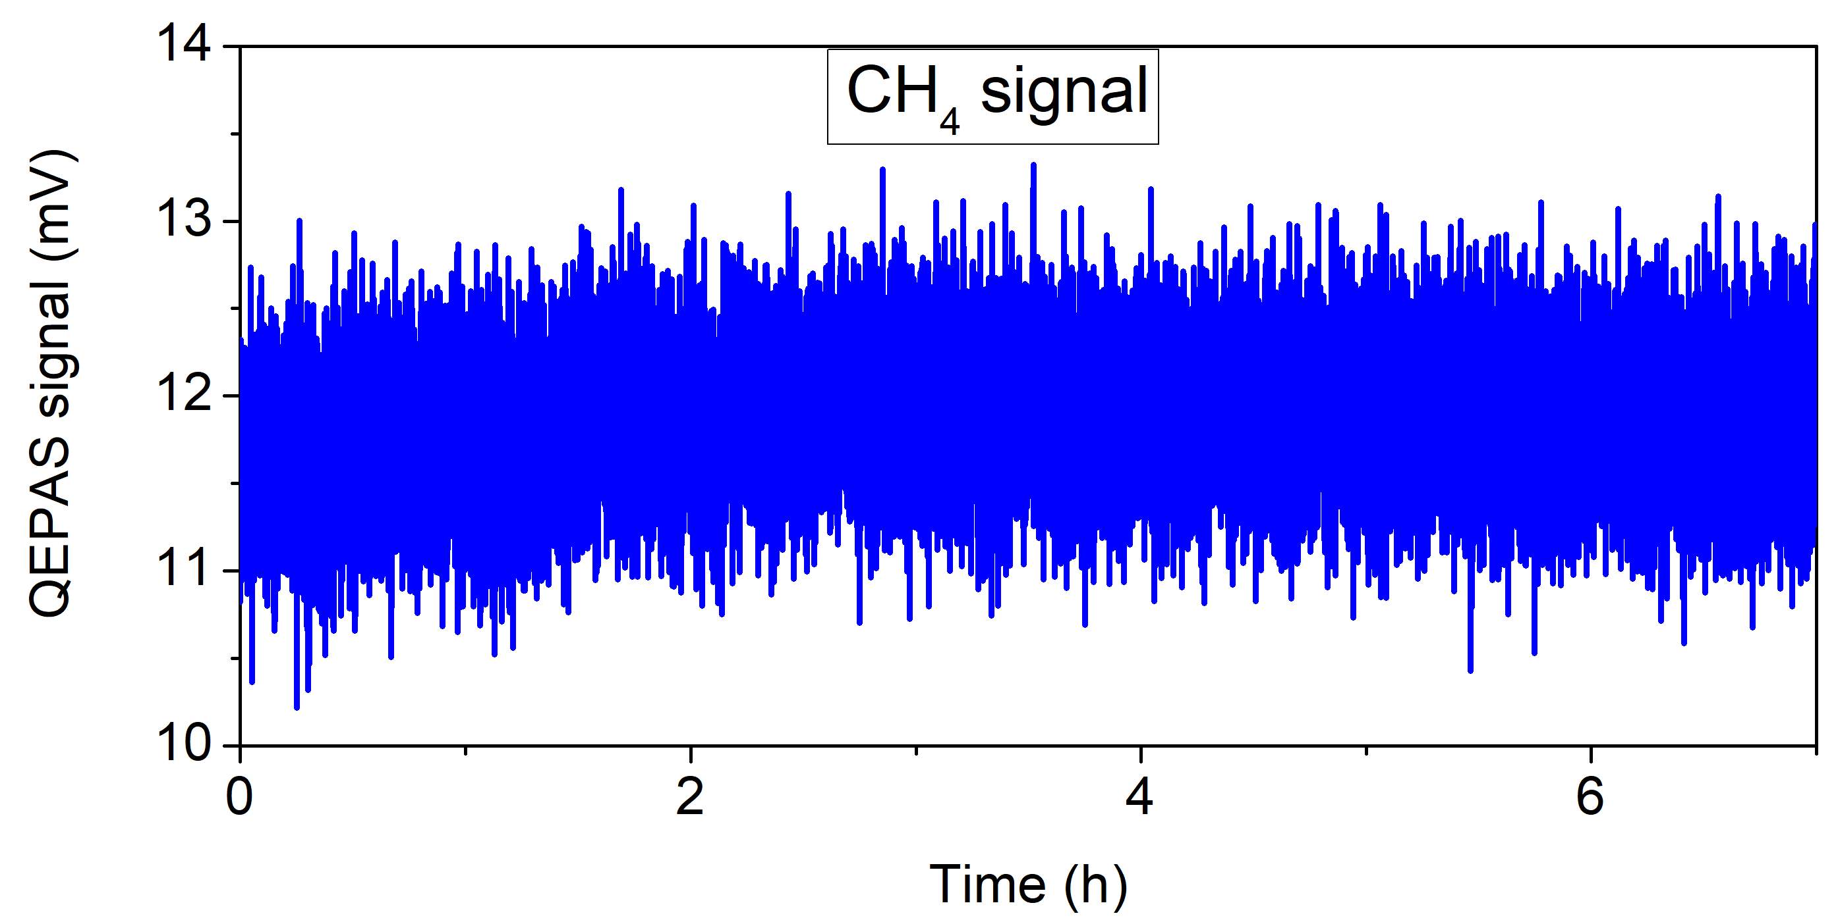
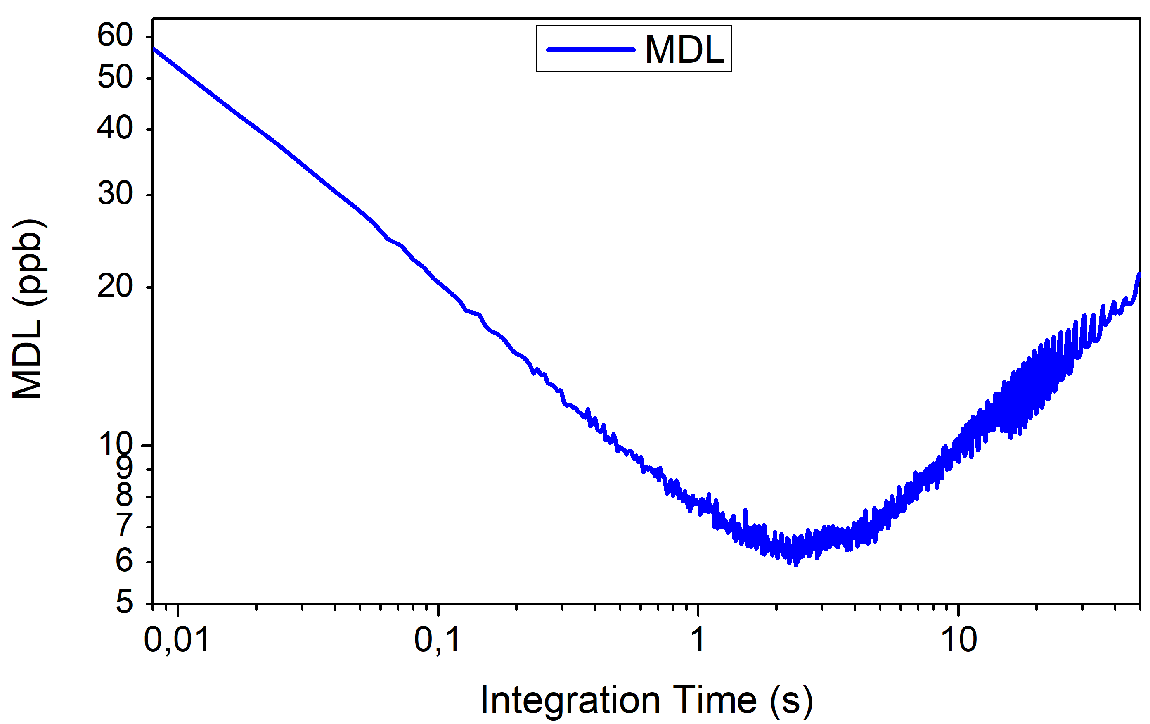
Study of the stability of a compact QEPAS sensor for the CH₄ detection
Permselect
Ultimate Detection Limit:
57 ppb @ Tint= 8 ms
2 ppb @ Tint= 6 s

Slide 9
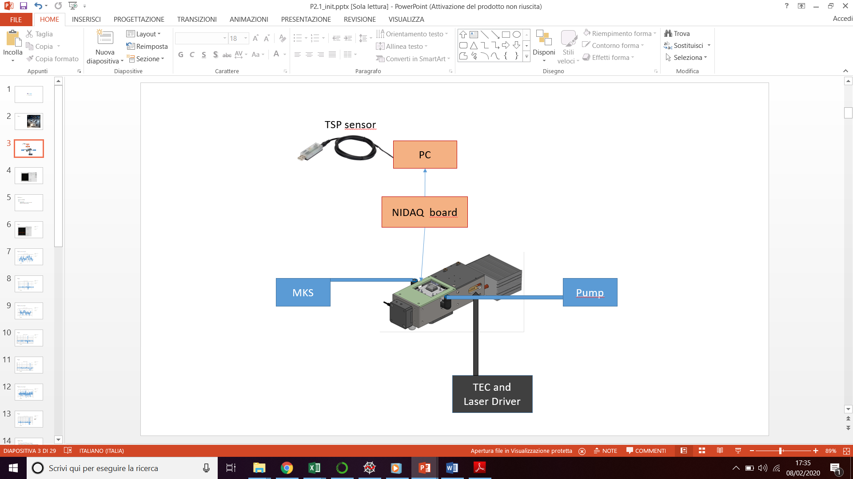
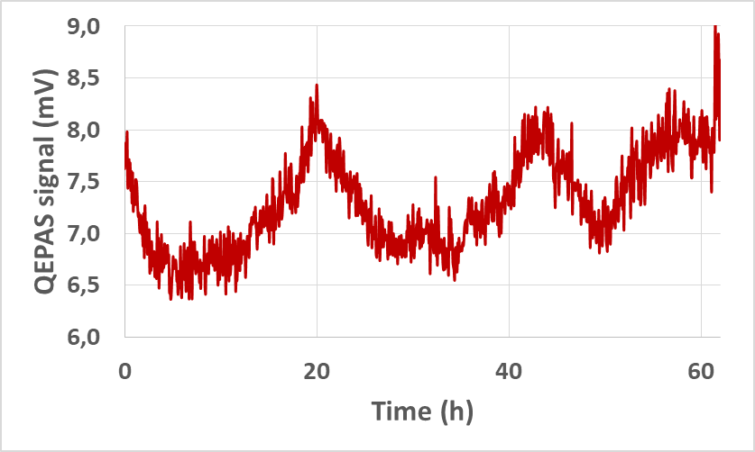
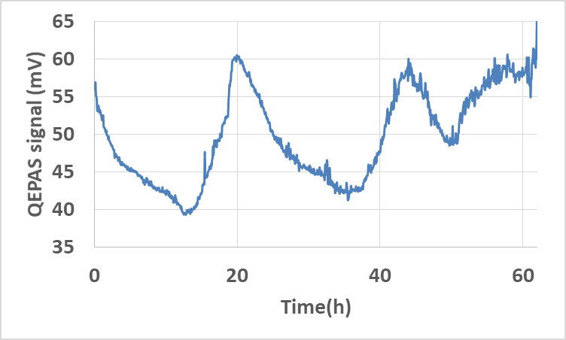
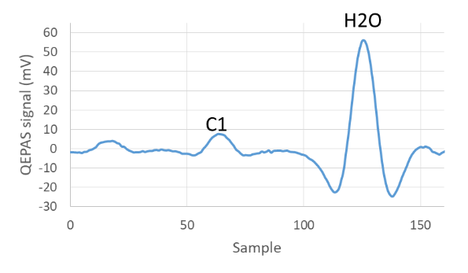
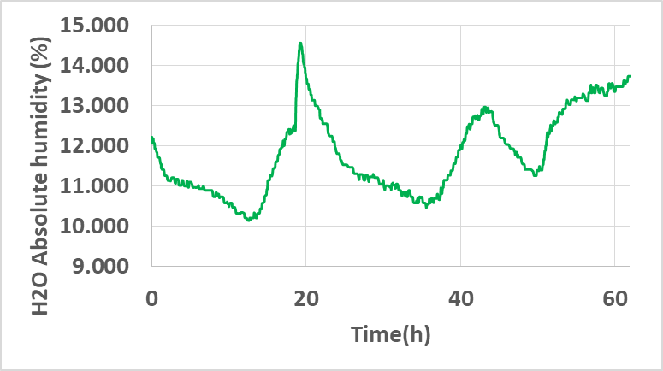
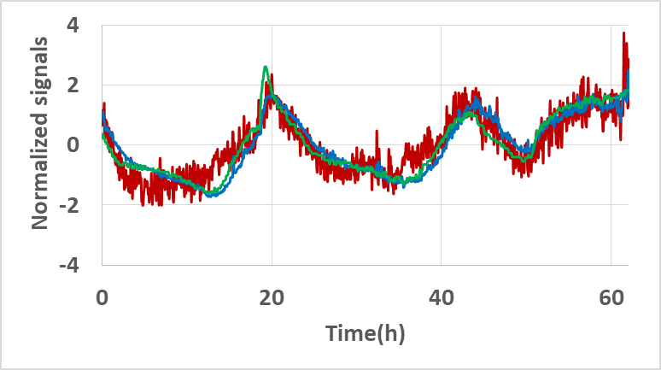
Calibration of the CH₄ QEPAS sensor with the water vapor concentration
Motivation: Normalize the CH₄ QEPAS signal with respect to the absolute humidity
CH₄ QEPAS signal
H₂O QEPAS signal
H₂O Absolute Humidity TSP

Slide 10
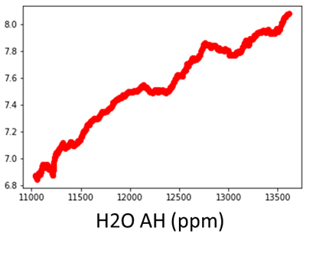
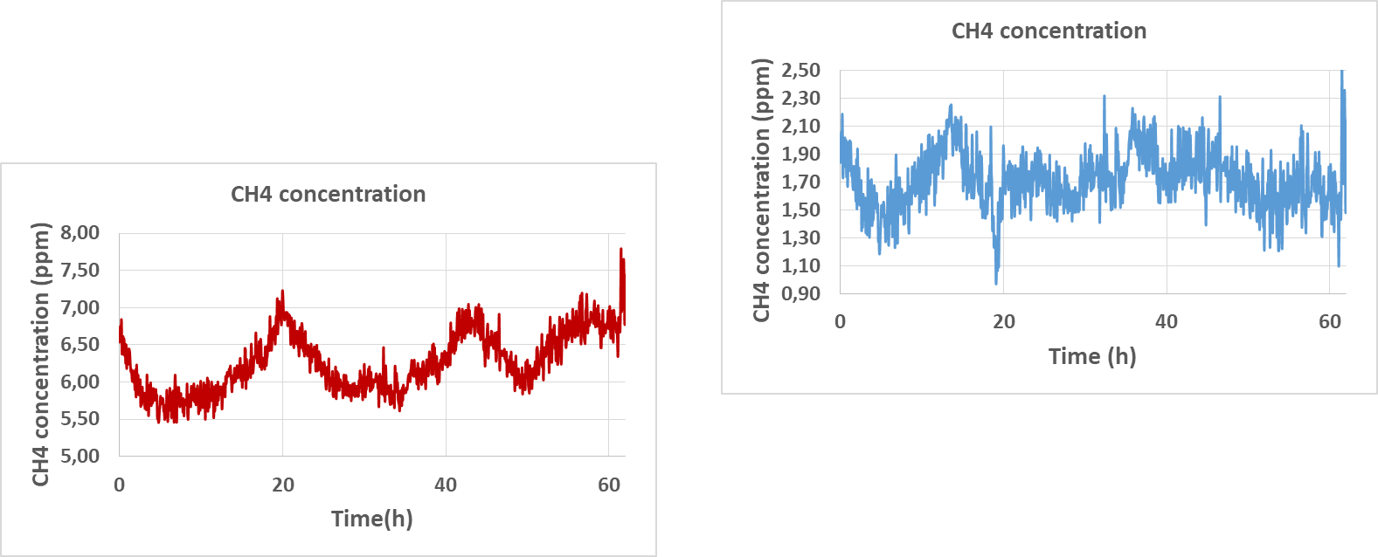
Calibration of the CH₄ QEPAS sensor with the water vapor concentration
CH₄ QEPAS (mV)
CH₄ (mV)=0.00044 (mV/ppm) * H2O AH (ppm) + 2. 09733 mV
R²=0. 982

Slide 11
3° year PhD goals
Implementation of the SF₆ sensor in the test station at Masmec
Assembling and testing of the QEPAS sensor with the dual QTF ADM for the detection of CH₄ in a wide concentration range

Slide 12
Publications and conference proceedings
Publications
M. Giglio, A. Zifarelli, A. Sampaolo, G. Menduni, A. Elefante, R. ,Blanchard, C. fluegl,M.F. Witinski, D. Vakhshoori, H. Wu, V.M.N. Passaro, P. Patimisco, F.K. Tittel, L. Dong, V. Spagnolo, “Broadbanddetection of methane and nitrous oxide using a distributed feedbackquantum cascade laser array and quartz-enhanced photoacousticsensing”, Photoacoustics 17, 100159 (2020).
A. Elefante, M. Giglio, A. Sampaolo, G. Menduni, P. Patimisco, V. M.N. Passaro, H. Wu, H. Rossmadl, V. Mackowiak, A. Cable, F.K. Tittel, L. Dong and V. Spagnolo, “Dual-Gas Quartz-Enhanced Photoacoustic Sensor for Simultaneous Detection of Methane/Nitrous Oxide and Water Vapor”, Anal. Chem. 91, 12866-12873 (2019).
Conference Proceedings
Fiber-coupled quartz-enhanced photoacoustic sensor for methane and ethane trace detection, Fabrizio Sgobba, Univ. degli Studi di Bari Aldo Moro (Italy); Giansergio Menduni, Angelo Sampaolo, Pietro Patimisco, Marilena Giglio, Politecnico di Bari (Italy); Arianna Elefante, Univ. degli Studi di Bari Aldo Moro (Italy); Vittorio M. N. Passaro, Politecnico di Bari (Italy); Frank K. Tittel, Rice Univ. (USA); Vincenzo Spagnolo, Politecnico di Bari (Italy)
Measurement of non-radiative gas molecules relaxation rates by using quartz-enhanced photoacoustic spectroscopy, Stefano dello Russo, Univ. degli Studi di Bari Aldo Moro (Italy); Pietro Patimisco, Angelo Sampaolo, Marilena Giglio, Giansergio Menduni, Politecnico di Bari (Italy); Arianna Elefante, Univ. degli Studi di Bari Aldo Moro (Italy); Vittorio M. N. Passaro, Politecnico di Bari (Italy); Frank K. Tittel, Rice Univ. (USA); Vincenzo Spagnolo, Politecnico di Bari (Italy).
Partial least squares regression as novel tool for gas mixtures analysis in quartz-enhanced photoacoustic spectroscopy, Andrea Zifarelli, Univ. degli Studi di Bari Aldo Moro (Italy); Pietro Patimisco, Angelo Sampaolo, Marilena Giglio, Giansergio Menduni, Politecnico di Bari (Italy); Arianna Elefante, Univ. degli Studi di Bari Aldo Moro (Italy); Vittorio M. N. Passaro, Politecnico di Bari (Italy); Frank K. Tittel, Rice Univ. (USA); Vincenzo Spagnolo, Politecnico di Bari (Italy)

