Slide 1
Introduction to GPU programming using CUDA
Felice Pantaleo
EP-CMG-CO
felice@cern.ch

Slide 2
Prerequisites
You need experience with C or C++
You don’t need GPU experience
You don’t need parallel programming experience
You don’t need graphics experience

Slide 3
Content of the theoretical session
Heterogeneous Parallel computing systems
CUDA Basics
Parallel constructs in CUDA
Shared Memory
Device Management
Thrust

Slide 4
Content of the tutorial session
Write and launch CUDA C/C++ kernels
Manage GPU memory
Manage communication and synchronization
…Think parallel

Slide 5
Accelerators
Exceptional raw power wrt CPUs
Higher energy efficiency
Plug & Accelerate
Massively parallel architecture
Low Memory/core
Notes:
The whole industry is moving into heterogeneous computing from mobile to supercomputing. This is motivated by the fact that heterogeneous computing system can achieve much more energy efficiency and higher performance than the traditional computing systems.

Slide 6
Accelerators
GPUs were traditionally used for real-time rendering.
NVIDIA & AMD main manufacturers.
Intel introduced the coprocessor Xeon Phi (MIC)

Slide 7
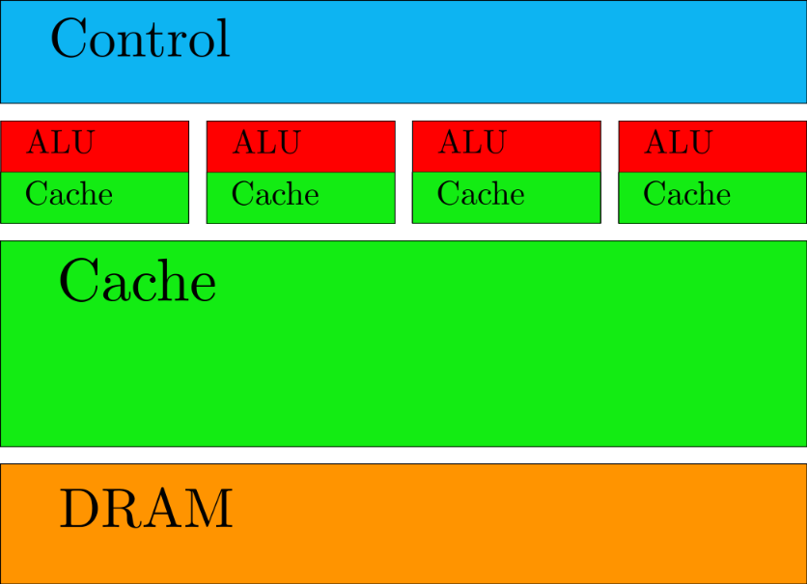
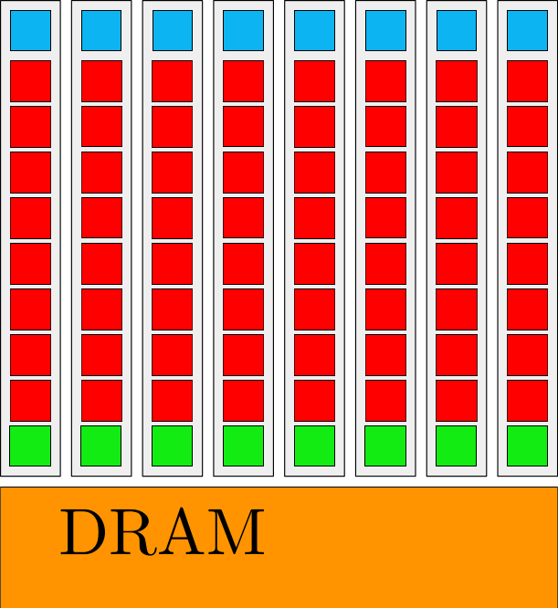
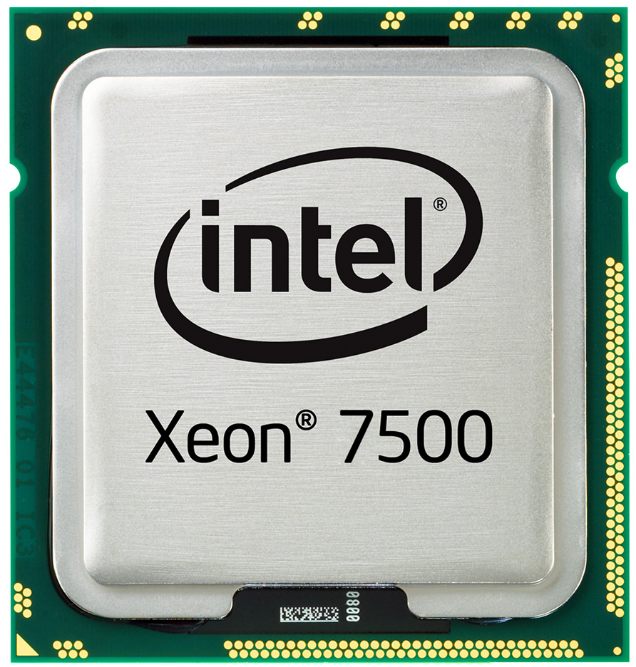
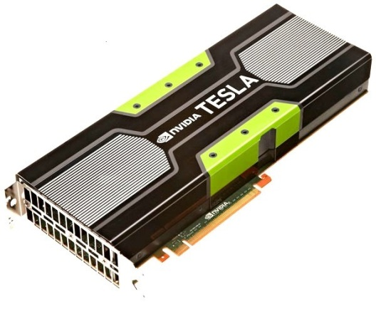
CPU vs GPU architectures
CPU
GPU
Notes:
The traditional CPUs and GPUs are based on very different design philosophy. On the lefthand side the cpus are designed with optimized latency of executing instructions. Whereas the gpus are designed with throughput in mind and the goal is to maximize the throughput of instructions that the processor can achieve by executing as many instructions as possible at the same time.
If we look at the CPUs today, there are several important design techniques:
CPUs tend to come with large caches, they are designed to convert long latency memory accesses to short latency cache accesses. The goal is to keep as many of the data elements as possible in the cache so that a lot of times we need the data we’ll find the data in the cache and instead of going into DRAM (which takes a long memory) we can actually get data from the cache very quickly.
Two other control mechanism:
Branch prediction
branches corrispond to decisions that we make in the source code. Whenever we make a decision sometimes it takes a long time for data to become available. the branch prediction allows the hardware to immediately predict what is going to be executed after the branch and reduce the latency.
with data forwarding the cpu is able to immediately use a result in the next clock cycle
another common technique to reduce latency is to produce a powerful ALU (a lot of transistors = less clock cycles)
the gpus on the other hand are representative instances of the so called throughput oriented designed.
they come with small caches as staging, consolidation memory and we can reduce the traffic to the dram.
has very simple control: no branch prediction, no data forwarding.
Energy efficient ALU: fairly long latency for producing operation, but heavily pipelined for high throughput.
The best way to achieve performance is by having a massive number of threads to tolerate latencies
winning applications use both CPU and GPUs
The CUDA architecture is built around a scalable array of multithreaded Streaming Multiprocessors (SMs). A multiprocessor is designed to execute hundreds of threads concurrently. To
manage such a large amount of threads, it employs a unique architecture called
SIMT (Single-Instruction, Multiple-Thread)
The instructions are pipelined to leverage instruction-level parallelism within a single thread, as well as thread-level parallelism through simultaneous hardware multithreading.
Unlike CPU cores instructions are issued in order however and there is no branch prediction and no speculative execution.

Slide 8
CPU vs GPU architectures
Large caches (slow memory accesses to quick cache accesses)
SIMD
Branch prediction
Data forwarding
Powerful ALU
Pipelining
CPU
Notes:
The traditional CPUs and GPUs are based on very different design philosophy. On the lefthand side the cpus are designed with optimized latency of executing instructions. Whereas the gpus are designed with throughput in mind and the goal is to maximize the throughput of instructions that the processor can achieve by executing as many instructions as possible at the same time.
If we look at the CPUs today, there are several important design techniques:
CPUs tend to come with large caches, they are designed to convert long latency memory accesses to short latency cache accesses. The goal is to keep as many of the data elements as possible in the cache so that a lot of times we need the data we’ll find the data in the cache and instead of going into DRAM (which takes a long memory) we can actually get data from the cache very quickly.
Two other control mechanism:
Branch prediction
branches corrispond to decisions that we make in the source code. Whenever we make a decision sometimes it takes a long time for data to become available. the branch prediction allows the hardware to immediately predict what is going to be executed after the branch and reduce the latency.
with data forwarding the cpu is able to immediately use a result in the next clock cycle
another common technique to reduce latency is to produce a powerful ALU (a lot of transistors = less clock cycles)
the gpus on the other hand are representative instances of the so called throughput oriented designed.
they come with small caches as staging, consolidation memory and we can reduce the traffic to the dram.
has very simple control: no branch prediction, no data forwarding.
Energy efficient ALU: fairly long latency for producing operation, but heavily pipelined for high throughput.
The best way to achieve performance is by having a massive number of threads to tolerate latencies
winning applications use both CPU and GPUs
The CUDA architecture is built around a scalable array of multithreaded Streaming Multiprocessors (SMs). A multiprocessor is designed to execute hundreds of threads concurrently. To
manage such a large amount of threads, it employs a unique architecture called
SIMT (Single-Instruction, Multiple-Thread)
The instructions are pipelined to leverage instruction-level parallelism within a single thread, as well as thread-level parallelism through simultaneous hardware multithreading.
Unlike CPU cores instructions are issued in order however and there is no branch prediction and no speculative execution.

Slide 9
CPU vs GPU architectures
SMX* executes kernels (aka functions) using hundreds of threads concurrently.
SIMT (Single-Instruction, Multiple-Thread)
Instructions pipelined
Thread-level parallelism
Instructions issued in order
No Branch prediction
Branch predication
Cost ranging from few hundreds to a thousand euros depending on features (e.g. NVIDIA GTX680 400 euros)
GPU
*SMX = Streaming multiprocessor
Notes:
The traditional CPUs and GPUs are based on very different design philosophy. On the lefthand side the cpus are designed with optimized latency of executing instructions. Whereas the gpus are designed with throughput in mind and the goal is to maximize the throughput of instructions that the processor can achieve by executing as many instructions as possible at the same time.
If we look at the CPUs today, there are several important design techniques:
CPUs tend to come with large caches, they are designed to convert long latency memory accesses to short latency cache accesses. The goal is to keep as many of the data elements as possible in the cache so that a lot of times we need the data we’ll find the data in the cache and instead of going into DRAM (which takes a long memory) we can actually get data from the cache very quickly.
Two other control mechanism:
Branch prediction
branches corrispond to decisions that we make in the source code. Whenever we make a decision sometimes it takes a long time for data to become available. the branch prediction allows the hardware to immediately predict what is going to be executed after the branch and reduce the latency.
with data forwarding the cpu is able to immediately use a result in the next clock cycle
another common technique to reduce latency is to produce a powerful ALU (a lot of transistors = less clock cycles)
the gpus on the other hand are representative instances of the so called throughput oriented designed.
they come with small caches as staging, consolidation memory and we can reduce the traffic to the dram.
has very simple control: no branch prediction, no data forwarding.
Energy efficient ALU: fairly long latency for producing operation, but heavily pipelined for high throughput.
The best way to achieve performance is by having a massive number of threads to tolerate latencies
winning applications use both CPU and GPUs
The CUDA architecture is built around a scalable array of multithreaded Streaming Multiprocessors (SMs). A multiprocessor is designed to execute hundreds of threads concurrently. To
manage such a large amount of threads, it employs a unique architecture called
SIMT (Single-Instruction, Multiple-Thread)
The instructions are pipelined to leverage instruction-level parallelism within a single thread, as well as thread-level parallelism through simultaneous hardware multithreading.
Unlike CPU cores instructions are issued in order however and there is no branch prediction and no speculative execution.

Slide 10
Throughput
Theoretical peak throughput: the maximum amount of data that a kernel can read and produce in the unit time.

Slide 11
Throughput
Theoretical peak throughput: the maximum amount of data that a kernel can read and produce in the unit time.
Throughput_{peak} (GB/s) = 2 x access width (byte) x mem_freq (GHz)

Slide 12
Throughput
Theoretical peak throughput: the maximum amount of data that a kernel can read and produce in the unit time.
Throughput_{peak} (GB/s) = 2 x access width (byte) x mem_freq (GHz)
This means that if your device comes with a memory clock rate of 1GHz DDR (double data rate) and a 384-bit wide memory interface, the amount of data that a kernel can process and produce in the unit time is at most:

Slide 13
Throughput
Theoretical peak throughput: the maximum amount of data that a kernel can read and produce in the unit time.
Throughput_{peak} (GB/s) = 2 x access width (byte) x mem_freq (GHz)
This means that if your device comes with a memory clock rate of 1GHz DDR (double data rate) and a 384-bit wide memory interface, the amount of data that a kernel can process and produce in the unit time is at most:
Throughput_{peak} (GB/s) = 2 x (384/8)(byte) x 1 (GHz) = 96GB/s

Slide 14
Global memory
Kepler Architecture:
1.3 TFLOPS DPFP peak throughput
250 GB/s peak off-chip memory access bandwidth
31 G DPFP operands per second
To achieve peak throughput, a program must perform 1,300/31 = ~42 FP arithmetic operations for each operand value fetched from off-chip memory

Slide 15
Bandwidth

Slide 16
Bandwidth

Slide 17
Conflicting data
Conflicting Data Updates Cause Serialization and Delays:
Massively parallel execution cannot afford serialization
Contentions in updating critical data causes serialization

Slide 18
Heterogeneous Parallel Computing Systems

Slide 19
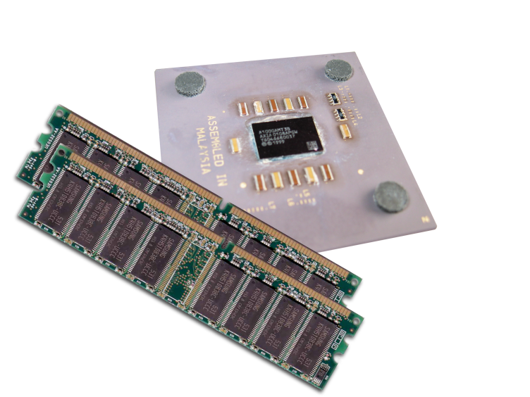
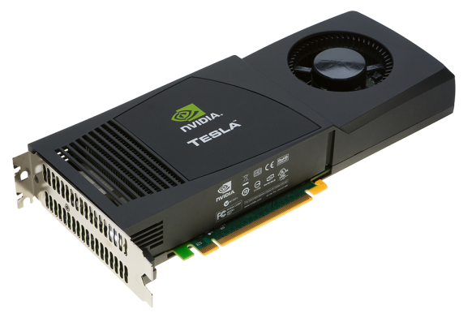
Heterogeneous Computing
Terminology
Host The CPU and its memory space
Device The GPU and its memory space
Host
Device
Notes:
The CUDA programming model assumes that both the host and the device maintain their own separate memory spaces in DRAM, referred to as host memory and device memory, respectively. Therefore, a program manages the global, constant, and texture memory spaces visible to kernels through calls to the CUDA runtime. This includes device memory allocation and deallocation as well as data transfer between host and device memory.

Slide 20
Heterogeneous Computing
#include <iostream>
#include <algorithm>
using namespace std;
#define N 1024
#define RADIUS 3
#define BLOCK_SIZE 16
__global__ void stencil_1d(int *in, int *out) {
__shared__ int temp[BLOCK_SIZE + 2 * RADIUS];
int gindex = threadIdx.x + blockIdx.x * blockDim.x;
int lindex = threadIdx.x + RADIUS;
// Read input elements into shared memory
temp[lindex] = in[gindex];
if (threadIdx.x < RADIUS) {
temp[lindex - RADIUS] = in[gindex - RADIUS];
temp[lindex + BLOCK_SIZE] = in[gindex + BLOCK_SIZE];
}
// Synchronize (ensure all the data is available)
__syncthreads();
// Apply the stencil
int result = 0;
for (int offset = -RADIUS ; offset <= RADIUS ; offset++)
result += temp[lindex + offset];
// Store the result
out[gindex] = result;
}
void fill_ints(int *x, int n) {
fill_n(x, n, 1);
}
int main(void) {
int *in, *out; // host copies of a, b, c
int *d_in, *d_out; // device copies of a, b, c
int size = (N + 2*RADIUS) * sizeof(int);
// Alloc space for host copies and setup values
in = (int *)malloc(size); fill_ints(in, N + 2*RADIUS);
out = (int *)malloc(size); fill_ints(out, N + 2*RADIUS);
// Alloc space for device copies
cudaMalloc((void **)&d_in, size);
cudaMalloc((void **)&d_out, size);
// Copy to device
cudaMemcpy(d_in, in, size, cudaMemcpyHostToDevice);
cudaMemcpy(d_out, out, size, cudaMemcpyHostToDevice);
// Launch stencil_1d() kernel on GPU
stencil_1d<<<N/BLOCK_SIZE,BLOCK_SIZE>>>(d_in + RADIUS, d_out + RADIUS);
// Copy result back to host
cudaMemcpy(out, d_out, size, cudaMemcpyDeviceToHost);
// Cleanup
free(in); free(out);
cudaFree(d_in); cudaFree(d_out);
return 0;
}
Notes:
the way to conceptualize the execution of a cuda program is that we will start with a serial code running on the host, then we will start a section where we have abundant parallelism, where we launch a kernel. This kernel is a function. The execution of the kernel will create a large number of parallel threads. These threads are going to be executed on different part of the data structure.
After the execution of the kernel function we go back to the serial code. Note that the launch of the kernel is asynchronous, the control is back to the CPU right after the kernel launch.

Slide 21
Heterogeneous Computing
#include <iostream>
#include <algorithm>
using namespace std;
#define N 1024
#define RADIUS 3
#define BLOCK_SIZE 16
__global__ void stencil_1d(int *in, int *out) {
__shared__ int temp[BLOCK_SIZE + 2 * RADIUS];
int gindex = threadIdx.x + blockIdx.x * blockDim.x;
int lindex = threadIdx.x + RADIUS;
// Read input elements into shared memory
temp[lindex] = in[gindex];
if (threadIdx.x < RADIUS) {
temp[lindex - RADIUS] = in[gindex - RADIUS];
temp[lindex + BLOCK_SIZE] = in[gindex + BLOCK_SIZE];
}
// Synchronize (ensure all the data is available)
__syncthreads();
// Apply the stencil
int result = 0;
for (int offset = -RADIUS ; offset <= RADIUS ; offset++)
result += temp[lindex + offset];
// Store the result
out[gindex] = result;
}
void fill_ints(int *x, int n) {
fill_n(x, n, 1);
}
int main(void) {
int *in, *out; // host copies of a, b, c
int *d_in, *d_out; // device copies of a, b, c
int size = (N + 2*RADIUS) * sizeof(int);
// Alloc space for host copies and setup values
in = (int *)malloc(size); fill_ints(in, N + 2*RADIUS);
out = (int *)malloc(size); fill_ints(out, N + 2*RADIUS);
// Alloc space for device copies
cudaMalloc((void **)&d_in, size);
cudaMalloc((void **)&d_out, size);
// Copy to device
cudaMemcpy(d_in, in, size, cudaMemcpyHostToDevice);
cudaMemcpy(d_out, out, size, cudaMemcpyHostToDevice);
// Launch stencil_1d() kernel on GPU
stencil_1d<<<N/BLOCK_SIZE,BLOCK_SIZE>>>(d_in + RADIUS, d_out + RADIUS);
// Copy result back to host
cudaMemcpy(out, d_out, size, cudaMemcpyDeviceToHost);
// Cleanup
free(in); free(out);
cudaFree(d_in); cudaFree(d_out);
return 0;
}
serial code
Notes:
the way to conceptualize the execution of a cuda program is that we will start with a serial code running on the host, then we will start a section where we have abundant parallelism, where we launch a kernel. This kernel is a function. The execution of the kernel will create a large number of parallel threads. These threads are going to be executed on different part of the data structure.
After the execution of the kernel function we go back to the serial code. Note that the launch of the kernel is asynchronous, the control is back to the CPU right after the kernel launch.

Slide 22
Heterogeneous Computing
#include <iostream>
#include <algorithm>
using namespace std;
#define N 1024
#define RADIUS 3
#define BLOCK_SIZE 16
__global__ void stencil_1d(int *in, int *out) {
__shared__ int temp[BLOCK_SIZE + 2 * RADIUS];
int gindex = threadIdx.x + blockIdx.x * blockDim.x;
int lindex = threadIdx.x + RADIUS;
// Read input elements into shared memory
temp[lindex] = in[gindex];
if (threadIdx.x < RADIUS) {
temp[lindex - RADIUS] = in[gindex - RADIUS];
temp[lindex + BLOCK_SIZE] = in[gindex + BLOCK_SIZE];
}
// Synchronize (ensure all the data is available)
__syncthreads();
// Apply the stencil
int result = 0;
for (int offset = -RADIUS ; offset <= RADIUS ; offset++)
result += temp[lindex + offset];
// Store the result
out[gindex] = result;
}
void fill_ints(int *x, int n) {
fill_n(x, n, 1);
}
int main(void) {
int *in, *out; // host copies of a, b, c
int *d_in, *d_out; // device copies of a, b, c
int size = (N + 2*RADIUS) * sizeof(int);
// Alloc space for host copies and setup values
in = (int *)malloc(size); fill_ints(in, N + 2*RADIUS);
out = (int *)malloc(size); fill_ints(out, N + 2*RADIUS);
// Alloc space for device copies
cudaMalloc((void **)&d_in, size);
cudaMalloc((void **)&d_out, size);
// Copy to device
cudaMemcpy(d_in, in, size, cudaMemcpyHostToDevice);
cudaMemcpy(d_out, out, size, cudaMemcpyHostToDevice);
// Launch stencil_1d() kernel on GPU
stencil_1d<<<N/BLOCK_SIZE,BLOCK_SIZE>>>(d_in + RADIUS, d_out + RADIUS);
// Copy result back to host
cudaMemcpy(out, d_out, size, cudaMemcpyDeviceToHost);
// Cleanup
free(in); free(out);
cudaFree(d_in); cudaFree(d_out);
return 0;
}
parallel fn
serial code
parallel code
Notes:
the way to conceptualize the execution of a cuda program is that we will start with a serial code running on the host, then we will start a section where we have abundant parallelism, where we launch a kernel. This kernel is a function. The execution of the kernel will create a large number of parallel threads. These threads are going to be executed on different part of the data structure.
After the execution of the kernel function we go back to the serial code. Note that the launch of the kernel is asynchronous, the control is back to the CPU right after the kernel launch.

Slide 23
Heterogeneous Computing
#include <iostream>
#include <algorithm>
using namespace std;
#define N 1024
#define RADIUS 3
#define BLOCK_SIZE 16
__global__ void stencil_1d(int *in, int *out) {
__shared__ int temp[BLOCK_SIZE + 2 * RADIUS];
int gindex = threadIdx.x + blockIdx.x * blockDim.x;
int lindex = threadIdx.x + RADIUS;
// Read input elements into shared memory
temp[lindex] = in[gindex];
if (threadIdx.x < RADIUS) {
temp[lindex - RADIUS] = in[gindex - RADIUS];
temp[lindex + BLOCK_SIZE] = in[gindex + BLOCK_SIZE];
}
// Synchronize (ensure all the data is available)
__syncthreads();
// Apply the stencil
int result = 0;
for (int offset = -RADIUS ; offset <= RADIUS ; offset++)
result += temp[lindex + offset];
// Store the result
out[gindex] = result;
}
void fill_ints(int *x, int n) {
fill_n(x, n, 1);
}
int main(void) {
int *in, *out; // host copies of a, b, c
int *d_in, *d_out; // device copies of a, b, c
int size = (N + 2*RADIUS) * sizeof(int);
// Alloc space for host copies and setup values
in = (int *)malloc(size); fill_ints(in, N + 2*RADIUS);
out = (int *)malloc(size); fill_ints(out, N + 2*RADIUS);
// Alloc space for device copies
cudaMalloc((void **)&d_in, size);
cudaMalloc((void **)&d_out, size);
// Copy to device
cudaMemcpy(d_in, in, size, cudaMemcpyHostToDevice);
cudaMemcpy(d_out, out, size, cudaMemcpyHostToDevice);
// Launch stencil_1d() kernel on GPU
stencil_1d<<<N/BLOCK_SIZE,BLOCK_SIZE>>>(d_in + RADIUS, d_out + RADIUS);
// Copy result back to host
cudaMemcpy(out, d_out, size, cudaMemcpyDeviceToHost);
// Cleanup
free(in); free(out);
cudaFree(d_in); cudaFree(d_out);
return 0;
}
parallel fn
serial code
parallel code
serial code
Notes:
the way to conceptualize the execution of a cuda program is that we will start with a serial code running on the host, then we will start a section where we have abundant parallelism, where we launch a kernel. This kernel is a function. The execution of the kernel will create a large number of parallel threads. These threads are going to be executed on different part of the data structure.
After the execution of the kernel function we go back to the serial code. Note that the launch of the kernel is asynchronous, the control is back to the CPU right after the kernel launch.

Slide 24
Heterogeneous Computing
#include <iostream>
#include <algorithm>
using namespace std;
#define N 1024
#define RADIUS 3
#define BLOCK_SIZE 16
__global__ void stencil_1d(int *in, int *out) {
__shared__ int temp[BLOCK_SIZE + 2 * RADIUS];
int gindex = threadIdx.x + blockIdx.x * blockDim.x;
int lindex = threadIdx.x + RADIUS;
// Read input elements into shared memory
temp[lindex] = in[gindex];
if (threadIdx.x < RADIUS) {
temp[lindex - RADIUS] = in[gindex - RADIUS];
temp[lindex + BLOCK_SIZE] = in[gindex + BLOCK_SIZE];
}
// Synchronize (ensure all the data is available)
__syncthreads();
// Apply the stencil
int result = 0;
for (int offset = -RADIUS ; offset <= RADIUS ; offset++)
result += temp[lindex + offset];
// Store the result
out[gindex] = result;
}
void fill_ints(int *x, int n) {
fill_n(x, n, 1);
}
int main(void) {
int *in, *out; // host copies of a, b, c
int *d_in, *d_out; // device copies of a, b, c
int size = (N + 2*RADIUS) * sizeof(int);
// Alloc space for host copies and setup values
in = (int *)malloc(size); fill_ints(in, N + 2*RADIUS);
out = (int *)malloc(size); fill_ints(out, N + 2*RADIUS);
// Alloc space for device copies
cudaMalloc((void **)&d_in, size);
cudaMalloc((void **)&d_out, size);
// Copy to device
cudaMemcpy(d_in, in, size, cudaMemcpyHostToDevice);
cudaMemcpy(d_out, out, size, cudaMemcpyHostToDevice);
// Launch stencil_1d() kernel on GPU
stencil_1d<<<N/BLOCK_SIZE,BLOCK_SIZE>>>(d_in + RADIUS, d_out + RADIUS);
// Copy result back to host
cudaMemcpy(out, d_out, size, cudaMemcpyDeviceToHost);
// Cleanup
free(in); free(out);
cudaFree(d_in); cudaFree(d_out);
return 0;
}
parallel fn
serial code
parallel code
serial code
Notes:
the way to conceptualize the execution of a cuda program is that we will start with a serial code running on the host, then we will start a section where we have abundant parallelism, where we launch a kernel. This kernel is a function. The execution of the kernel will create a large number of parallel threads. These threads are going to be executed on different part of the data structure.
After the execution of the kernel function we go back to the serial code. Note that the launch of the kernel is asynchronous, the control is back to the CPU right after the kernel launch.

Slide 25
Heterogeneous Computing
#include <iostream>
#include <algorithm>
using namespace std;
#define N 1024
#define RADIUS 3
#define BLOCK_SIZE 16
__global__ void stencil_1d(int *in, int *out) {
__shared__ int temp[BLOCK_SIZE + 2 * RADIUS];
int gindex = threadIdx.x + blockIdx.x * blockDim.x;
int lindex = threadIdx.x + RADIUS;
// Read input elements into shared memory
temp[lindex] = in[gindex];
if (threadIdx.x < RADIUS) {
temp[lindex - RADIUS] = in[gindex - RADIUS];
temp[lindex + BLOCK_SIZE] = in[gindex + BLOCK_SIZE];
}
// Synchronize (ensure all the data is available)
__syncthreads();
// Apply the stencil
int result = 0;
for (int offset = -RADIUS ; offset <= RADIUS ; offset++)
result += temp[lindex + offset];
// Store the result
out[gindex] = result;
}
void fill_ints(int *x, int n) {
fill_n(x, n, 1);
}
int main(void) {
int *in, *out; // host copies of a, b, c
int *d_in, *d_out; // device copies of a, b, c
int size = (N + 2*RADIUS) * sizeof(int);
// Alloc space for host copies and setup values
in = (int *)malloc(size); fill_ints(in, N + 2*RADIUS);
out = (int *)malloc(size); fill_ints(out, N + 2*RADIUS);
// Alloc space for device copies
cudaMalloc((void **)&d_in, size);
cudaMalloc((void **)&d_out, size);
// Copy to device
cudaMemcpy(d_in, in, size, cudaMemcpyHostToDevice);
cudaMemcpy(d_out, out, size, cudaMemcpyHostToDevice);
// Launch stencil_1d() kernel on GPU
stencil_1d<<<N/BLOCK_SIZE,BLOCK_SIZE>>>(d_in + RADIUS, d_out + RADIUS);
// Copy result back to host
cudaMemcpy(out, d_out, size, cudaMemcpyDeviceToHost);
// Cleanup
free(in); free(out);
cudaFree(d_in); cudaFree(d_out);
return 0;
}
parallel fn
serial code
parallel code
serial code
Notes:
the way to conceptualize the execution of a cuda program is that we will start with a serial code running on the host, then we will start a section where we have abundant parallelism, where we launch a kernel. This kernel is a function. The execution of the kernel will create a large number of parallel threads. These threads are going to be executed on different part of the data structure.
After the execution of the kernel function we go back to the serial code. Note that the launch of the kernel is asynchronous, the control is back to the CPU right after the kernel launch.

Slide 26
Heterogeneous Computing
#include <iostream>
#include <algorithm>
using namespace std;
#define N 1024
#define RADIUS 3
#define BLOCK_SIZE 16
__global__ void stencil_1d(int *in, int *out) {
__shared__ int temp[BLOCK_SIZE + 2 * RADIUS];
int gindex = threadIdx.x + blockIdx.x * blockDim.x;
int lindex = threadIdx.x + RADIUS;
// Read input elements into shared memory
temp[lindex] = in[gindex];
if (threadIdx.x < RADIUS) {
temp[lindex - RADIUS] = in[gindex - RADIUS];
temp[lindex + BLOCK_SIZE] = in[gindex + BLOCK_SIZE];
}
// Synchronize (ensure all the data is available)
__syncthreads();
// Apply the stencil
int result = 0;
for (int offset = -RADIUS ; offset <= RADIUS ; offset++)
result += temp[lindex + offset];
// Store the result
out[gindex] = result;
}
void fill_ints(int *x, int n) {
fill_n(x, n, 1);
}
int main(void) {
int *in, *out; // host copies of a, b, c
int *d_in, *d_out; // device copies of a, b, c
int size = (N + 2*RADIUS) * sizeof(int);
// Alloc space for host copies and setup values
in = (int *)malloc(size); fill_ints(in, N + 2*RADIUS);
out = (int *)malloc(size); fill_ints(out, N + 2*RADIUS);
// Alloc space for device copies
cudaMalloc((void **)&d_in, size);
cudaMalloc((void **)&d_out, size);
// Copy to device
cudaMemcpy(d_in, in, size, cudaMemcpyHostToDevice);
cudaMemcpy(d_out, out, size, cudaMemcpyHostToDevice);
// Launch stencil_1d() kernel on GPU
stencil_1d<<<N/BLOCK_SIZE,BLOCK_SIZE>>>(d_in + RADIUS, d_out + RADIUS);
// Copy result back to host
cudaMemcpy(out, d_out, size, cudaMemcpyDeviceToHost);
// Cleanup
free(in); free(out);
cudaFree(d_in); cudaFree(d_out);
return 0;
}
parallel fn
serial code
parallel code
serial code
Notes:
the way to conceptualize the execution of a cuda program is that we will start with a serial code running on the host, then we will start a section where we have abundant parallelism, where we launch a kernel. This kernel is a function. The execution of the kernel will create a large number of parallel threads. These threads are going to be executed on different part of the data structure.
After the execution of the kernel function we go back to the serial code. Note that the launch of the kernel is asynchronous, the control is back to the CPU right after the kernel launch.

Slide 27
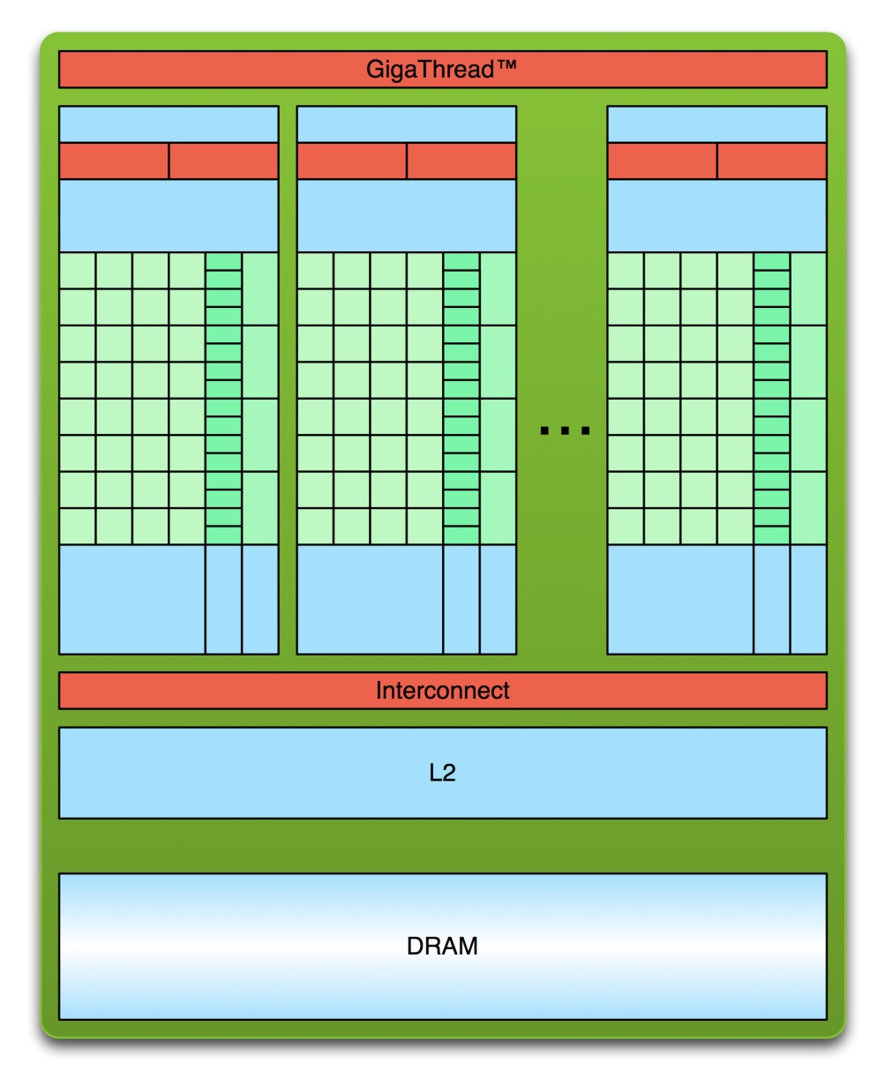
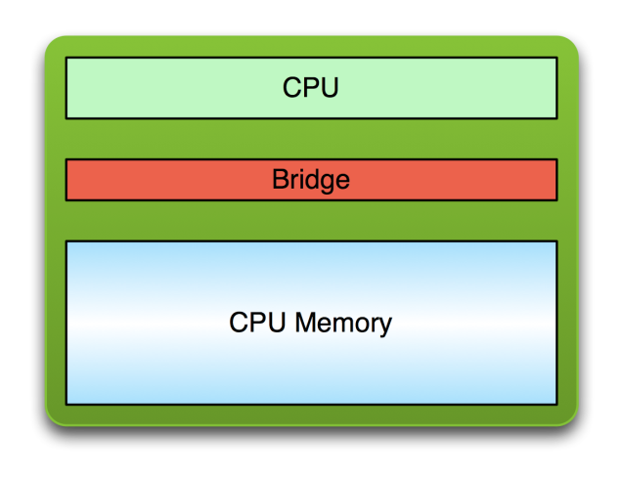
Simple Processing Flow
PCI Bus

Slide 28
Simple Processing Flow
PCI Bus
Copy input data from CPU memory to GPU memory

Slide 29
Simple Processing Flow
PCI Bus
Copy input data from CPU memory to GPU memory
Load GPU program and execute, caching data on chip for performance

Slide 30
Simple Processing Flow
PCI Bus
Copy input data from CPU memory to GPU memory
Load GPU program and execute, caching data on chip for performance
Copy results from GPU memory to CPU memory

Slide 31
CUDA Basics

Slide 32
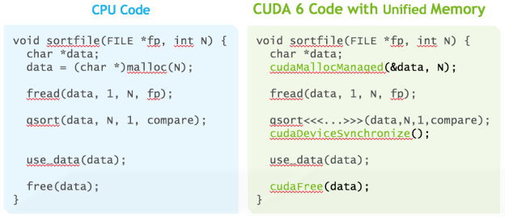
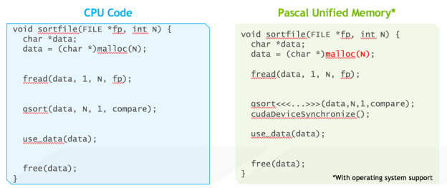
CUDA 8
Pascal supports unified memory with the default system allocator
With page faulting on GP100, locality can be ensured for
programs with sparse data access
pages accessed by the CPU or GPU cannot be known ahead of time
CPU and GPU access parts of the same array allocations simultaneously

Slide 33
thrust lambda support

Slide 34
What is CUDA?
CUDA* Architecture
Expose GPU parallelism for general-purpose computing
Retain performance
CUDA C/C++
Based on industry-standard C/C++
Small set of extensions to enable heterogeneous programming
Straightforward APIs to manage devices, memory etc.
*Compute Unified Device Architecture

Slide 35
SPMD Phases
Initialize
Establish localized data structure and communication channels
Obtain a unique identifier
Each thread acquires a unique identifier, typically range from 0 to N-1, where N is the number of threads
Distribute Data
Decompose global data into chunks and localize them, or
Sharing/replicating major data structure using thread ID to associate subset of the data to threads
Run the core computation
Finalize
Reconcile global data structure, prepare for the next major iteration

Slide 36
Memory Hierarchy in CUDA
Registers/Shared memory:
Fast
Only accessible by the thread/block
Lifetime of the thread/block
Notes:
When a CUDA program on the host CPU invokes a kernel grid, the blocks of the grid are numbered and distributed to multiprocessors with available execution capacity.
The threads of a thread block execute concurrently on one multiprocessor, and multiple thread blocks can execute concurrently on one multiprocessor.
As thread blocks terminate, new blocks are launched on the vacated multiprocessors.
Each thread has private local memory. Each thread block has shared memory visible to all threads of the block and with the same lifetime as the block. All threads have access to the same global memory.

Slide 37
Memory Hierarchy in CUDA
Registers/Shared memory:
Fast
Only accessible by the thread/block
Lifetime of the thread/block
Global memory:
Notes:
When a CUDA program on the host CPU invokes a kernel grid, the blocks of the grid are numbered and distributed to multiprocessors with available execution capacity.
The threads of a thread block execute concurrently on one multiprocessor, and multiple thread blocks can execute concurrently on one multiprocessor.
As thread blocks terminate, new blocks are launched on the vacated multiprocessors.
Each thread has private local memory. Each thread block has shared memory visible to all threads of the block and with the same lifetime as the block. All threads have access to the same global memory.

Slide 38
Memory Hierarchy in CUDA
Registers/Shared memory:
Fast
Only accessible by the thread/block
Lifetime of the thread/block
Global memory:
Potentially 150x slower than register or shared memory
Accessible from either the host or device
Lifetime of the application
Notes:
When a CUDA program on the host CPU invokes a kernel grid, the blocks of the grid are numbered and distributed to multiprocessors with available execution capacity.
The threads of a thread block execute concurrently on one multiprocessor, and multiple thread blocks can execute concurrently on one multiprocessor.
As thread blocks terminate, new blocks are launched on the vacated multiprocessors.
Each thread has private local memory. Each thread block has shared memory visible to all threads of the block and with the same lifetime as the block. All threads have access to the same global memory.

Slide 39
Hello World!
int main(void) {
printf("Hello World!\n");
return 0;
}

Slide 40
Hello World!
int main(void) {
printf("Hello World!\n");
return 0;
}
Standard C that runs on the host
NVIDIA compiler (nvcc) can be used to compile programs with no device code
Output:
$ nvcc hello_world.cu
$ ./a.out
Hello World!
$

Slide 41
Hello World! with Device Code
__global__ void mykernel(void) {
}
int main(void) {
mykernel<<<1,1>>>();
printf("Hello World!\n");
return 0;
}

Slide 42
Hello World! with Device Code
__global__ void mykernel(void) {
}
int main(void) {
mykernel<<<1,1>>>();
printf("Hello World!\n");
return 0;
}
Two new syntactic elements…

Slide 43
Hello World! with Device Code
__global__ void mykernel(void) {
}

Slide 44
Hello World! with Device Code
__global__ void mykernel(void) {
}
CUDA C/C++ keyword __global__ indicates a function that:
Runs on the device
Is called from host code
nvcc separates source code into host and device components
Device functions (e.g. mykernel()) processed by NVIDIA compiler
Host functions (e.g. main()) processed by standard host compiler

Slide 45
Hello World! with Device Code
mykernel<<<1,1>>>();

Slide 46
Hello World! with Device Code
mykernel<<<1,1>>>();
Triple angle brackets mark a call from host code to device code
Also called a “kernel launch”
We’ll return to the parameters (1,1) in a moment
That’s all that is required to execute a function on the GPU!

Slide 47
Hello World! with Device Code
__global__ void mykernel(void){
}
int main(void) {
mykernel<<<1,1>>>();
printf("Hello World!\n");
return 0;
}

Slide 48
Hello World! with Device Code
__global__ void mykernel(void){
}
int main(void) {
mykernel<<<1,1>>>();
printf("Hello World!\n");
return 0;
}
Output:
$ nvcc hello.cu
$ a.out
Hello World!
$

Slide 49
Parallel constructs in CUDA

Slide 50
Parallel Programming in CUDA
We’ll start by adding two integers and build up to vector addition
a
b
c

Slide 51
Addition on the Device
A simple kernel to add two integers
__global__ void add(int *a, int *b, int *c) {
*c = *a + *b;
}

Slide 52
Addition on the Device
A simple kernel to add two integers
__global__ void add(int *a, int *b, int *c) {
*c = *a + *b;
}
As before __global__ is a CUDA C/C++ keyword meaning
add() will execute on the device
add() will be called from the host

Slide 53
Addition on the Device
Note that we use pointers for the variables
__global__ void add(int *a, int *b, int *c) {
*c = *a + *b;
}

Slide 54
Addition on the Device
Note that we use pointers for the variables
__global__ void add(int *a, int *b, int *c) {
*c = *a + *b;
}
add() runs on the device, so a, b and c must point to device memory
We need to allocate memory on the GPU

Slide 55
Memory Management
Host and device memory are separate entities
Device pointers point to GPU memory
May be passed to/from host code
May not be dereferenced in host code
Host pointers point to CPU memory
May be passed to/from device code
May not be dereferenced in device code

Slide 56
Memory Management
Host and device memory are separate entities
Device pointers point to GPU memory
May be passed to/from host code
May not be dereferenced in host code
Host pointers point to CPU memory
May be passed to/from device code
May not be dereferenced in device code
Simple CUDA API for handling device memory
cudaMalloc(), cudaFree(), cudaMemcpy()
Similar to the C equivalents malloc(), free(), memcpy()

Slide 57
Addition on the Device: add()
Returning to our add() kernel
__global__ void add(int *a, int *b, int *c) {
*c = *a + *b;
}
Let’s take a look at main()…

Slide 58
Addition on the Device: main()
int main(void) {
int a, b, c; // host copies of a, b, c
int *d_a, *d_b, *d_c;// device copies of a, b, c

Slide 59
Addition on the Device: main()
int main(void) {
int a, b, c; // host copies of a, b, c
int *d_a, *d_b, *d_c;// device copies of a, b, c
int size = sizeof(int);
// Allocate space for device copies of a, b, c
cudaMalloc((void **)&d_a, size);
cudaMalloc((void **)&d_b, size);
cudaMalloc((void **)&d_c, size);

Slide 60
Addition on the Device: main()
int main(void) {
int a, b, c; // host copies of a, b, c
int *d_a, *d_b, *d_c;// device copies of a, b, c
int size = sizeof(int);
// Allocate space for device copies of a, b, c
cudaMalloc((void **)&d_a, size);
cudaMalloc((void **)&d_b, size);
cudaMalloc((void **)&d_c, size);
// Setup input values
a = 2;
b = 7;

Slide 61
Addition on the Device: main()
// Copy inputs to device
cudaMemcpy(d_a, &a, size, cudaMemcpyHostToDevice);
cudaMemcpy(d_b, &b, size, cudaMemcpyHostToDevice);

Slide 62
Addition on the Device: main()
// Copy inputs to device
cudaMemcpy(d_a, &a, size, cudaMemcpyHostToDevice);
cudaMemcpy(d_b, &b, size, cudaMemcpyHostToDevice);
// Launch add() kernel on GPU
add<<<1,1>>>(d_a, d_b, d_c);

Slide 63
Addition on the Device: main()
// Copy inputs to device
cudaMemcpy(d_a, &a, size, cudaMemcpyHostToDevice);
cudaMemcpy(d_b, &b, size, cudaMemcpyHostToDevice);
// Launch add() kernel on GPU
add<<<1,1>>>(d_a, d_b, d_c);
// Copy result back to host
cudaMemcpy(&c, d_c, size, cudaMemcpyDeviceToHost);

Slide 64
Addition on the Device: main()
// Copy inputs to device
cudaMemcpy(d_a, &a, size, cudaMemcpyHostToDevice);
cudaMemcpy(d_b, &b, size, cudaMemcpyHostToDevice);
// Launch add() kernel on GPU
add<<<1,1>>>(d_a, d_b, d_c);
// Copy result back to host
cudaMemcpy(&c, d_c, size, cudaMemcpyDeviceToHost);
// Cleanup
cudaFree(d_a); cudaFree(d_b); cudaFree(d_c);
return 0;
}

Slide 65
Moving to Parallel
GPU computing is about massive parallelism
So how do we run code in parallel on the device?

Slide 66
Moving to Parallel
GPU computing is about massive parallelism
So how do we run code in parallel on the device?
add<<< 1, 1 >>>();
add<<< N, 1 >>>();
Instead of executing add() once, execute N times in parallel

Slide 67
Vector Addition on the Device
With add() running in parallel we can do vector addition

Slide 68
Vector Addition on the Device
With add() running in parallel we can do vector addition
Terminology: each parallel invocation of add() is referred to as a block

Slide 69
Vector Addition on the Device
With add() running in parallel we can do vector addition
Terminology: each parallel invocation of add() is referred to as a block
The set of blocks is referred to as a grid
Each invocation can refer to its block index using blockIdx.x
__global__ void add(int *a, int *b, int *c) {
c[blockIdx.x] = a[blockIdx.x] + b[blockIdx.x];
}
By using blockIdx.x to index into the array, each block handles a different index

Slide 70
Vector Addition on the Device
__global__ void add(int *a, int *b, int *c) {
c[blockIdx.x] = a[blockIdx.x] + b[blockIdx.x];
}

Slide 71
Vector Addition on the Device
__global__ void add(int *a, int *b, int *c) {
c[blockIdx.x] = a[blockIdx.x] + b[blockIdx.x];
}
On the device, each block can execute in parallel:
Block 0
Block 1
Block 2
Block 3
c[0]= a[0]+b[0];
c[1]= a[1]+b[1];
c[2]= a[2]+b[2];
c[3]= a[3]+b[3];

Slide 72
Vector Addition on the Device: add()
Returning to our parallelized add() kernel
__global__ void add(int *a, int *b, int *c) {
c[blockIdx.x] = a[blockIdx.x] + b[blockIdx.x];
}
Let’s take a look at main()…

Slide 73
Vector Addition on the Device: main()
#define N 512
int main(void) {
int *a, *b, *c; // host copies of a, b, c
int *d_a, *d_b, *d_c; // device copies of a, b, c

Slide 74
Vector Addition on the Device: main()
#define N 512
int main(void) {
int *a, *b, *c; // host copies of a, b, c
int *d_a, *d_b, *d_c; // device copies of a, b, c
int size = N * sizeof(int);
// Alloc space for device copies of a, b, c
cudaMalloc((void **)&d_a, size);
cudaMalloc((void **)&d_b, size);
cudaMalloc((void **)&d_c, size);

Slide 75
Vector Addition on the Device: main()
#define N 512
int main(void) {
int *a, *b, *c; // host copies of a, b, c
int *d_a, *d_b, *d_c; // device copies of a, b, c
int size = N * sizeof(int);
// Alloc space for device copies of a, b, c
cudaMalloc((void **)&d_a, size);
cudaMalloc((void **)&d_b, size);
cudaMalloc((void **)&d_c, size);
// Alloc space for host copies of a, b, c and

Slide 76
Vector Addition on the Device: main()
#define N 512
int main(void) {
int *a, *b, *c; // host copies of a, b, c
int *d_a, *d_b, *d_c; // device copies of a, b, c
int size = N * sizeof(int);
// Alloc space for device copies of a, b, c
cudaMalloc((void **)&d_a, size);
cudaMalloc((void **)&d_b, size);
cudaMalloc((void **)&d_c, size);
// Alloc space for host copies of a, b, c and
// setup input values
a = (int *)malloc(size); random_ints(a, N);
b = (int *)malloc(size); random_ints(b, N);
c = (int *)malloc(size);

Slide 77
Vector Addition on the Device:
// Copy inputs to device
cudaMemcpy(d_a, a, size, cudaMemcpyHostToDevice);
cudaMemcpy(d_b, b, size, cudaMemcpyHostToDevice);

Slide 78
Vector Addition on the Device:
// Copy inputs to device
cudaMemcpy(d_a, a, size, cudaMemcpyHostToDevice);
cudaMemcpy(d_b, b, size, cudaMemcpyHostToDevice);
// Launch add() kernel on GPU with N blocks
add<<<N,1>>>(d_a, d_b, d_c);

Slide 79
Vector Addition on the Device:
// Copy inputs to device
cudaMemcpy(d_a, a, size, cudaMemcpyHostToDevice);
cudaMemcpy(d_b, b, size, cudaMemcpyHostToDevice);
// Launch add() kernel on GPU with N blocks
add<<<N,1>>>(d_a, d_b, d_c);
// Copy result back to host
cudaMemcpy(c, d_c, size, cudaMemcpyDeviceToHost);

Slide 80
Vector Addition on the Device:
// Copy inputs to device
cudaMemcpy(d_a, a, size, cudaMemcpyHostToDevice);
cudaMemcpy(d_b, b, size, cudaMemcpyHostToDevice);
// Launch add() kernel on GPU with N blocks
add<<<N,1>>>(d_a, d_b, d_c);
// Copy result back to host
cudaMemcpy(c, d_c, size, cudaMemcpyDeviceToHost);
// Cleanup
free(a); free(b); free(c);
cudaFree(d_a); cudaFree(d_b); cudaFree(d_c);
return 0;
}

Slide 81
CUDA Threads
Terminology: a block can be split into parallel threads
Let’s change add() to use parallel threads instead of parallel blocks

Slide 82
CUDA Threads
Terminology: a block can be split into parallel threads
Let’s change add() to use parallel threads instead of parallel blocks
__global__ void add(int *a, int *b, int *c) {
c[threadIdx.x] = a[threadIdx.x] + b[threadIdx.x];
}
We use threadIdx.x instead of blockIdx.x
Need to make one change in main()…

Slide 83
Vector Addition Using Threads:
#define N 512
int main(void) {
int *a, *b, *c; // host copies of a, b, c
int *d_a, *d_b, *d_c; // device copies of a, b, c
int size = N * sizeof(int);
// Alloc space for device copies of a, b, c
cudaMalloc((void **)&d_a, size);
cudaMalloc((void **)&d_b, size);
cudaMalloc((void **)&d_c, size);
//Alloc space for host copies of a, b, c and setup input values
a = (int *)malloc(size); random_ints(a, N);
b = (int *)malloc(size); random_ints(b, N);
c = (int *)malloc(size);

Slide 84
Vector Addition Using Threads:
// Copy inputs to device
cudaMemcpy(d_a, a, size, cudaMemcpyHostToDevice);
cudaMemcpy(d_b, b, size, cudaMemcpyHostToDevice);
// Launch add() kernel on GPU with N threads
add<<<1,N>>>(d_a, d_b, d_c);
// Copy result back to host
cudaMemcpy(c, d_c, size, cudaMemcpyDeviceToHost);
// Cleanup
free(a); free(b); free(c);
cudaFree(d_a); cudaFree(d_b); cudaFree(d_c);
return 0;
}

Slide 85
Combining Blocks and Threads
We’ve seen parallel vector addition using:
Many blocks with one thread each
One block with many threads

Slide 86
Combining Blocks and Threads
We’ve seen parallel vector addition using:
Many blocks with one thread each
One block with many threads
Let’s adapt vector addition to use both blocks and threads

Slide 87
Combining Blocks and Threads
We’ve seen parallel vector addition using:
Many blocks with one thread each
One block with many threads
Let’s adapt vector addition to use both blocks and threads
Why? We’ll come to that…
First let’s discuss data indexing…

Slide 88
Indexing Arrays with Blocks and Threads
No longer as simple as using blockIdx.x and threadIdx.x
Consider indexing an array with one element per thread (8 threads/block)
threadIdx.x
threadIdx.x
threadIdx.x
threadIdx.x
0
1
2
3
4
5
6
7
0
1
2
3
4
5
6
7
0
1
2
3
4
5
6
7
0
1
2
3
4
5
6
7
blockIdx.x = 0
blockIdx.x = 1
blockIdx.x = 2
blockIdx.x = 3
Notes:
Identical to finding offset in 1-dimensional storage of a 2-dimensional matrix:
int index = x + width * y;

Slide 89
Indexing Arrays with Blocks and Threads
No longer as simple as using blockIdx.x and threadIdx.x
Consider indexing an array with one element per thread (8 threads/block)
threadIdx.x
threadIdx.x
threadIdx.x
threadIdx.x
0
1
2
3
4
5
6
7
0
1
2
3
4
5
6
7
0
1
2
3
4
5
6
7
0
1
2
3
4
5
6
7
blockIdx.x = 0
blockIdx.x = 1
blockIdx.x = 2
blockIdx.x = 3
With M threads/block a unique index for each thread is given by:
unsigned int index = threadIdx.x + blockIdx.x * M;
Notes:
Identical to finding offset in 1-dimensional storage of a 2-dimensional matrix:
int index = x + width * y;

Slide 90
Vector Addition with Blocks and Threads
Use the built-in variable blockDim.x for threads per block
int index = threadIdx.x + blockIdx.x * blockDim.x;

Slide 91
Vector Addition with Blocks and Threads
Use the built-in variable blockDim.x for threads per block
int index = threadIdx.x + blockIdx.x * blockDim.x;
Combined version of add() to use parallel threads and parallel blocks
__global__ void add(int *a, int *b, int *c) {
int index = threadIdx.x + blockIdx.x * blockDim.x;
c[index] = a[index] + b[index];
}

Slide 92
Vector Addition with Blocks and Threads
Use the built-in variable blockDim.x for threads per block
int index = threadIdx.x + blockIdx.x * blockDim.x;
Combined version of add() to use parallel threads and parallel blocks
__global__ void add(int *a, int *b, int *c) {
int index = threadIdx.x + blockIdx.x * blockDim.x;
c[index] = a[index] + b[index];
}
What changes need to be made in main()?

Slide 93
Addition with Blocks and Threads:
#define N (2048*2048)
#define THREADS_PER_BLOCK 512
int main(void) {
int *a, *b, *c; // host copies of a, b, c
int *d_a, *d_b, *d_c; // device copies of a, b, c
int size = N * sizeof(int);
// Alloc space for device copies of a, b, c
cudaMalloc((void **)&d_a, size);
cudaMalloc((void **)&d_b, size);
cudaMalloc((void **)&d_c, size);
// Alloc space for host copies of a, b, c and setup input values
a = (int *)malloc(size); random_ints(a, N);
b = (int *)malloc(size); random_ints(b, N);
c = (int *)malloc(size);

Slide 94
Addition with Blocks and Threads:
// Copy inputs to device
cudaMemcpy(d_a, a, size, cudaMemcpyHostToDevice);
cudaMemcpy(d_b, b, size, cudaMemcpyHostToDevice);
// Launch add() kernel on GPU
add<<<N/THREADS_PER_BLOCK,THREADS_PER_BLOCK>>>(d_a, d_b, d_c);
// Copy result back to host
cudaMemcpy(c, d_c, size, cudaMemcpyDeviceToHost);
// Cleanup
free(a); free(b); free(c);
cudaFree(d_a); cudaFree(d_b); cudaFree(d_c);
return 0;
}
}

Slide 95
Handling Arbitrary Vector Sizes
Typical problems are not friendly multiples of blockDim.x

Slide 96
Handling Arbitrary Vector Sizes
Typical problems are not friendly multiples of blockDim.x
Avoid accessing beyond the end of the arrays:
__global__ void add(int *a, int *b, int *c, int n) {
int index = threadIdx.x + blockIdx.x * blockDim.x;
if (index < n)
c[index] = a[index] + b[index];
}

Slide 97
Handling Arbitrary Vector Sizes
Typical problems are not friendly multiples of blockDim.x
Avoid accessing beyond the end of the arrays:
__global__ void add(int *a, int *b, int *c, int n) {
int index = threadIdx.x + blockIdx.x * blockDim.x;
if (index < n)
c[index] = a[index] + b[index];
}
Update the kernel launch:

Slide 98
Handling Arbitrary Vector Sizes
Typical problems are not friendly multiples of blockDim.x
Avoid accessing beyond the end of the arrays:
__global__ void add(int *a, int *b, int *c, int n) {
int index = threadIdx.x + blockIdx.x * blockDim.x;
if (index < n)
c[index] = a[index] + b[index];
}
Update the kernel launch:
add<<<(N + M - 1)/M, M >>>(d_a, d_b, d_c, N);

Slide 99
Why Bother with Threads?
Threads seem unnecessary
They add a level of complexity
What do we gain?

Slide 100
Why Bother with Threads?
Threads seem unnecessary
They add a level of complexity
What do we gain?
Unlike parallel blocks, threads have mechanisms to:
Communicate

Slide 101
Why Bother with Threads?
Threads seem unnecessary
They add a level of complexity
What do we gain?
Unlike parallel blocks, threads have mechanisms to:
Communicate
Synchronize

Slide 102
Why Bother with Threads?
Threads seem unnecessary
They add a level of complexity
What do we gain?
Unlike parallel blocks, threads have mechanisms to:
Communicate
Synchronize
To understand the gain, we need a new example…

Slide 103
Shared Memory

Slide 104
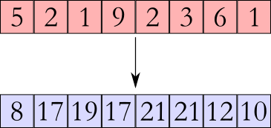
1D Stencil
Consider applying a 1D stencil sum to a 1D array of elements
Each output element is the sum of input elements within a radius
Example of stencil with radius 2:

Slide 105
Sharing Data Between Threads
Terminology: within a block, threads share data via shared memory
Extremely fast on-chip memory, user-managed
Declare using __shared__, allocated per block
Data is not visible to threads in other blocks

Slide 106
Implementing With Shared Memory
Cache data in shared memory
Read (blockDim.x + 2 * radius) input elements from global memory to shared memory
Compute blockDim.x output elements
Write blockDim.x output elements to global memory
blockDim.x output elements

Slide 107
Implementing With Shared Memory
Cache data in shared memory
Read (blockDim.x + 2 * radius) input elements from global memory to shared memory
Compute blockDim.x output elements
Write blockDim.x output elements to global memory
Each block needs a halo of radius elements at each boundary
halo on left
halo on right
blockDim.x output elements

Slide 108
Stencil Kernel
__global__ void stencil_1d(int *in, int *out) {

Slide 109
Stencil Kernel
__global__ void stencil_1d(int *in, int *out) {
__shared__ int temp[BLOCK_SIZE + 2 * RADIUS];

Slide 110
Stencil Kernel
__global__ void stencil_1d(int *in, int *out) {
__shared__ int temp[BLOCK_SIZE + 2 * RADIUS];
int g_index = threadIdx.x + blockIdx.x * blockDim.x;
int s_index = threadIdx.x + RADIUS;

Slide 111
Stencil Kernel
__global__ void stencil_1d(int *in, int *out) {
__shared__ int temp[BLOCK_SIZE + 2 * RADIUS];
int g_index = threadIdx.x + blockIdx.x * blockDim.x;
int s_index = threadIdx.x + RADIUS;
// Read input elements into shared memory
temp[s_index] = in[g_index];

Slide 112
Stencil Kernel
__global__ void stencil_1d(int *in, int *out) {
__shared__ int temp[BLOCK_SIZE + 2 * RADIUS];
int g_index = threadIdx.x + blockIdx.x * blockDim.x;
int s_index = threadIdx.x + RADIUS;
// Read input elements into shared memory
temp[s_index] = in[g_index];
if (threadIdx.x < RADIUS) {
temp[s_index - RADIUS] = in[g_index - RADIUS];

Slide 113
Stencil Kernel
__global__ void stencil_1d(int *in, int *out) {
__shared__ int temp[BLOCK_SIZE + 2 * RADIUS];
int g_index = threadIdx.x + blockIdx.x * blockDim.x;
int s_index = threadIdx.x + RADIUS;
// Read input elements into shared memory
temp[s_index] = in[g_index];
if (threadIdx.x < RADIUS) {
temp[s_index - RADIUS] = in[g_index - RADIUS];
temp[s_index + BLOCK_SIZE] =

Slide 114
Stencil Kernel
__global__ void stencil_1d(int *in, int *out) {
__shared__ int temp[BLOCK_SIZE + 2 * RADIUS];
int g_index = threadIdx.x + blockIdx.x * blockDim.x;
int s_index = threadIdx.x + RADIUS;
// Read input elements into shared memory
temp[s_index] = in[g_index];
if (threadIdx.x < RADIUS) {
temp[s_index - RADIUS] = in[g_index - RADIUS];
temp[s_index + BLOCK_SIZE] =
in[g_index + BLOCK_SIZE];
}

Slide 115
Stencil Kernel
// Apply the stencil
int result = 0;
for (int offset = -RADIUS ; offset <= RADIUS ; offset++)
result += temp[s_index + offset];
// Store the result
out[g_index] = result;
}

Slide 116
Data Race!
The stencil example will not work…

Slide 117
Data Race!
The stencil example will not work…
Suppose thread 15 reads the halo before thread 0 has fetched it…
temp[s_index] = in[g_index];
if (threadIdx.x < RADIUS) {
temp[s_index – RADIUS = in[g_index – RADIUS];
temp[s_index + BLOCK_SIZE] = in[g_index + BLOCK_SIZE];
}
int result = 0;
result += temp[s_index + 1];

Slide 118
Data Race!
The stencil example will not work…
Suppose thread 15 reads the halo before thread 0 has fetched it…
temp[s_index] = in[g_index];
if (threadIdx.x < RADIUS) {
temp[s_index – RADIUS = in[g_index – RADIUS];
temp[s_index + BLOCK_SIZE] = in[g_index + BLOCK_SIZE];
}
int result = 0;
result += temp[s_index + 1];

Slide 119
Data Race!
The stencil example will not work…
Suppose thread 15 reads the halo before thread 0 has fetched it…
temp[s_index] = in[g_index];
if (threadIdx.x < RADIUS) {
temp[s_index – RADIUS = in[g_index – RADIUS];
temp[s_index + BLOCK_SIZE] = in[g_index + BLOCK_SIZE];
}
int result = 0;
result += temp[s_index + 1];

Slide 120
Data Race!
The stencil example will not work…
Suppose thread 15 reads the halo before thread 0 has fetched it…
temp[s_index] = in[g_index];
if (threadIdx.x < RADIUS) {
temp[s_index – RADIUS = in[g_index – RADIUS];
temp[s_index + BLOCK_SIZE] = in[g_index + BLOCK_SIZE];
}
int result = 0;
result += temp[s_index + 1];
Store at temp[18]
Skipped
threadIdx > RADIUS
Load from temp[19]

Slide 121
__syncthreads()
void __syncthreads();
Synchronizes all threads within a block
Used to prevent RAW / WAR / WAW hazards
All threads must reach the barrier
In conditional code, the condition must be uniform across the block

Slide 122
Stencil Kernel
__global__ void stencil_1d(int *in, int *out) {
__shared__ int temp[BLOCK_SIZE + 2 * RADIUS];
int g_index = threadIdx.x + blockIdx.x * blockDim.x;
int s_index = threadIdx.x + radius;
// Read input elements into shared memory
temp[s_index] = in[g_index];
if (threadIdx.x < RADIUS) {
temp[s_index – RADIUS] = in[g_index – RADIUS];
temp[s_index + BLOCK_SIZE] = in[g_index + BLOCK_SIZE];
}

Slide 123
Stencil Kernel
__global__ void stencil_1d(int *in, int *out) {
__shared__ int temp[BLOCK_SIZE + 2 * RADIUS];
int g_index = threadIdx.x + blockIdx.x * blockDim.x;
int s_index = threadIdx.x + radius;
// Read input elements into shared memory
temp[s_index] = in[g_index];
if (threadIdx.x < RADIUS) {
temp[s_index – RADIUS] = in[g_index – RADIUS];
temp[s_index + BLOCK_SIZE] = in[g_index + BLOCK_SIZE];
}
// Synchronize (ensure all the data is available)
__syncthreads();

Slide 124
Stencil Kernel
// Apply the stencil
int result = 0;
for(int offset = -RADIUS ; offset <= RADIUS ; offset++)
result += temp[s_index + offset];
// Store the result
out[g_index] = result;
}

Slide 125
Review (1 of 2)
Launching parallel threads
Launch N blocks with M threads per block with kernel<<<N,M>>>(…);
Use blockIdx.x to access block index within grid
Use threadIdx.x to access thread index within block
Allocate elements to threads:
int index = threadIdx.x + blockIdx.x * blockDim.x;

Slide 126
Review (2 of 2)
Use __shared__ to declare a variable/array in shared memory
Data is shared between threads in a block
Not visible to threads in other blocks
Use __syncthreads() as a barrier to prevent data hazards

Slide 127
Device Management

Slide 128
Compute Capability
The compute capability of a device describes its architecture, e.g.
Number of registers
Sizes of memories
Features & capabilities
By running the application deviceQuery in the practical part you will be able to know useful information like
The maximum number of threads per block
The amount of shared memory
The frequency of the DDR memory
The compute capability is given as a major.minor version number (i.e: 2.0, 2.1, 3.0, 3.5)

Slide 129
Coordinating Host & Device
Kernel launches are asynchronous
control is returned to the host thread before the device has completed the requested task
CPU needs to synchronize before consuming the results
cudaMemcpy() | Blocks the CPU until the copy is complete Copy begins when all preceding CUDA calls have completed
cudaMemcpyAsync() | Asynchronous, does not block the CPU
cudaDeviceSynchronize() | Blocks the CPU until all preceding CUDA calls have completed

Slide 130
Pinned memory
Pinned (or page-locked memory) is a main memory area that is not pageable by the operating system
Ensures faster transfers (the DMA engine can work without CPU intervention)
The only way to get closer to PCI peak bandwidth
Allows CUDA asynchronous operations to work correctly
// allocate page-locked memory cudaMallocHost(&area, sizeof(double) * N); // free page-locked memory cudaFreeHost(area);

Slide 131
Asynchronous GPU Operations: CUDA Streams
A stream is a FIFO command queue;
Default stream (aka stream ‘0’): Kernel launches and memory copies that do not specify any stream (or set the stream to zero) are issued to the default stream.****
A stream is independent to every other active stream;
Streams are the main way to exploit concurrent execution and I/O operations
Explicit Synchronization:
cudaDeviceSynchronize()
blocks host until all issued CUDA calls are complete
cudaStreamSynchronize(streamId)
blocks host until all CUDA calls in streamid are complete
cudaStreamWaitEvent(streamId, event)
all commands added to the stream delay their execution until the event has completed
Implicit Synchronization:
any CUDA command to the default stream,
a page-locked host memory allocation,
a device memory set or allocation,

Slide 132
CUDA streams enable concurrency
Concurrency: the ability to perform multiple CUDA operations simultaneously.
Starting from compute capability 2.0, simultaneous support:
Up to 16 CUDA kernels on GPU
2 cudaMemcpyAsyncs (in opposite directions)
Computation on the CPU
Requirements for Concurrency:
CUDA operations must be in different, non-0, streams
cudaMemcpyAsync with host from 'pinned' memory

Slide 133
CUDA Streams

Slide 134
****CUDA 7
The default stream is useful where concurrency is not crucial to performance.
CUDA 7 introduces a new option, the per-thread default stream
it gives each host thread its own default stream
commands issued to the default stream by different host threads can run concurrently
these default streams are regular streams
commands in the default stream may run concurrently with commands in non-default streams.
Compile with the nvcc command-line option --default-stream per-thread

Slide 135
Reporting Errors
All CUDA API calls return an error code (cudaError_t)
Error in the API call itself
OR
Error in an earlier asynchronous operation (e.g. kernel)

Slide 136
Reporting Errors
All CUDA API calls return an error code (cudaError_t)
Error in the API call itself
OR
Error in an earlier asynchronous operation (e.g. kernel)
Get the error code for the last error:
cudaError_t cudaGetLastError(void)
Get a string to describe the error:
char *cudaGetErrorString(cudaError_t)

Slide 137
Reporting Errors
All CUDA API calls return an error code (cudaError_t)
Error in the API call itself
OR
Error in an earlier asynchronous operation (e.g. kernel)
Get the error code for the last error:
cudaError_t cudaGetLastError(void)
Get a string to describe the error:
char *cudaGetErrorString(cudaError_t)
printf("%s\n", cudaGetErrorString(cudaGetLastError()));

Slide 138
Timing
You can use the standard timing facilities (host side) in an almost standard way…
but remember: CUDA calls can be asynchronous!
start = clock();
my_kernel<<< blocks, threads>>>(); cudaDeviceSynchronize();
end = clock();

Slide 139
Timing
CUDA provides the cudaEvents facility. They grant you access to the GPU timer.
Needed to time a single stream without loosing Host/Device concurrency.
cudaEvent_t start, stop;
cudaEventCreate(start); cudaEventCreate(stop); cudaEventRecord(start, 0);
My_kernel<<<blocks, threads>>> ();
cudaEventRecord(stop, 0);
cudaEventSynchronize(stop);
float ElapsedTime;
cudaEventElapsedTime(&elapsedTime, start, stop);
cudaEventDestroy(start); cudaEventDestroy(stop);

Slide 140
IDs and Dimensions
Device
A kernel is launched as a grid of blocks of threads
blockIdx and threadIdx are 3D (dim3)
We showed only one dimension (x)
Built-in variables:
threadIdx
blockIdx
blockDim
gridDim
Grid 1
Block (0,0,0)
Block (1,0,0)
Block (2,0,0)
Block (0,1,0)
Block (1,1,0)
Block (2,1,0)
Block (1,1,0)
Thread (0,0,0) | Thread (1,0,0) | Thread (2,0,0) | Thread (3,0,0) | Thread (4,0,0)
Thread (0,1,0) | Thread (1,1,0) | Thread (2,1,0) | Thread (3,1,0) | Thread (4,1,0)
Thread (0,2,0) | Thread (1,2,0) | Thread (2,2,0) | Thread (3,2,0) | Thread (4,2,0)

Slide 141
CUDA 8
Pascal supports unified memory with the default system allocator
With page faulting on GP100, locality can be ensured for
programs with sparse data access
pages accessed by the CPU or GPU cannot be known ahead of time
CPU and GPU access parts of the same array allocations simultaneously

Slide 142
thrust lambda support

Slide 143
Thrust

Slide 144
Thrust
Thrust is a C++ template library for CUDA based on the Standard Template Library (STL).
Thrust allows you to implement high performance parallel applications with minimal programming effort through a high-level interface that is fully interoperable with CUDA C.
Rich collection of data parallel primitives such as scan, sort, and reduce Read more at: http://docs.nvidia.com/cuda/thrust/index.html#ixzz3ypRKV2Zt

Slide 145
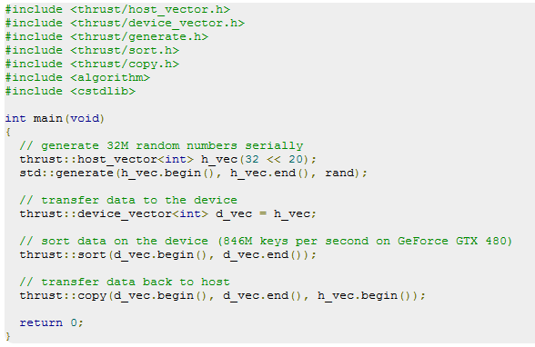
Sorting using Thrust
https://thrust.github.io/

Slide 146
Thrust and CUDA Interoperability
You can easily launch your custom CUDA Kernels on thrust device vectors, by passing the pointer to the first element (you can use the thrust::device_vector::data() method or &vector[0])
Improves readability
Memory managed automatically
CUDA code generated behind the scenes
thrust::device_vector<int> d_vector;
int* d_array= thrust::raw_pointer_cast(&d_vector[0]);
myCUDAKernel<<< x, y >>>(d_array, d_vector.size());

Slide 147
Questions?

Slide 148
References
CUDA Training – NVIDIA
Programming Massively Parallel Processors – D. B. Kirk, W. W. Hwu

