Slide 1
Part XII
Homeland security

Slide 2
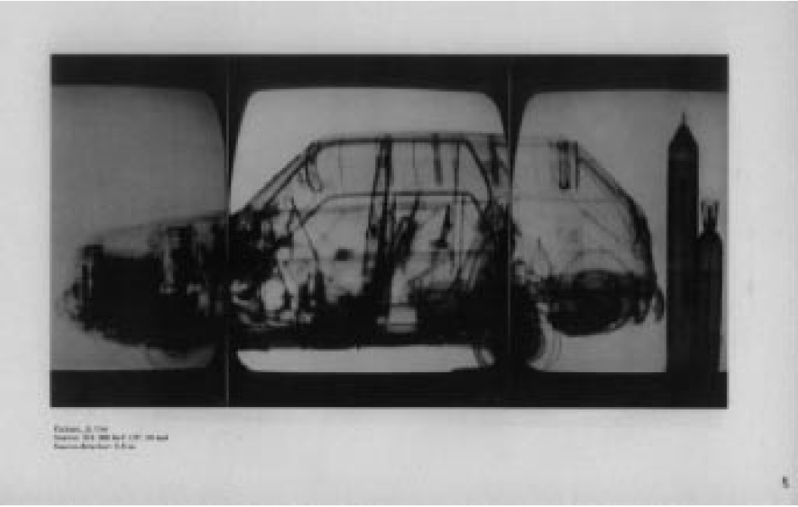
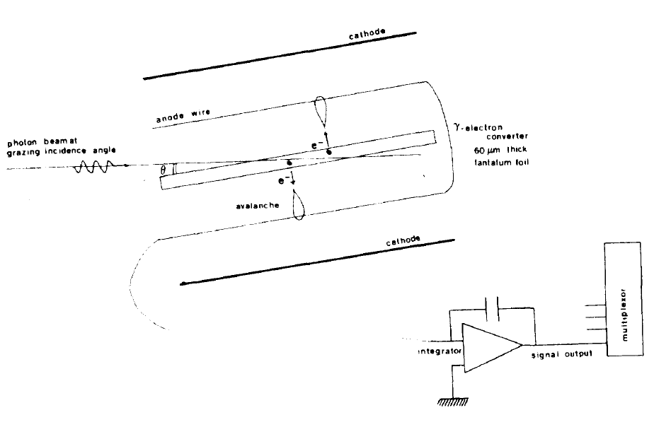
Schlumberger scanners based on Tantalum convertor and MWPC
30% efficiency for 400keV gammas

Slide 3
Ultra-low dose commercial airport scanner based on microstrip detectors

Slide 4
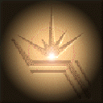
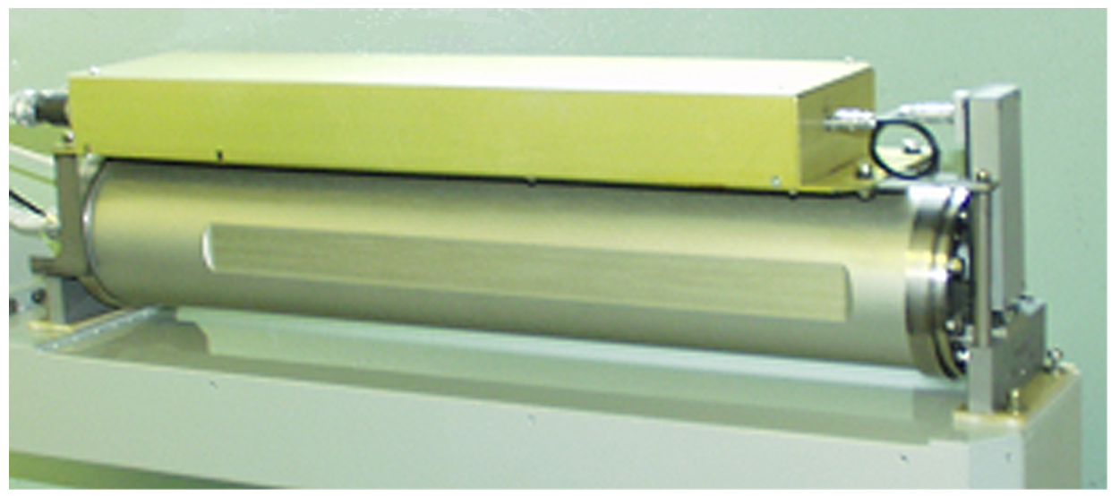
High pressure micropattern detector
Advantages of MPGD :
Low noise
Large dynamic range
High radiation resistance
Fill factor 100%
Disadvantage:
High pressure
The MPGD for security (800 mm)

Slide 5
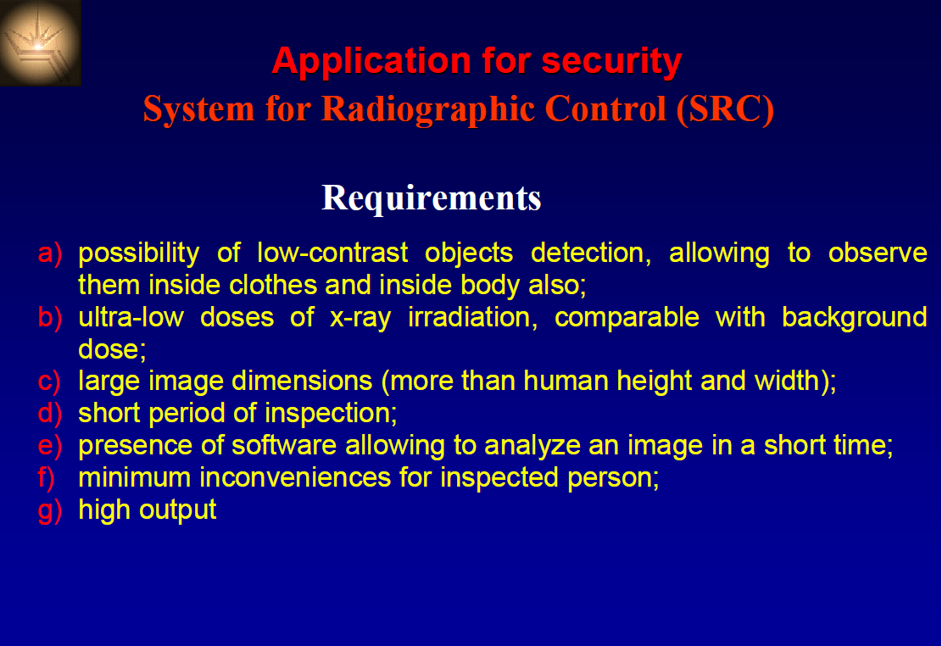

Slide 6
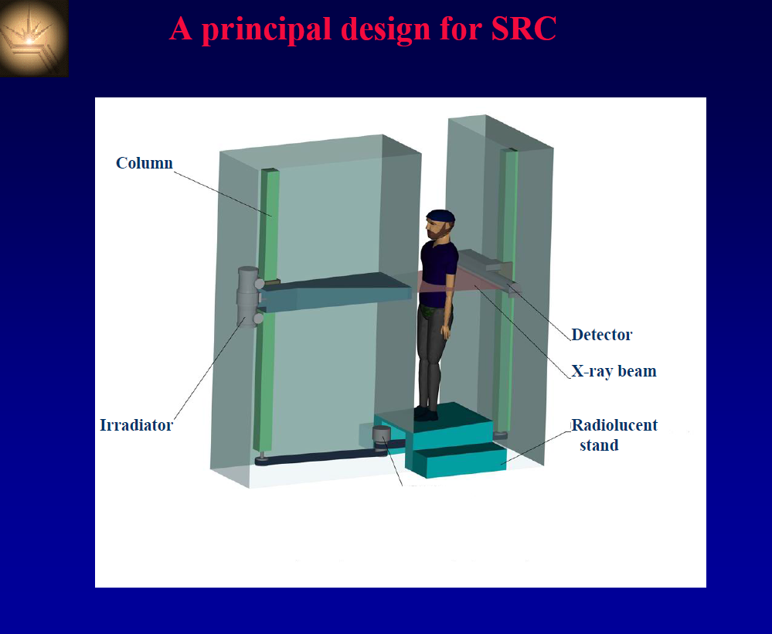

Slide 7
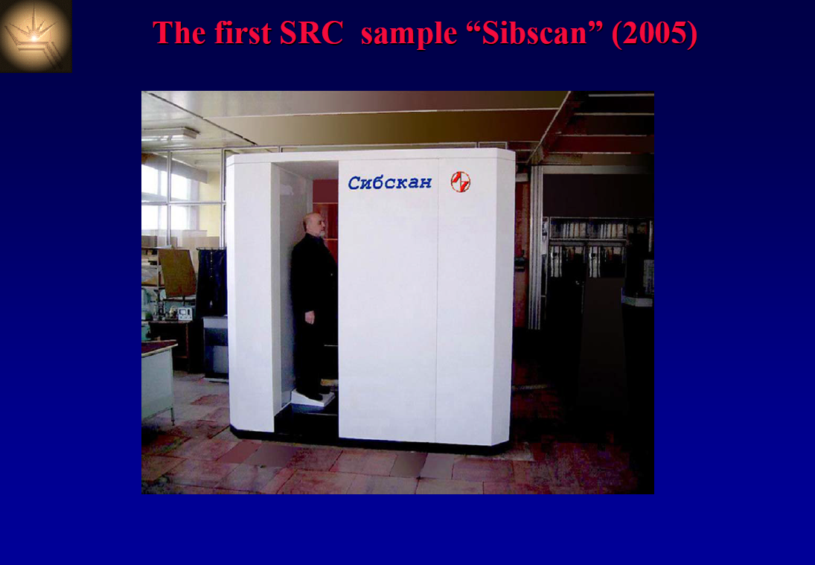

Slide 8
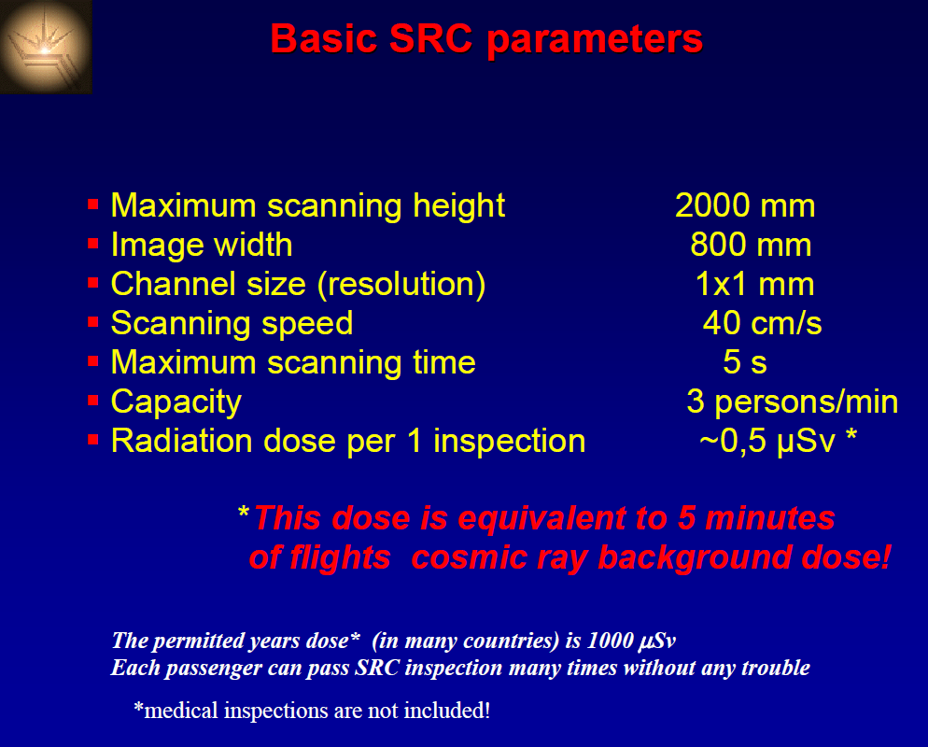

Slide 9
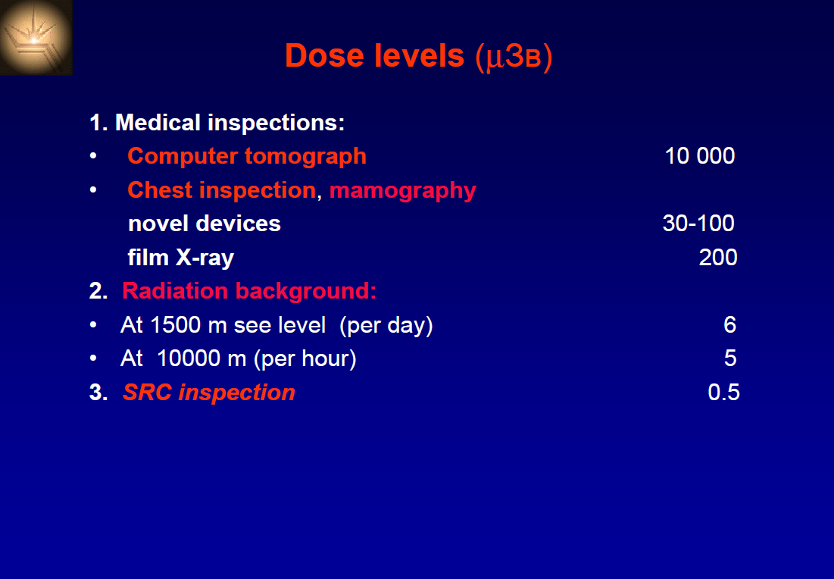

Slide 10
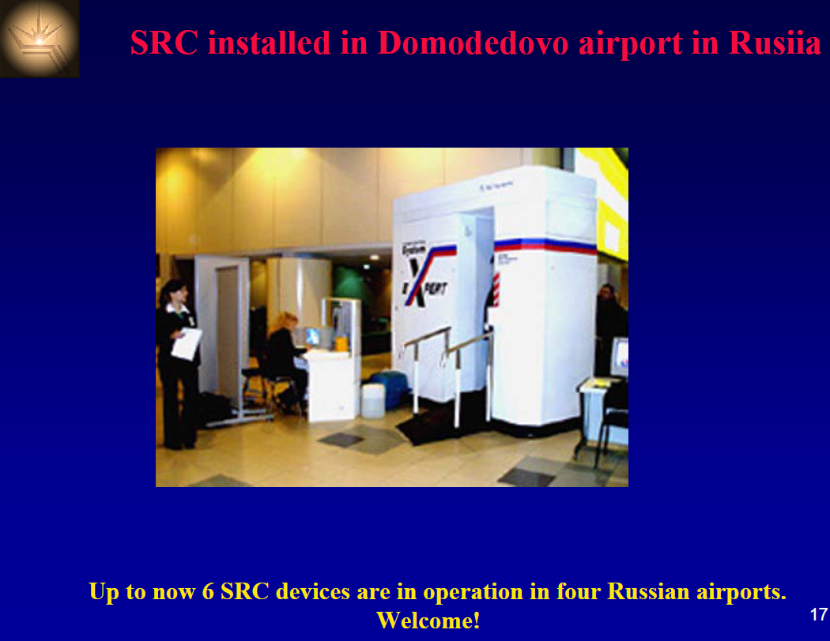

Slide 11
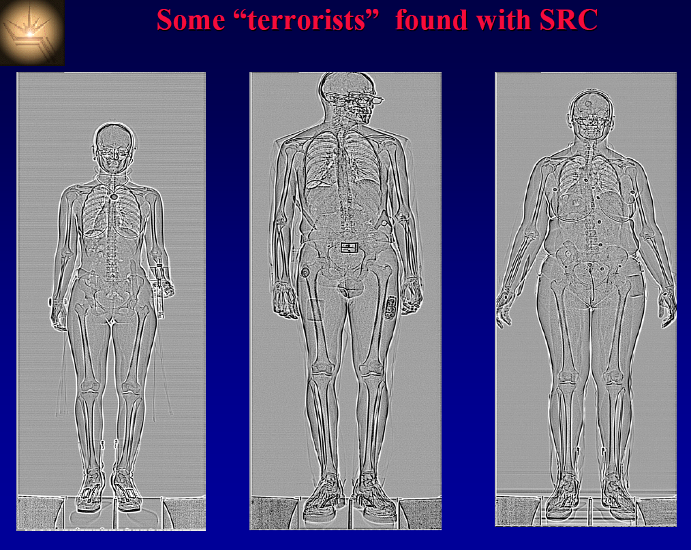

Slide 12
Comments about the dose
Dose in Sv = Absorbed Dose in Gy x radiation weighting factor (WR)

Slide 13
Imaging procedures and their approximate effective radiation doses*
Procedure | Average effective dose (mSv) | Range reported in the literature (mSv)
Bone density test+ | 0.001 | 0.00–0.035
X-ray, arm or leg | 0.001 | 0.0002–0.1
X-ray, panoramic dental | 0.01 | 0.007–0.09
X-ray, chest | 0.1 | 0.05–0.24
X-ray, abdominal | 0.7 | 0.04–1.1
Mammogram | 0.4 | 0.10–0.6
X-ray, lumbar spine | 1.5 | 0.5–1.8
CT, head | 2 | 0.9–4
CT, cardiac for calcium scoring | 3 | 1.0–12
Nuclear imaging, bone scan | 6.3
CT, spine | 6 | 1.5–10
CT, pelvis | 6 | 3.3–10
CT, chest | 7 | 4.0–18
CT, abdomen | 8 | 3.5–25
CT, colonoscopy | 10 | 4.0–13.2
CT, angiogram | 16 | 5.0–32
CT, whole body | variable | 20 or more
Nuclear imaging, cardiac stress test | 40.7
*The actual radiation exposure depends on many things, including the device itself, the duration of the scan, your size, and the sensitivity of the tissue being targeted. +Dual energy x-ray absorptiometry, or DXA.
Source: Mettler FA, et al. “Effective Doses in Radiology and Diagnostic Nuclear Medicine: A Catalog,” Radiology (July 2008), Vol. 248, pp. 254–63.

Slide 14
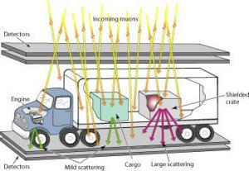
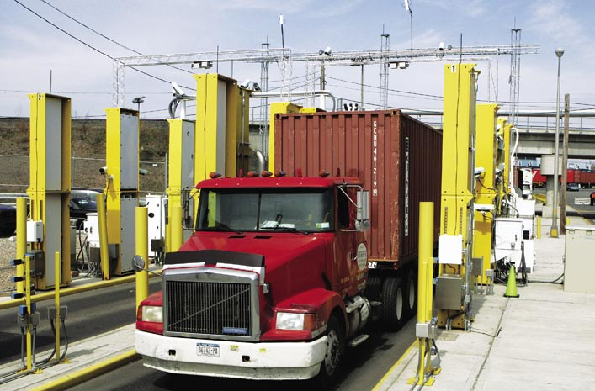
Muon tomography

Slide 15
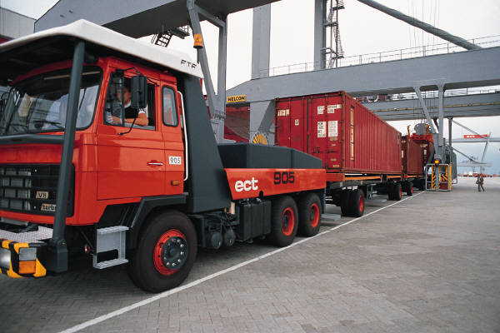
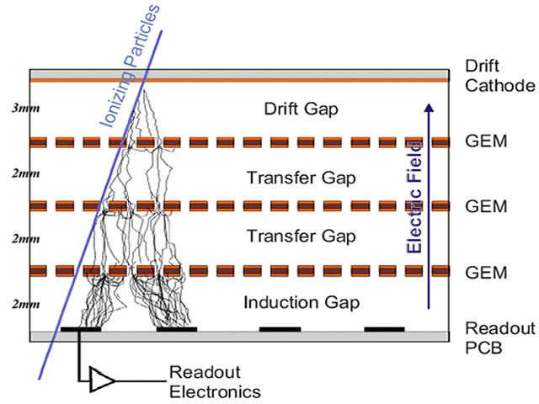
Fl. Tech Concept – MT with MPGDs
Use Micro Pattern Gaseous Detectors for tracking cosmic ray muons
ADVANTAGES:
excellent spatial resolution
improves scattering angle
measurement
compact detector structure allows
for more compact MT station design
  thin detector layers
  small gaps between layers
  smaller scattering in detector itself
CHALLENGES:
requires large-area MPGDs
(MPGDs as muon detector !)
large number of electronics
channels (but occupancies very low)
low rates from cosmics, need good eff.
cost (but access to funding outside HEP)
That’s why we’re here today!
Cargo container
MPGD Tracking Detector
hidden &
shielded
high-Z
nuclear
material
Θ
μ
Θ
MPGD, e.g. GEM Detector
MPGD Tracking Detector
~ 1 cm
e⁻
μ tracks
Readout electronics
F. Sauli

Slide 16
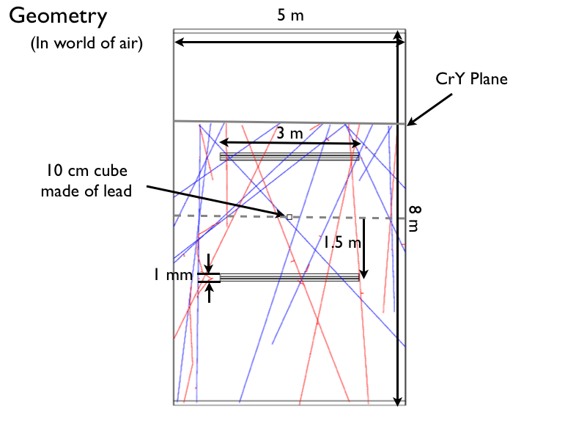
Monte Carlo Simulation
Typical Geometry:
Side View
Generate cosmic ray muons with CRY (Lawrence Livermore NL)
Simulate geometry, target, detector, tracks with GEANT4
Take advantage of detailed description of multiple scattering effects within GEANT4
(follows Lewis theory of multiple scattering)
10m
Muons originate here over
an area of 1,000,000 cm²
(1M muons in ~1min exposure)
4m
Basic Target
GEM
detector
planes
3 GEM layers
with 5mm gaps between layers
Top View
10m
5m
CRY plane
μ⁺
μ⁻
3m
4m
GEMs

Slide 17
Experimentally obtained muon images of highly contrast objects

Slide 18
Part-XIII
Plasma diagnostics

Slide 22

Real-time x-ray imaging
of Tokamak plasma

