Slide 1
Part-VIII
Latest developments in spark-protective miropattern detectors

Slide 2
In the previous lecture we described resistive GEM and MICROMEGAS detectors
This concept of spark protection allowed to reanimate many other old designs of micropattern detectors which were abanded because they could not withstand sparks

Slide 3
As examples, we will introduce here three old designs which got a second life
Resistive microstrip detector
Resistive microdot
Resistive microstrip-microdot
Resistve microwell detector

Slide 4
1. Microstrip detector
Recall: it was the firs micropattern detector, invented by A.Oed

Slide 5
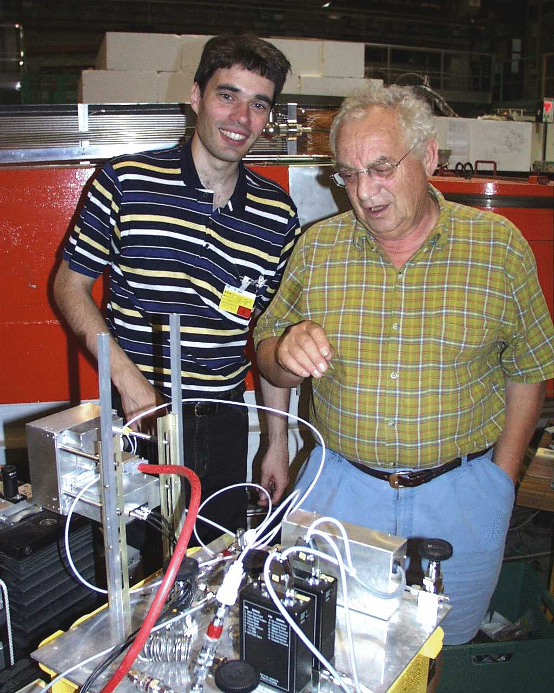
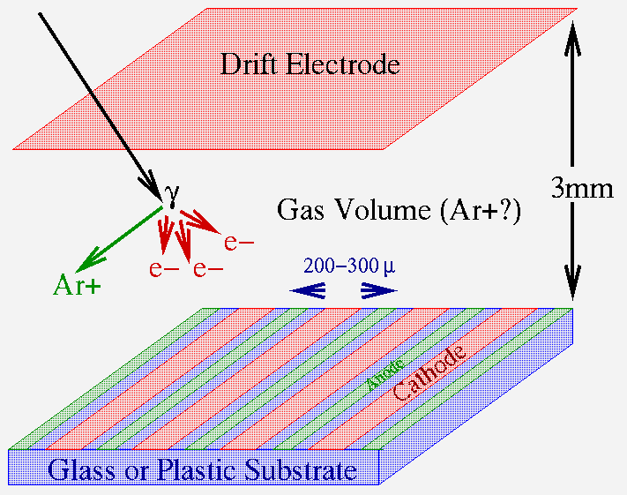
A. Oed

Slide 6
Side and top view of microstrip detectors

Slide 7
Induced signals

Slide 8
Position and energy resolutions

Slide 9
Earler attempt to avoid sparks

Slide 10
This detector could be easily destroyed by sparks and was finally abanded

Slide 11
Resistive microstrip detector
Main steps in manufacturing
(side view)

Slide 12
Top view
Photograph

Slide 13
Another concept: microstrip-microgap detector to achieve simultaneously high position and time resolutions

Slide 14
The microstrip-microgap approach was inspired by work of Portuguese group

Slide 16
The bulk of the X distribution shows a width of 47 μm sigma, while Y distribution shows a width of 86 μm sigma.
Position and time resolution of this detector
The average single-layer resolution is 77 ps.
The combined time resolution of the telescope
(combination of three layers) was 77/√3 = 44 ps

Slide 17
2. Resistive Microdot detectors

Slide 18
Conventional microdot detector

Slide 20
Latest progress in resistive microdot detectors

Slide 22
3. Another design if microdot detector: resistive microstrip-microdot

Slide 23
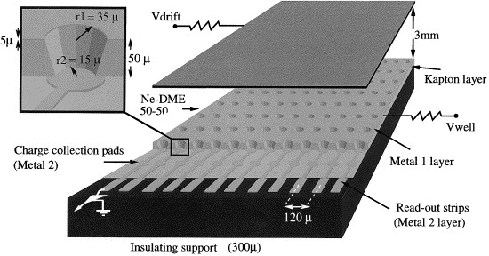
4.Micro-restive well
Was introduced by Ballazzini, Pisa
a long time ago, but abanded due to
the spark problems

Slide 24
Its second birth
Israeli group

Slide 25
The µ-RWELL architecture
The µ-RWELL detector is composed by two elements:
the cathode and the µ-RWELL_PCB .
Drift/cathode PCB
The µ-RWELL_PCB is realized by coupling:
a “suitable WELL patterned kapton foil as “amplification stage”
a “resistive stage” for the discharge suppression & current evacuation
  “Low particle rate” (LR) << 100 kHz/cm²: single resistive layer → surface resistivity ~100 MΩ/ (CMS-phase2 upgrade - SHIP)
  “High particle rate” (HR) >> 100 kHz/cm²: more sophisticated resistive scheme must be implemented (MPDG_NEXT- LNF & LHCb-muon upgrade)
a standard readout PCB
Copper top layer (5µm)
Well pitch: 140 µm
Well diameter: 70-50 µm
Kapton thickness: 50 µm
DLC layer (0.1-0.2 µm)
R ̴50 -100 MΩ/□
1
2
3
Rigid PCB readout electrode
µ-RWELL PCB
G. Bencivenni et al., 2015_JINST_10_P02008

Slide 26
The µ-RWELL architecture
The µ-RWELL detector is composed by two elements:
the cathode and the µ-RWELL_PCB .
Drift/cathode PCB
The µ-RWELL_PCB is realized by coupling:
a “suitable WELL patterned kapton foil as “amplification stage”
a “resistive stage” for the discharge suppression & current evacuation
  “Low particle rate” (LR) << 100 kHz/cm²: single resistive layer → surface resistivity ~100 MΩ/ (CMS-phase2 upgrade - SHIP)
  “High particle rate” (HR) >> 100 kHz/cm²: more sophisticated resistive scheme must be implemented (MPDG_NEXT- LNF & LHCb-muon upgrade)
a standard readout PCB
Copper top layer (5µm)
Well pitch: 140 µm
Well diameter: 70-50 µm
Kapton thickness: 50 µm
DLC layer (0.1-0.2 µm)
R ̴50 -100 MΩ/□
1
2
3
Rigid PCB readout electrode
µ-RWELL PCB
G. Bencivenni et al., 2015_JINST_10_P02008

Slide 27
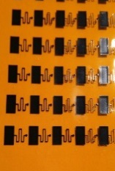
LR scheme: single resistive layer
HR scheme: double resistive layers
DLC-coated kapton base material: DLC layer ~ 0.1-0.2 µm (50-100 MΩ/)
Kapton layer 50 µm
Copper layer 5 µm
Kapton layer (12-25 µm) with 1/cm² vias density .
Screen printed with a “buried-resistances” pattern
Strip kapton layer (50 µm)
pre-preg #106 (50 µm)
DLC-coated kapton base material
DLC-coated base material after copper and kapton chemical etching

Slide 28
Principle of operation
A voltage of 400-500 V between the
top copper layer and the grounded resistive foil,
generates an an electric field of ~100 kV/cm
into the WELL which acts as
multiplication channel
top copper layer
kapton
HV
ρ
kapton
ε_{r}
t
the charge induced on the resistive foil is
dispersed with a time constant, RC, determined by
the surface resistivity, ρ
the capacitance per unit area, which depends on the distance between the resistive foil and the pad readout plane, t
the dielectric constant of the kapton, ε_{r} [M.S. Dixit et al., NIMA 566 (2006) 281]
the effect of the introduction of the resistive foil is the suppression of the
transition from streamer to spark by a local voltage drop around the avalanche location
Notes:
1) By applying a suitable voltage (400-500 V) between the top copper layer and the grounded bottom resistive layer, an electric field as high as ~100 kV/cm is generated into the WELL which acts as multiplication channel for electrons produced in the gas by an ionizing particle.
2) The localized charge induced on the resistive layer is dispersed with RC time constant, determined by the surface resistivity (ρ) and the capacitance per unit area, which depends on the spacing (t) between the resistive layer and the pad readout plane and on the dielectric constant (ε_{r}) of the kapton.
(M.S. Dixit et al., NIMA 566 (2006) 281)
3) The effect of the introduction of the resistive layer is the suppression of the transition from streamer to spark by a local voltage drop around the avalanche location. The discharge quenching, allowing higher amplification field inside the WELL, permits to increase the detector gain. As a drawback, the capability to stand high particle fluxes is reduced.

Slide 29
Towards large area & detector engineering
In the framework of the CMS-phase2 muon upgrade we are developing large size µ-RWELL. The R&D is performed in strict collaboration with Italian industrial partners (ELTOS SpA & MDT). The work will be performed in two years with following schedule:
Construction & test of the first 1.2x0.5m² (GE1/1) µ-RWELL 2016
Mechanical study and mock-up of 1.8x1.2 m² (GE2/1) µ-RWELL 12/2016
Construction & test of the first 1.8x1.2m² (GE2/1) µ-RWELL 12/2017- 6/2018
1.2x0.5m² (GE1/1) µ-RWELL
LR scheme
450
450
1.8x1.2m² (GE2/1) µ-RWELL
Splicing zone
< 0.5 mm wide
1200 mm
450
450
Four PCB µ-RWELL spliced with the same technique used for large ATLAS MM + only one cathode closing the detector

Slide 30
As can be seen from this review, resistive electrode approach gave birth to many designs of micropattern detectors
The classical GEM and MICROMEGAS start loosing their monopoly?

