Slide 1
Part-VI
The main characteristics and limitations of gaseous detectors

Slide 2

During last lectures we consider various designs of gaseous detectors: from a singe wire to micropattern

Slide 3
Their main characteristics
1. Position resolution
2. Time resolution
3. Energy resolution
4. Maximum achievable counting rate
5. Maximum achievable gas gain

Slide 4
Let’s consider these parameters in more details

Slide 5
1. Position resolution
Due to the small gap between electrodes and a small pitch of a pattern structure micropttern detectors have unprecidently high position resolution approaching ~10 µm which is close the solid state detectors

Slide 6
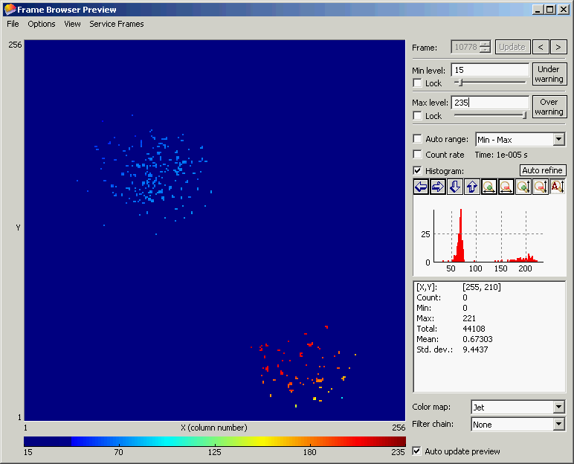
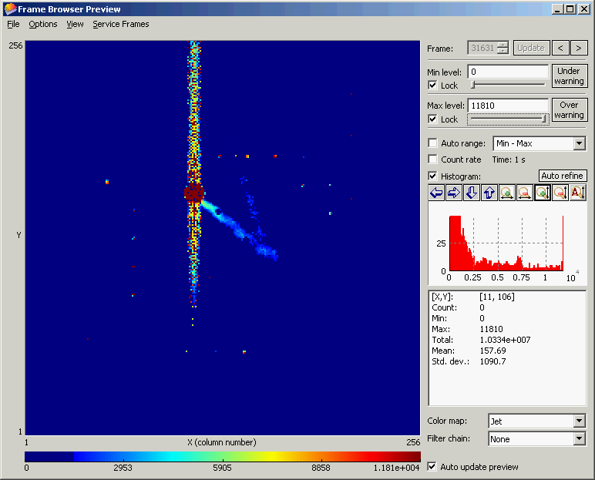
"InGrid" Detector: Single Electron Response and Discharges
Observe electrons (~220) from an
X-ray (5.9 keV) conversion one by one and count them
in micro-TPC (6 cm drift)
→ Study single electron response
Provoke discharges by introducing small amount of Thorium in the Ar gas - Thorium decays to Radon 222 which emits 2 alphas of 6.3 & 6.8 MeV
→ Round-shape images of discharges
1.5 cm
Fe⁵⁵
source
P. Colas, RD51 Collab. Meet.,
Jun.16-17, 2009, WG2 Meeting
M. Fransen, RD51 Collab. Meet.,
Oct.13-15, 2008, WG2 Meeting

Slide 7
2. Time resolution
Although intrinsically (due to the small gap) time resolutions of some micropattern detectors are rather high, in practice it is less than that achieved with micro gap parallel-plate detectors
The time resolution depends on several factors, one of them is the jitter in creation/arrival primary electrons

Slide 8
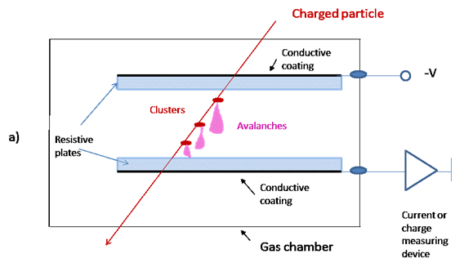
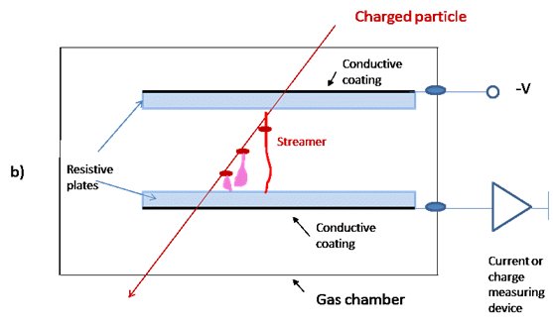
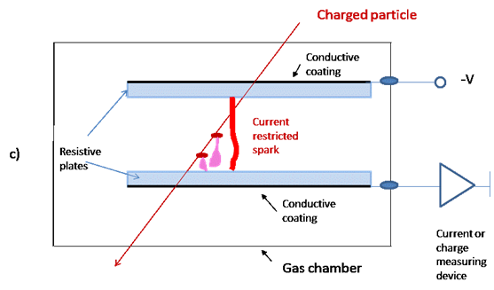
Small gap PPACs
N_{e} = n₀exp αx, so the maximum gain obtain electrons create
close to the cathode.
Another important factors are a high gas gain (signal shaping)
and a space charge effect

Slide 9
3. Energy resolution
Main peak
Escape peak

Slide 10
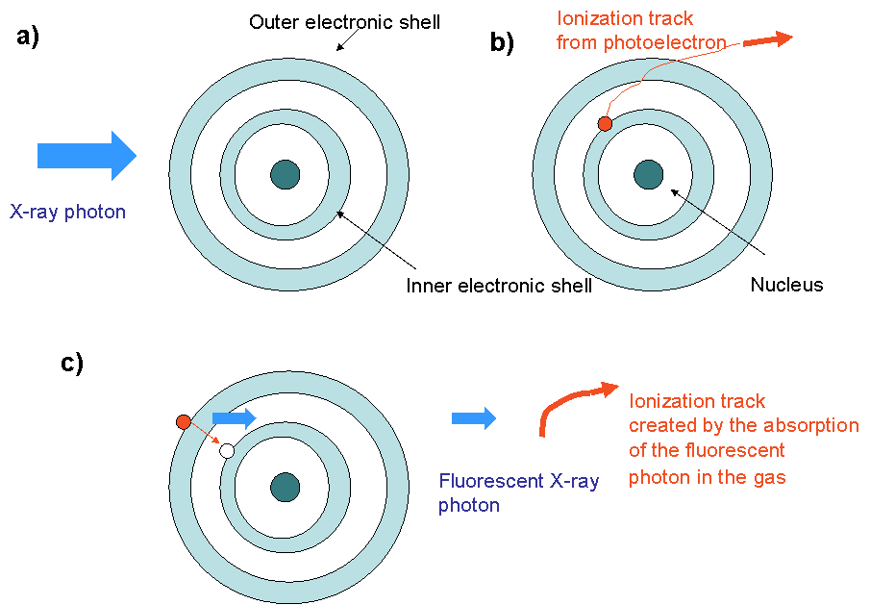
Schematic drawing illustrating the appearance of a fluorescent photoelectron following
the transition of an electron from the outer shell to the vacancy in the inner shell

Slide 11
4. Maximum achievable counting rate

Slide 12
The physics of gain drop with rate in
wire detectors is a space charge effect

Slide 13
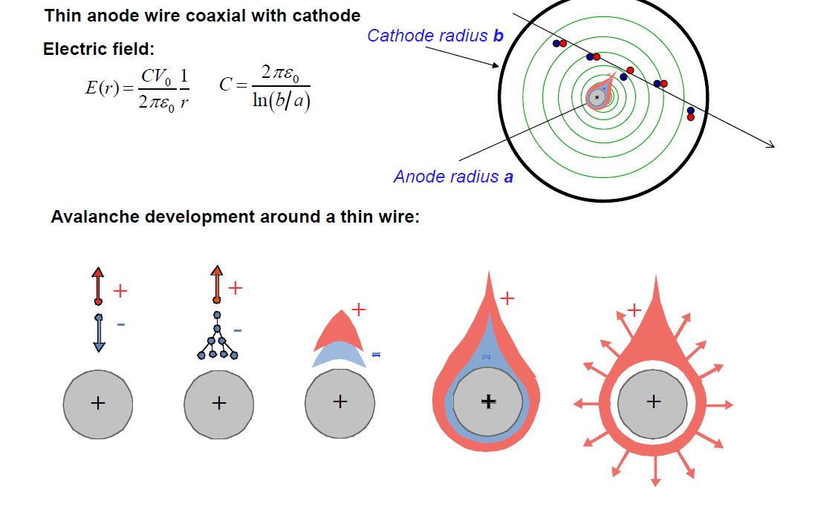
The first version of proportional counters has not any imaging capability
(The space charge appear at some critical value of An₀ which depends on geometry and electric field)

Slide 14
The space charge in wire-type detectors effect plays a “stabilization” role

Slide 15
At high counting rates ions start
Contributing!

Slide 16
Parallel-plate avalanche chamber
No space charge
Breakdowns
Physicsof breakdown : avalanche overlapping
Raether limit

Slide 17
Physics of breakdown-avalanche overlapping
At An₀~10⁸ electrons transition to a streamer
As a results An₀~10⁸ electrons

Slide 18
Parallel-plate avalanche chamber
Raether limit

Slide 19
Micropattern detectors
The maximum achievable gain, limited by breakdown, as
a function of the x-ray flux for various detectors: (1) PPAC with
3mm gap; (2) MICROMEGAS; (3) PPAC with 0.6mm gap;
(4) microstrip gas chamber with 1mm strip pitch; (5) microstrip gas
chamber with 0.2mm strip pitch; (6) GEM; (7) microgap detectors
with 0.2mm strip pitch.

Slide 20
5. Maximum achievable gas gain
Wire-type detectors
Parallel-plate detectors
An₀~10⁸ electrons
(parallel field lines)
Aγ_{ph}=1 or Aγ₊=1
(radial electric field)

Slide 21
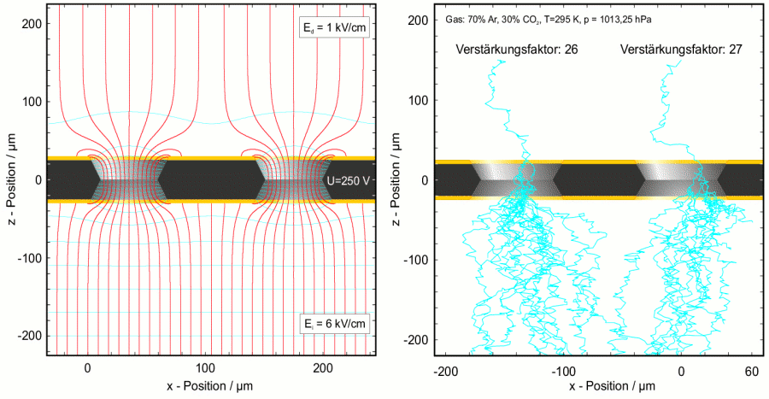
Why in micropattern detectors a discharge is governed by the Rather limit?
There are always regions of parallel electric fields

Slide 22
Micropattern detectors
The maximum achievable gain, limited by breakdown, as
a function of the x-ray flux for various detectors: (1) PPAC with
3mm gap; (2) MICROMEGAS; (3) PPAC with 0.6mm gap;
(4) microstrip gas chamber with 1mm strip pitch; (5) microstrip gas
chamber with 0.2mm strip pitch; (6) GEM; (7) microgap detectors
with 0.2mm strip pitch.

Slide 23
The conclusion concerning the counting rate capability:
Micropattern detectors have in general higher rate capability than MWPC, however less or equal than parallel-plate chambers

Slide 24
Summary
Pos. resolution | Time resolution | Energy resol. | Max. achievable counting rate | Max. achievable gains
Classical gas detectors | 70 ps | 12-17% FWHM | The highest in PPAC | Aγ=1 in wire-type detectors and An₀~10⁸ electrons in PPAC
Micropattern detectors | 2-3 ns | 12-17% FWHM | Below or equal to PPAC | An₀~10⁶-10⁷ electrons

Slide 25
Qualitative comparison to other detectors
Detector type | Pos. resolution | Time resolution | Energy resol. | Max. achievable counting rate | Max. achievable gains
Classical gas detectors | Typically~100 µm | 70 ps | 12-17% FWHM | The highest in PPAC | Aγ=1 in wire-type detectors and An₀~10⁸ electrons in PPAC
Micropattern detectors | Close to 20 -30 µm | 2-3 ns | 12-17% FWHM | Below or equal to PPAC | An₀~10⁶-10⁷ electrons
Vacuum detectors | Up to 3-10 µm | 2-3 ns PMT 50ps or less MCP | Often much less than 10% | Below or equal to gaseous detectors | ~10⁵
Solid-state detectors | Around 7 µm | Below 50ps | Often much less than 10% | Below or equal to gaseous detectors | 1 and high (>10³) in avalanche detectors
Liquid detectors | Have potentials, but in practice > mm (depends on a design) | µs? (depends on a design) | Potentially high, but not fully exploited | Not less than gaseous detectors | Typically 1

