Slide 1
Smaller scale applications of gaseous detectors
Medical
Biology
Home-land security
Environmental

Slide 2
Application in medicine
Part-X
(just a few examples)

Slide 3
Commercial MWPC-based x-ray scanners
(Early commercial designs, based on MWPC)

Slide 4
Full body low dose digital imaging
Budker Inst., Russia
In the first lecture I mentioned that the MWPC were the first high efficient electronic imaging device.
It is not astonishing that their firs application was for large-area medical imaging

Slide 5
MWPC filled with Xe at pressure of 3 atm, efficiency about 30 % for 60keV photons

Slide 6
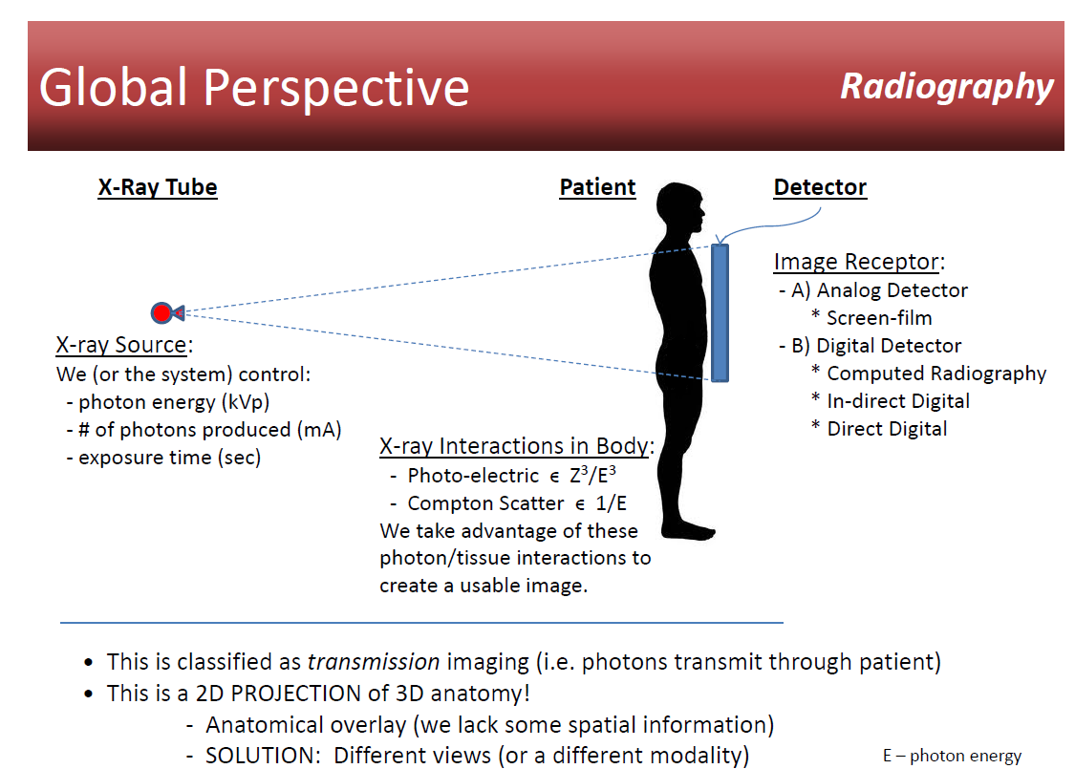

Slide 7
Due to the high signal to noise ratio and suppression of scattering effect the same image quality is obtained at strongly reduces dose

Slide 8
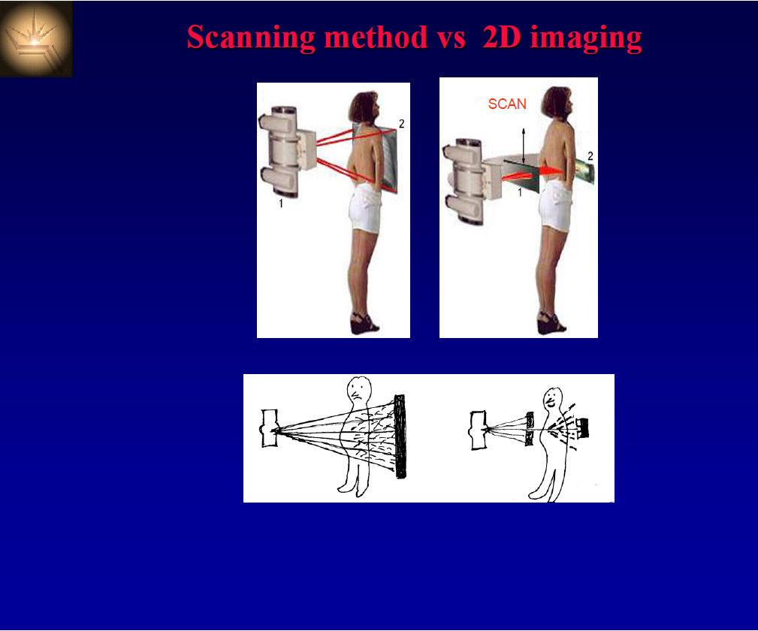
Compton scattering

Slide 9
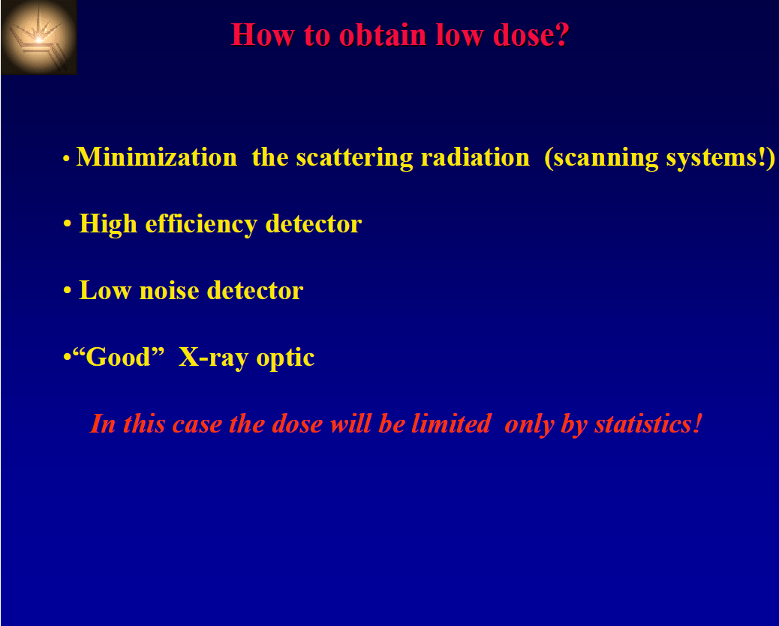

Slide 11
A note /reminder) about doses
1 Gy (Gray) = 1 joule/kilogram - a physical quantity. 1 Gy is the deposit of a joule of radiation energy in a kg of matter or tissue.
1 Gy = 100 rads
Dose in Sv = Absorbed Dose in Gy x radiation weighting factor (WR)
Type and energy range | Radiation weighting factor, WR
Gamma rays and x rys | 1
Beta particles | 1
Neutrons, energy < 10 keV > 10 keV to 100 keV > 100 keV to 2 MeV > 2 MeV to 20 MeV > 20 MeV | 5 10 20 10 5
Alpha particles | 20

Slide 13
Recall: Hysterosalpingography is a specialised form of X-ray that produces images of the parts of a woman's body needed to have a baby (reproductive tract). It helps to assess the size and shape of your womb (uterus). It can also assist in checking that your Fallopian tubes are open.
Hysterosalpingography is commonly used in women who are having difficulty becoming pregnant. This test allows the doctor to assess the shape and structure of the womb (uterus) and any scarring in the region.

Slide 14
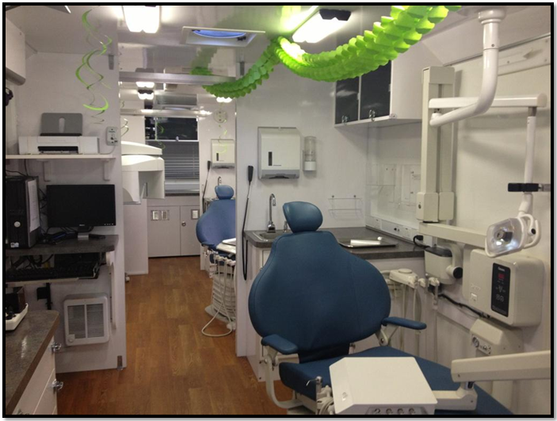
At this time it was the only low dose electronic imager!
Commercial devise were installed in more than
in 50 Russian clinics

Slide 15
Low dose fluorography based on high pressure microstrip counters

Slide 16
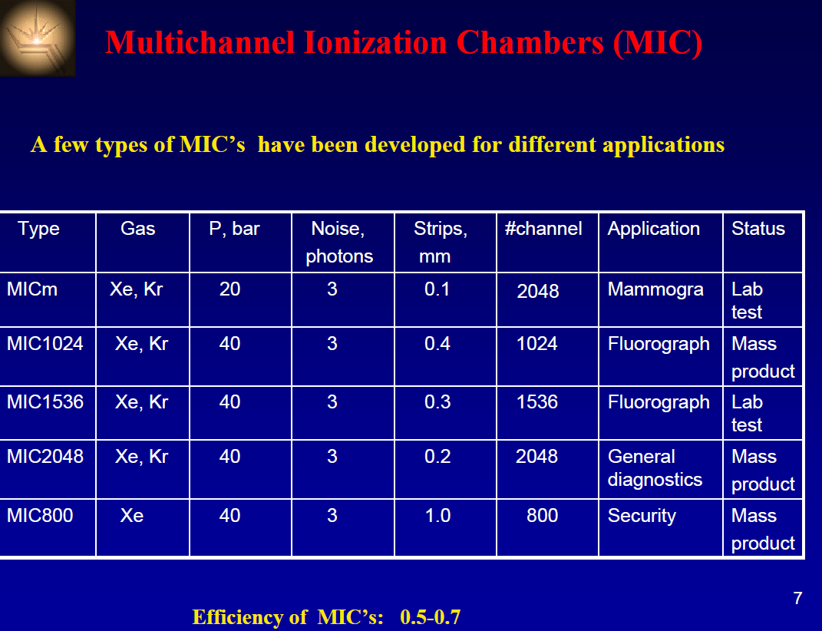

Slide 17
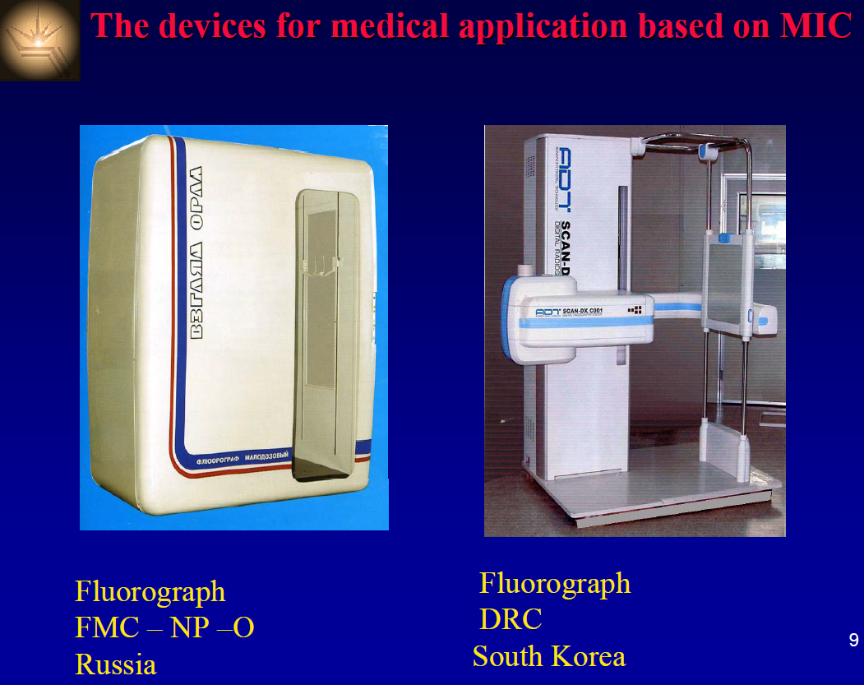

Slide 18
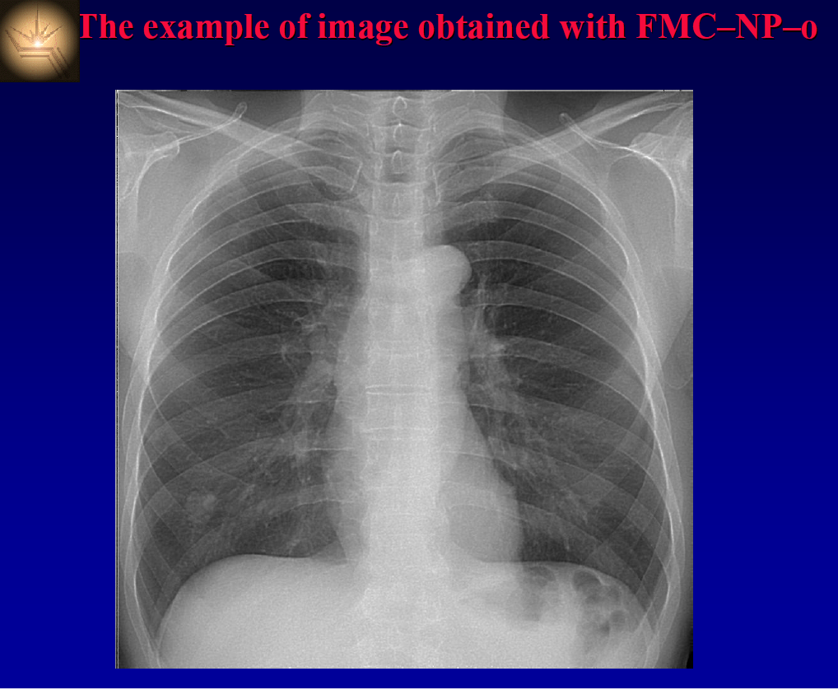

Slide 19
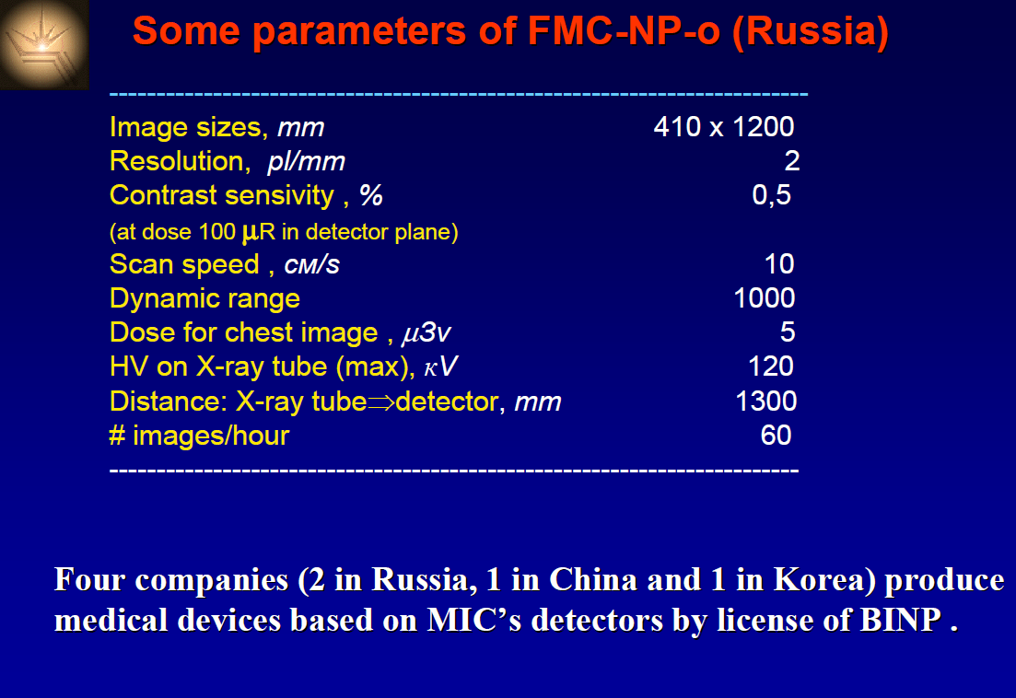

Slide 20
The French Company Biospace developed a similar devices based on high-pressure MICROMEGAS
They are In operation in several French clinics

Slide 21
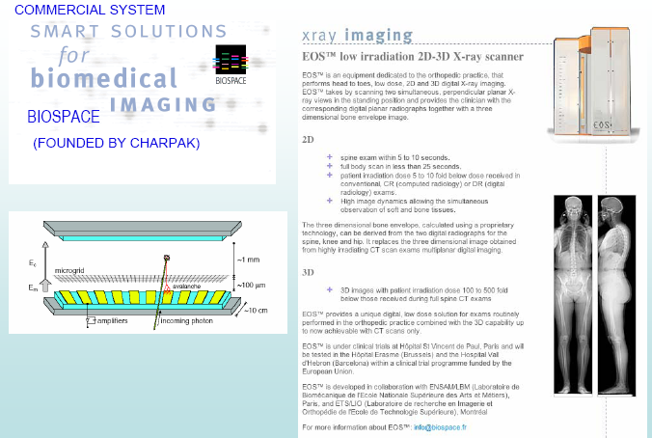

Slide 23
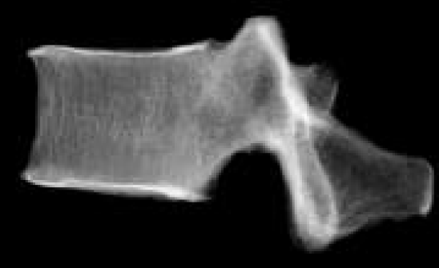
The Radiographic image of a vertebra taken by MICROMEGAS.

Slide 24
Digital mammography
Pioneering work of XCounter AB, Sweden)

Slide 25
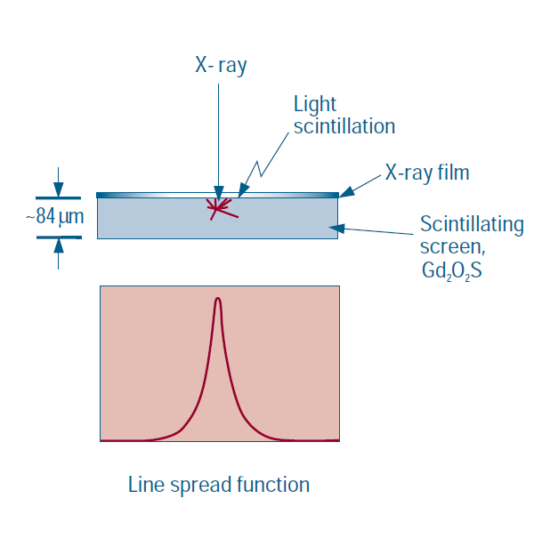
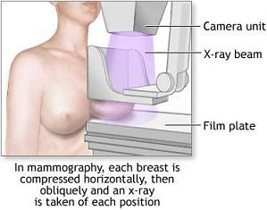
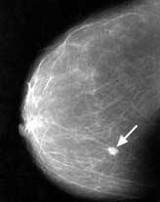
Conventional film mammography

Slide 26
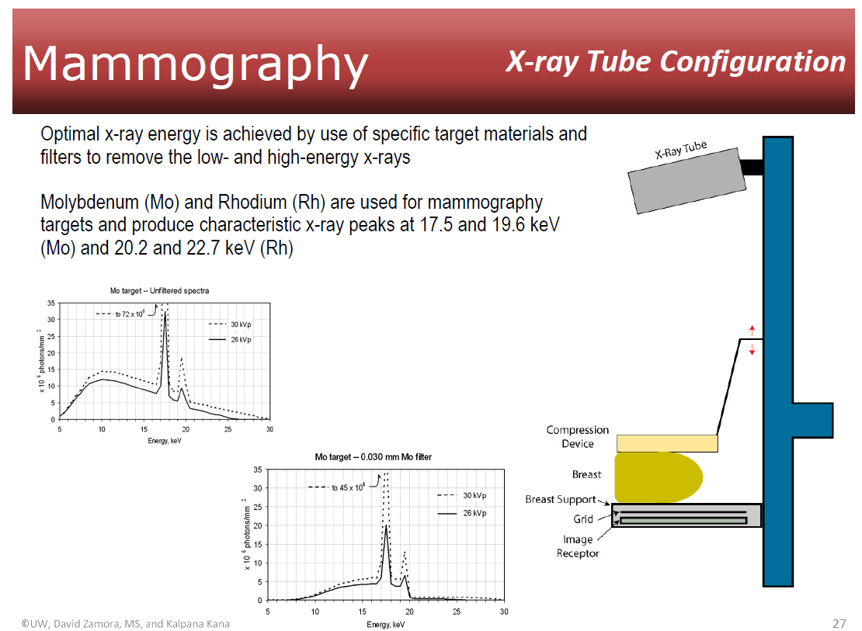

Slide 27
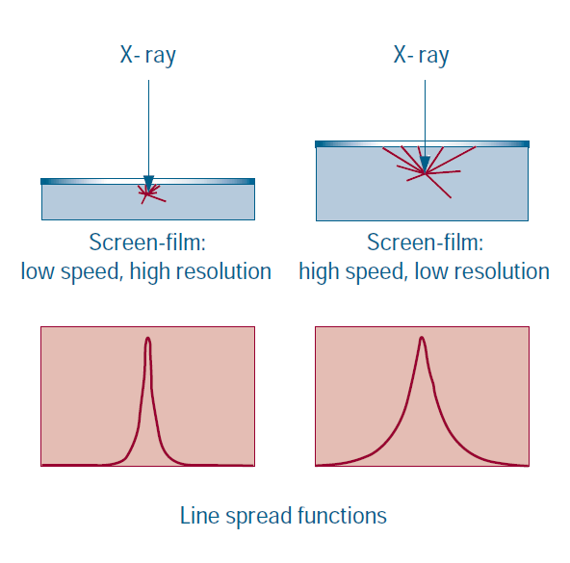
Limits
LSF-a graph obtained from the image of a narrow line, which quantifies the amount of blur produced by an imaging system

Slide 28
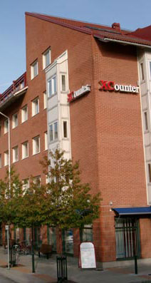
XCounter approach

Slide 29
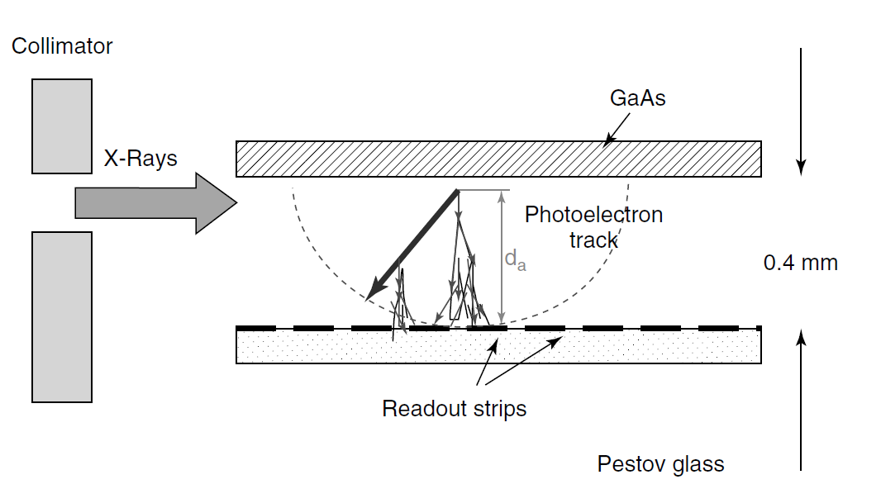

Slide 30
Features:
no spacers,
Gap0.1-0.3 mm,
very good timing
resolution <0.1ns,
position resolution
~ 30μm

Slide 31
Readout plate
(Developed in collaboration with XCouner AB, Sweden)
ASIC
Strips
(digital channels)
Amplifier
(analog channels)
Ceramic plate with Al strips 50μm in pitch
(« focused » on 78 cm distance)

Slide 32
Position resolution of ~50 µm was achieved in digital mode at counting rate of 10⁵ Hz/ strip
Figures a,b,c show results of scanning a collimated x-ray beam (~30 μm) in the direction perpendicular to strips -the number of counts from various strips accumulated during 0.1 sec)

Slide 33
An array of detectors

Slide 34
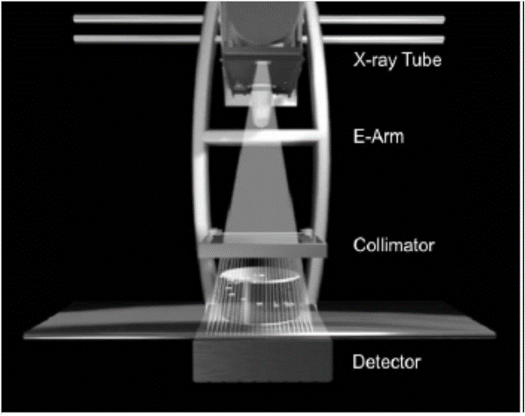

Slide 35
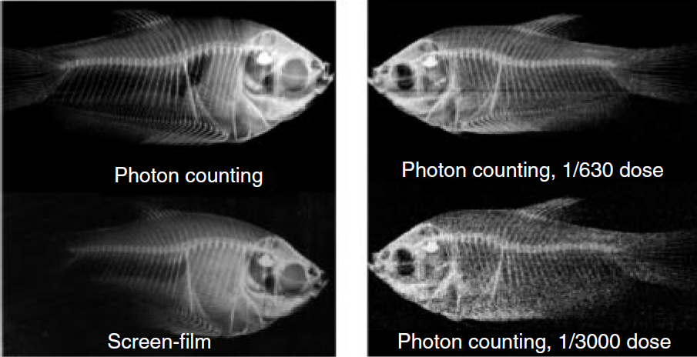

Slide 36
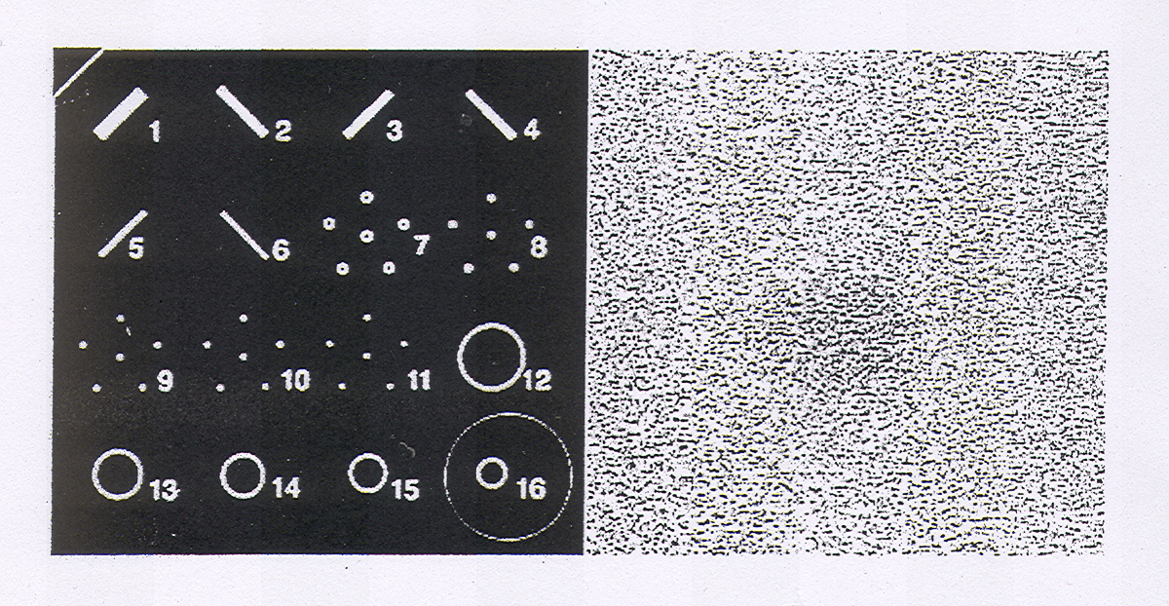
Mammographic phantom
Low contrast object
# 16
was possible to resolve

Slide 38
Some other medical devices
(examples only)

Slide 39
Application of MWPCs fro cardiac investigations
(commercial devices)

Slide 40
Advantages : positions resolution is close to film mammography, delivered dose was 10 times less

Slide 41
The detectors were installed and operated in a Swedish clinic

Slide 42
Routine tests in Huston clinic

Slide 43
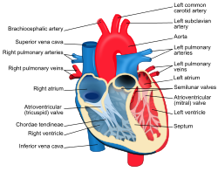
Verticle
This MWPC-based cardiodiagnostic device was also used for studies of abnormalities in the wall motion induced by exercise stress. As an example, in the next Figure ‘‘resting’’ images are shown on the left while the images corresponding to the peak of exercise activity are presented on the right. At the top, photographs show the wall motion images: the ventricular border from end diastole to end systole. The rest four panels show regional ejection fraction images presented in 1D and 2D formats obtained by a first-pass study utilizing MWPC and isotope injection. From these images the specialists may conclude that, at the peak of the exercise, a degraded function is visible along the inferior wall indicating compromised right coronary artery flow.

Slide 44
Displays of sequent end-diastolic images through
16 heart beats following the injection of 178Ta
(the emission energy 55-65 keV, half-life 9.3 min
Left ventricular wall motion images
Normal subject (upper left), abnormal inferior wall motion (upper right), abnormal apical wall motion (lower left),
severe global dysfunction (lower right)

Slide 45
Rest (left) and stress (right) wall motion images (top) and regional ejection fraction images (middle and bottom) obtained by
first pass study
From these images the specialists may conclude that, at the peak
of the exercise, a degraded function is visible along the inferior wall
indicating compromised right coronary artery flow.

Slide 46
MWPC

Slide 47
Cancer therapy
About half of the cancer patients in the world are today treated with radiotherapy. During the treatment, it is of great importance to closely monitor the local dose delivered to the tumor and the surrounding tissue to ensure an effective destruction of the cancer cells while the healthy ones are not damaged.

Slide 48
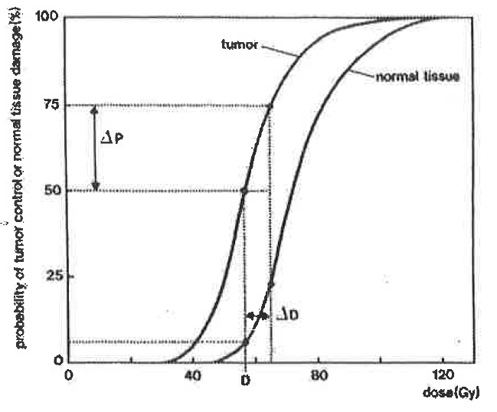

Slide 49
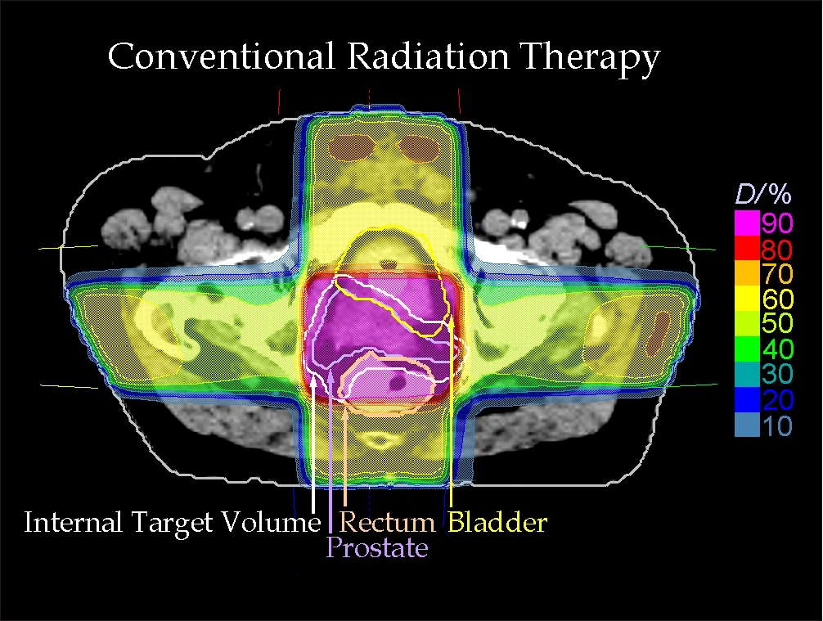
Courtesy of RaySearch Laboratories AB

Slide 51
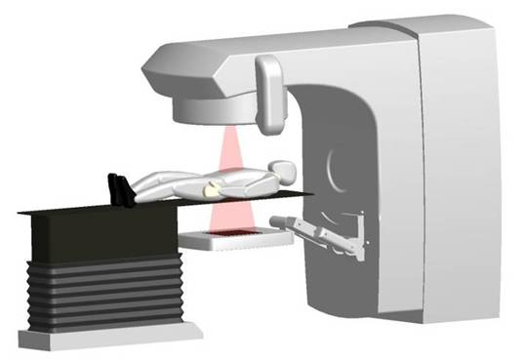
Portal imaging
The Racetrack produces bunches of 50-MeV electrons with
a duration of 0.5 to 6 s and a repetition frequency of 10 to
300 Hz. These electrons can be directly used for treating some
patients. The scanned electron beam can also be converted to
MeV-photons (therapeutic beam) by hitting a beryllium–tungsten
target.
2Gy per min (including neutrons)

Slide 52
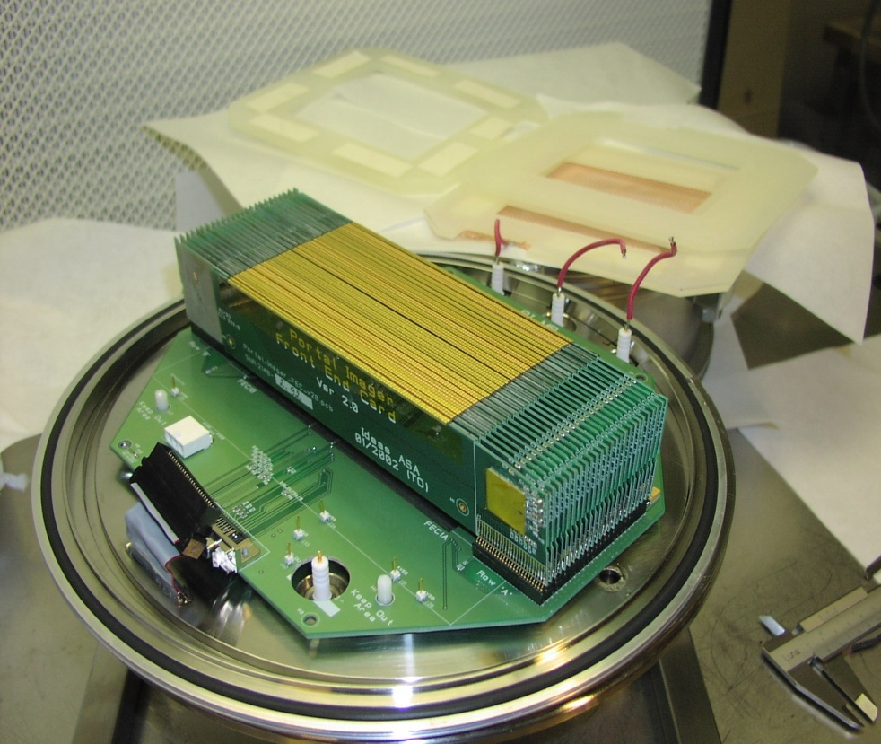
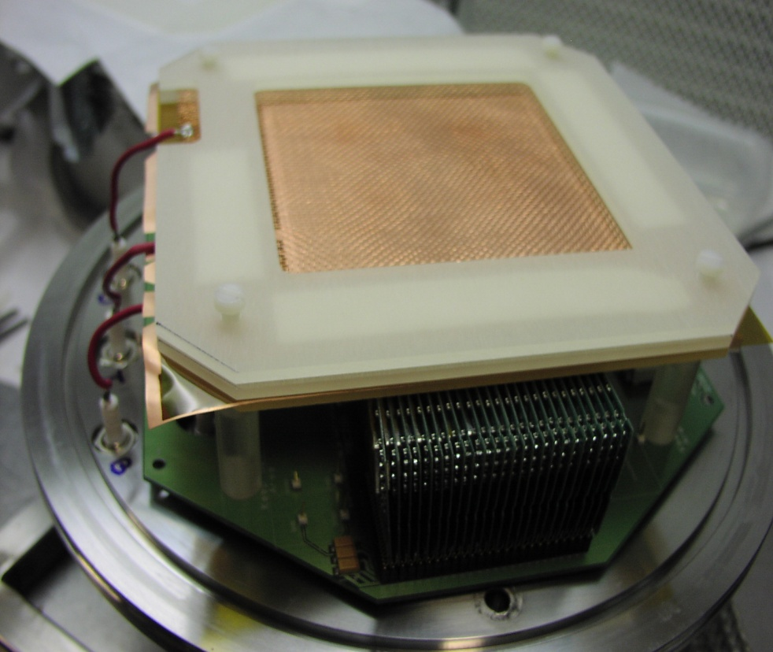
New electronic readout
Readout
pads
GEM
Test setup:
1 GEM installed
Distance: 130 cm between x-ray source and object imaged

Slide 53
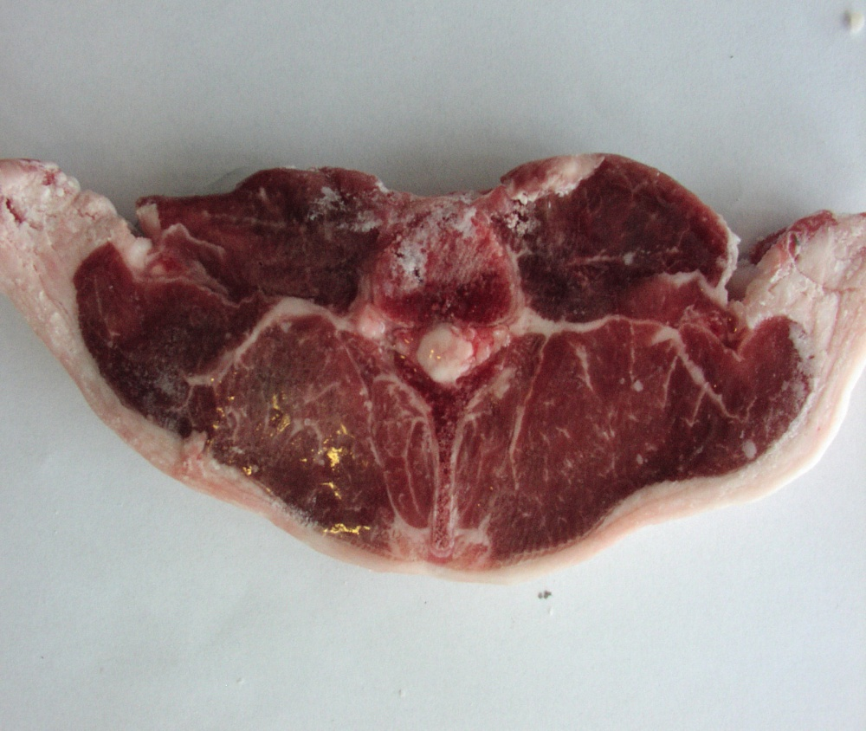
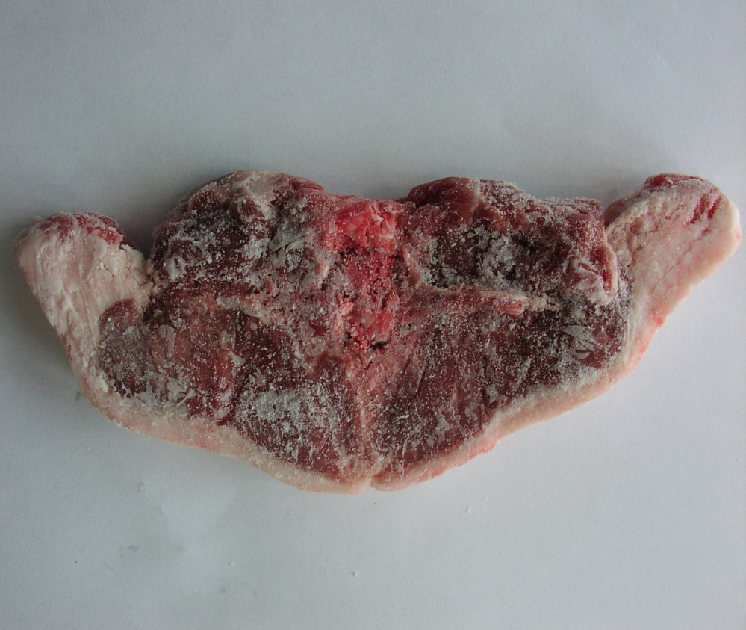
Lamb chop (thickness 15 mm)
Front side
Back side

Slide 54
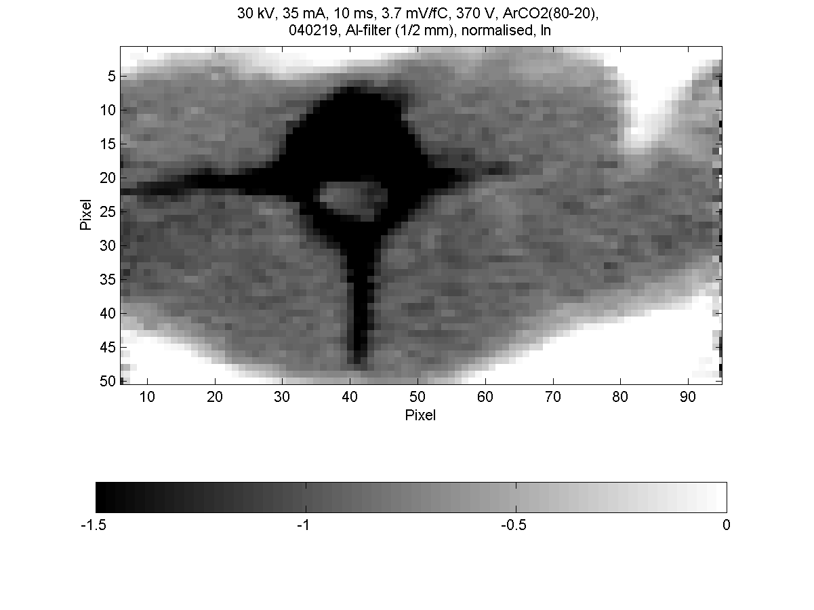
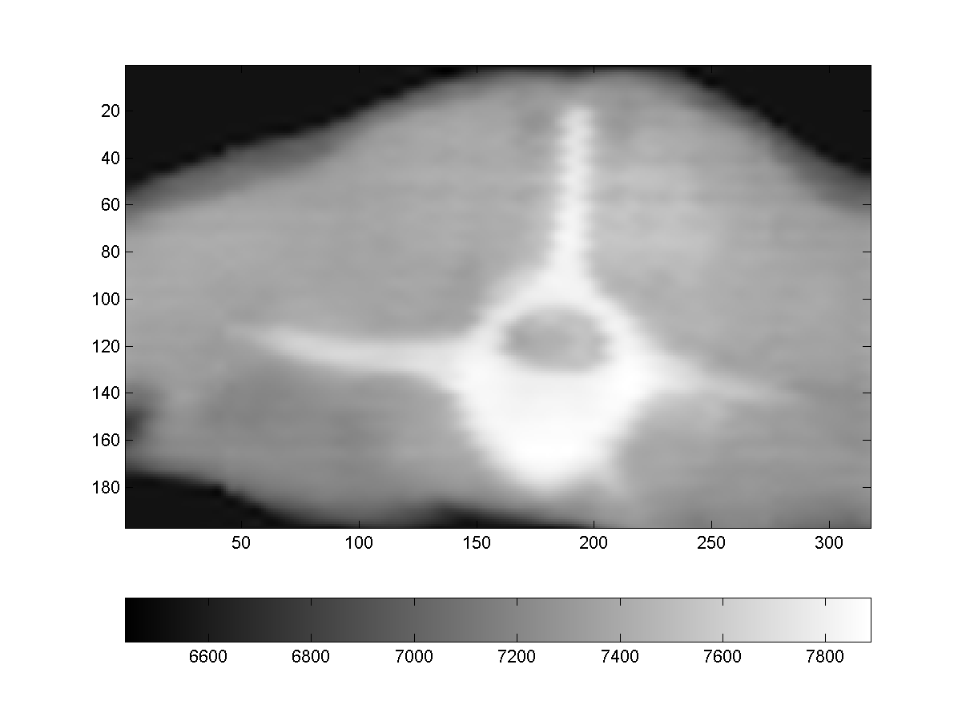
The black surface shows
total absorption of x-rays
The white surface shows
total absorption of x-rays

Slide 55
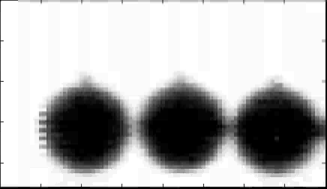
Digital camera video clip

Slide 56
Digital camera video clip

Slide 57
There are other promising developments based on micropattern detectors
(in progress)

Slide 58
Proton range radiography
The basic principle of the Proton Range Radiography (PRR) is to measure the residual energy of the beam traversing an absorber, and build a two-dimensional map of the integrated density in the target.

Slide 59
Protons lose their energy in matter mostly due to ionization
energy loss. The energy a proton loses is characterized by the
proton stopping power, which is dependent on the properties
of the traversed material ~i.e., electron density, atomic number, and atomic weight!
The precise knowledge of the proton
stopping power and hence the range ~and range variations!
of the protons in the patient is essential for radiotherapy treatment planning and for the precise application
of the irradiation. As the proton stopping power relative
to water varies not much with energy, a measurement of the
range of protons with slightly higher energy than used for
therapy reflects information which is essential for radiotherapy
treatment planning. Therefore proton radiographs
can be used not only for imaging purposes, but also for proton
treatment verification.

Slide 60
GEMs
Scintillatot
GEMs

Slide 61
Application in TOF-PET

Slide 62
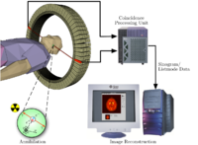
Ordinary PET
(positron –emissiontomography)
Radionuclides and radiotracers - Radionuclides used in PET scanning are typically isotopes with short half-lives
such as carbon-11 (~20 min), nitrogen-13 (~10 min), oxygen-15 (~2 min), fluorine-18 (~110 min),
gallium-68 (~67 min), zirconium-89 (~78.41 hours), or rubidium-82(~1.27 min).

Slide 63
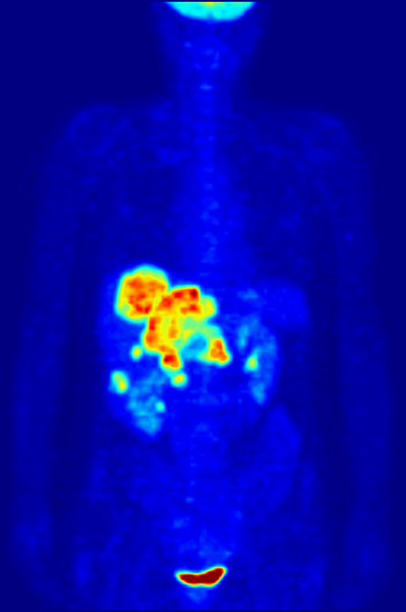
To conduct the scan, a short-lived radioactive tracer isotope is injected into the living subject (usually into blood circulation). Each tracer atom has been chemically incorporated into a biologically active molecule. There is a waiting period while the active molecule becomes concentrated in tissues of interest; then the subject is placed in the imaging scanner. The molecule most commonly used for this purpose is F-18 labeled fluorodeoxyglucose (FDG), a sugar, for which the waiting period is typically an hour. During the scan, a record of tissue concentration is made as the tracer decays.
Schema of a PET acquisition process
As the radioisotope undergoes positron emission decay (also known as positive beta decay), it emits a positron, an antiparticle of the electron with opposite charge. The emitted positron travels in tissue for a short distance (typically less than 1 mm, but dependent on the isotope^{[12]}), during which time it loses kinetic energy, until it decelerates to a point where it can interact with an electron.^{[13]} The encounter annihilates both electron and positron, producing a pair of annihilation (gamma) photons moving in approximately opposite directions. These are detected when they reach a scintillator in the scanning device, creating a burst of light which is detected by photomultiplier tubes or silicon avalanche photodiodes (Si APD). The technique depends on simultaneous or coincident detection of the pair of photons moving in approximately opposite directions (they would be exactly opposite in their center of mass frame, but the scanner has no way to know this, and so has a built-in slight direction-error tolerance). Photons that do not arrive in temporal "pairs" (i.e. within a timing-window of a few nanoseconds) are ignored.

Slide 64
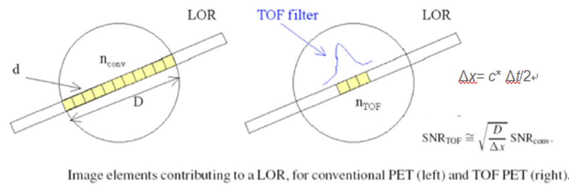
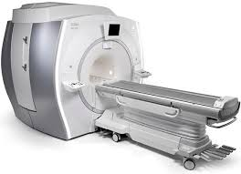
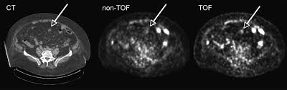
(LOR-line of response)

Slide 65
Of course these examples can be continued…

