Slide 1
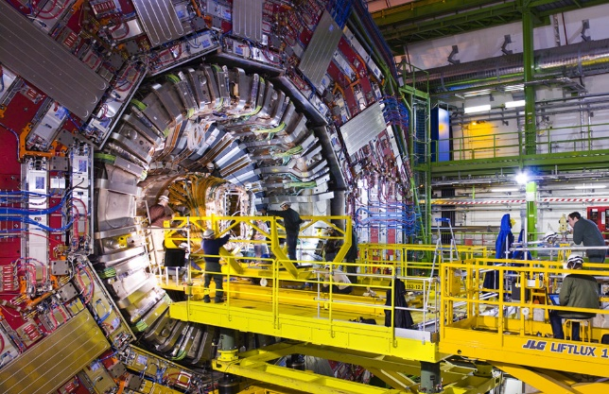
Gaseous detectors: from past to present
V. Peskov
CERN

Slide 2
Topics to be covered:
History of detectors of photons and charged particles
Main designs of gaseous detectors
Characteristics and physics of operation
Applications

Slide 3
Modern detectors of photons and charged particles can be classified into four main categories: vacuum, gaseous, liquid and solid–state.
Introduction

Slide 4
Images of the most advanced detectors

Slide 5
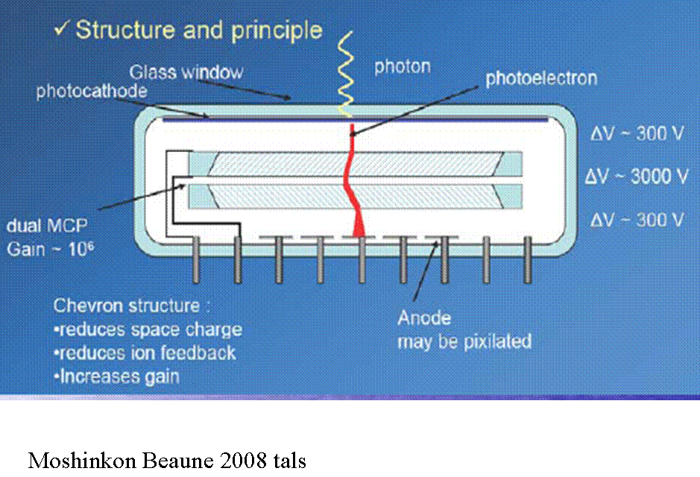
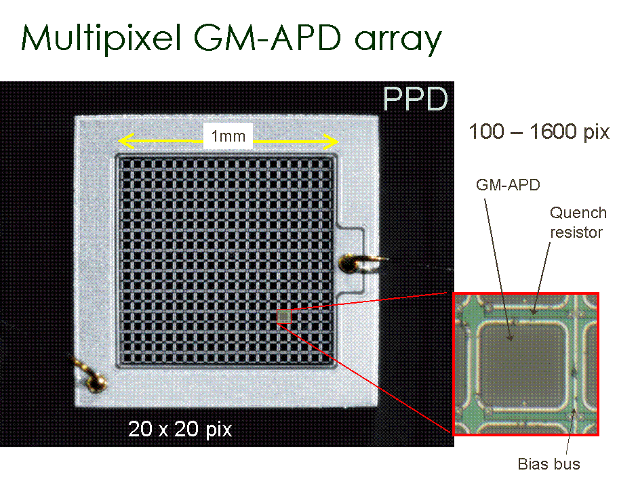
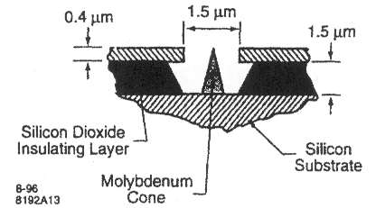
Vacuum amplifier
Gas electron amplifier
Avalanches in liquid
Solid-state amplifier

Slide 6

There is no universal detector which is the best for all applications
For each specific application exist one or several optimal detectors

Slide 7
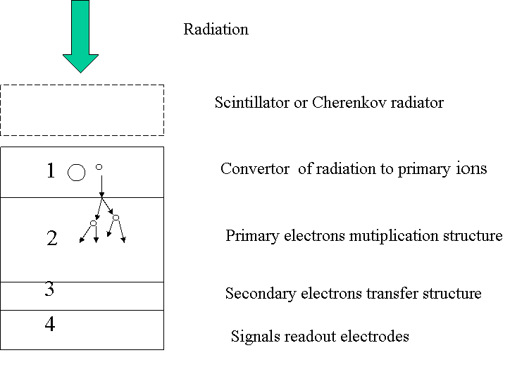
However , most of the detectors have a common operational schematics
Generic operational schematics of electronic detectors of photons and charged particles
(Removable)
(…and drift of primary ions)
(in many new designs!)

Slide 8
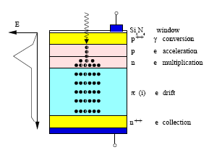
F
Example: solid-state avalanche photodiode

Slide 9
Why do we discuss gaseous detectors today ?
What is the interest associate to them?
From historical point of view: they were the first electronic detectors
From theoretical point of view : after learning you will be easy to understand solid –state and liquid detectors
From practical point of view: large area

Slide 10
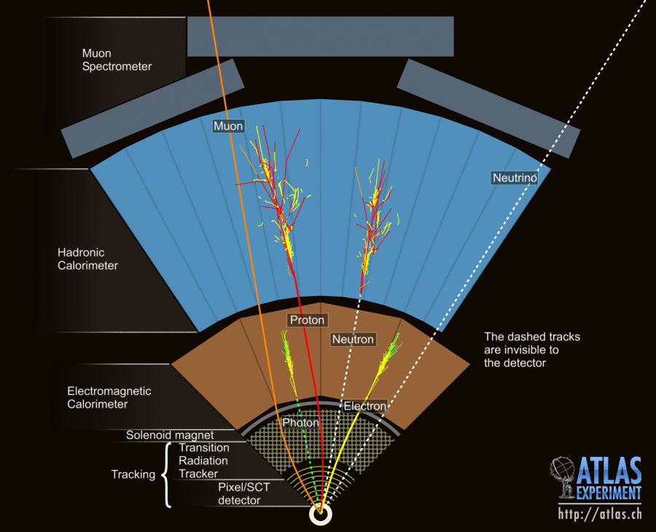
Gaseous detectors of photons and charged particles due to their features such as high gas gains, good position and energy resolutions and low cost per unit of sensitive area occupy a special niche among other detectors

Slide 11
To appreciate these advantages it will be useful to consider the history of developing detectors of photon and charge particles

Slide 12
History of detectors of charged particles and photons
Part-1

Slide 13
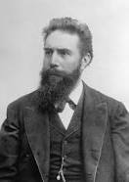
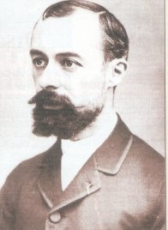
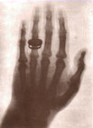
Photographic films were the first detectors used in studies of X-rays by Roentgen (1895)and radioactivity by Becquerel (1986)
Becquerel had discovered in 1896 that uranium gives off invisible rays that fog photographic film. The Curies had shown that thorium acts similarly. In November 1898, they reported the chemical separation of two unknown materials from the ore pitchblende, both highly radioactive — the first use of the word.

Slide 14
At this time the photographic technique did not allow to detect a single photon or a single particle

Slide 15
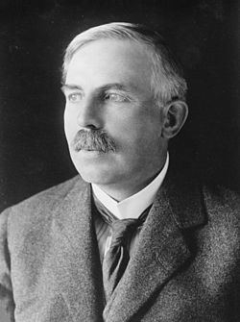
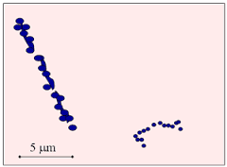
Around 1910 Rutherford start using ZnS scintillator
allowing to detect single alpha particles
Zinc sulphide fluoresces (gives out a photon of visible light) when it is hit by a charged particle. Covering the microscope lens with ZnS allowed the viewer to 'see' where the alpha particles hit (or at least count their impacts).

Slide 16
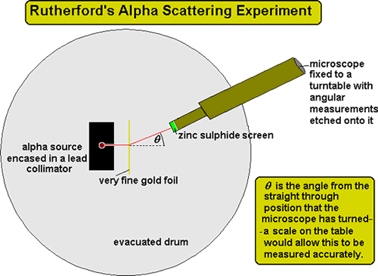
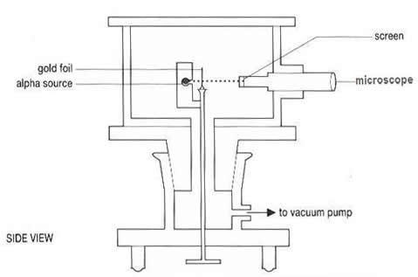
Scintillation screens

Slide 17
First electronic detector of photons and charged particles-Geiger counter

Slide 18
What was already known at this time and what physical principles were exploited in the Geiger counter?

Slide 19
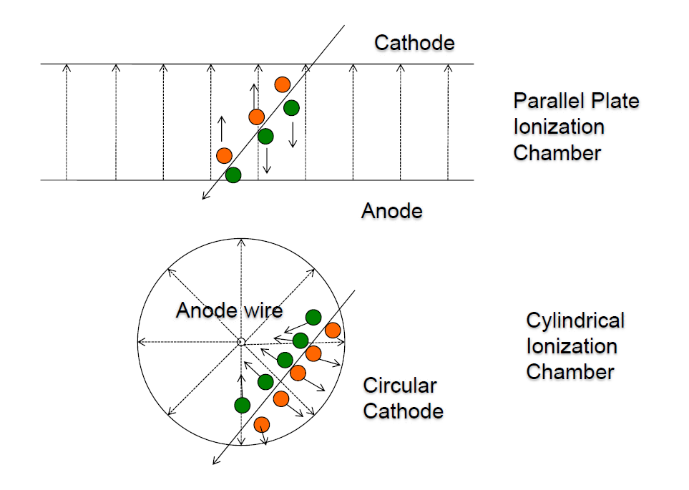
Ions movement in electric fields was already observed and understood.
Ionization chambers were already used in some experiments
Note:
Electrons drift much faster than ions

Slide 20
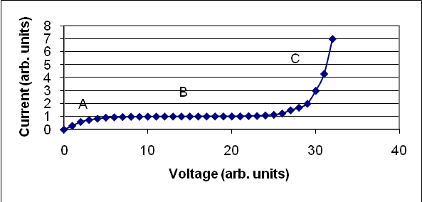
Note that ionization chamber were later and still now used in medicine as dosimeters
Ionization chamber current vs. the applied voltage

Slide 21
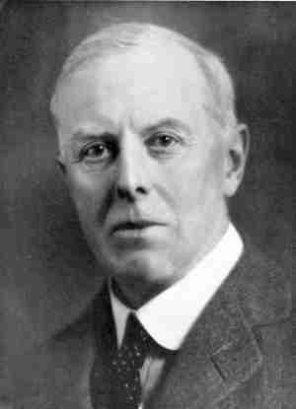
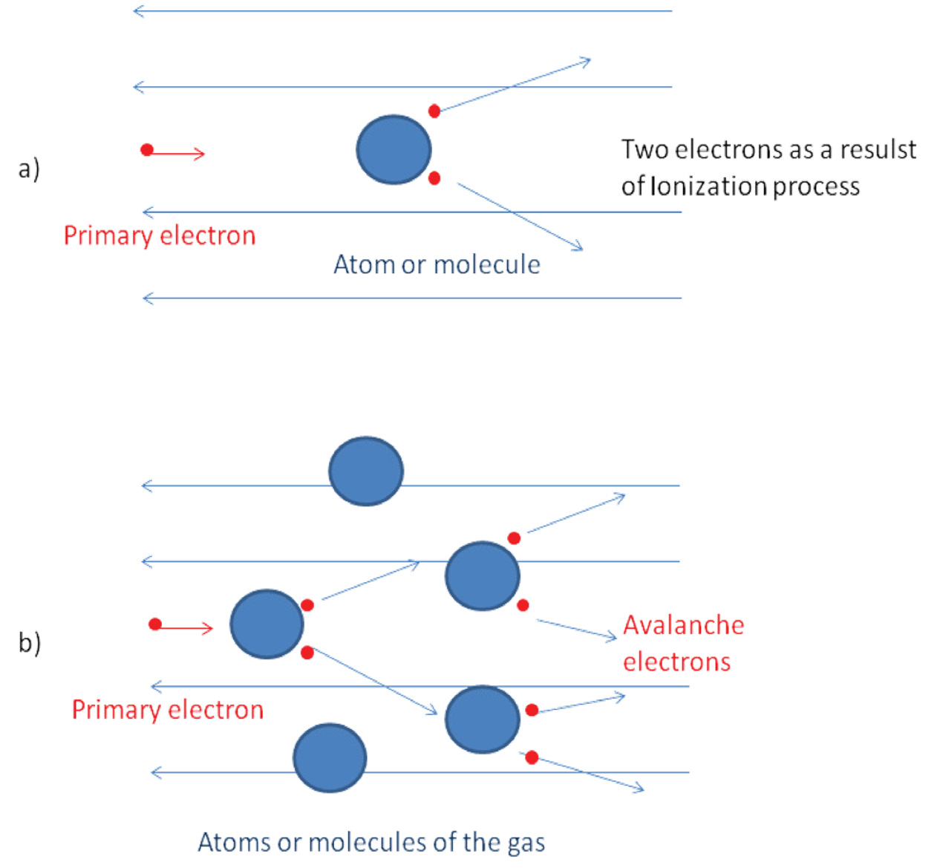
Townsend avalanches
Multiplication starts

Slide 22
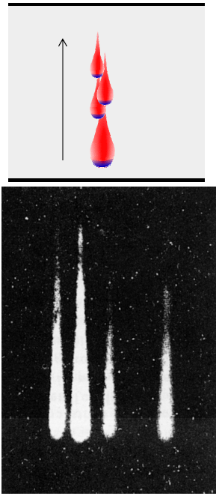
At relatively low voltages Townsend avalanches are well localized in space
For single primary electron:
dn_{e}=αn_{e} dx
n_{e}=exp αx
For n₀ primary electrons
N_{e} = n₀exp αx
Gas gain A=exp αx
“Low “ voltages
High voltages

Slide 23
How Geiger used both effects(drift and multiplication) in the invented him detector?

Slide 24
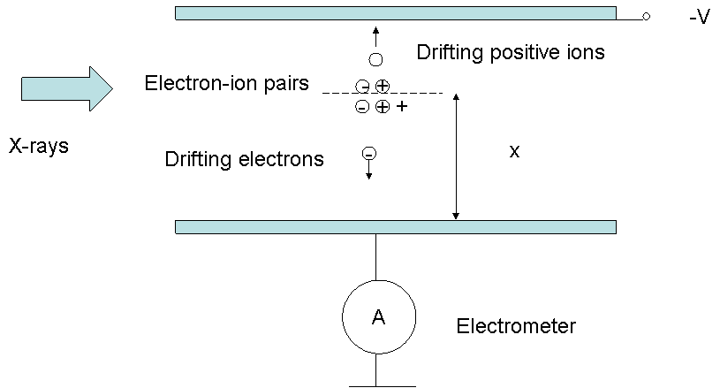
Avalanche development
The process of avalanche multiplication was studied by J. S. Townsend in gases at pressures of several Torr. The discovery was commented by E. Rutherford and H. Geiger:" Suppose that the current between two parallel plates immersed in a gas at low pressure is observed when the air was ionized by X-rays. The current though the gas for small voltages at first increases with the field and then reaches a saturation value, as is ordinary observed in ionized gases at atmospheric pressure. When the field is increase beyond a certain value, however, the current rises rapidly. Townsend has shown that this effect is due to the production of fresh ions in the gas by the collision of the negative ions with the gas molecules. At a later stage, when the electric field approaches the value required to cause a spark, the positive ions also become effective as ionizers but to a much smaller degree that the negative. Under such condition, the small current through the gas due the external ionizing agency may be easily increased several hundreds times. The magnification of the current depends upon the voltage applied and becomes very large just below the sparking value”.

Slide 25
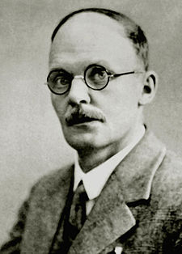

Geiger counters
Proportional mode
Geiger mode
E=1/r

Slide 26
In the beginning of the last century , when the electronics just started to be developed, the Geiger mode was the most useful since it provides with a huge output signal

Slide 27
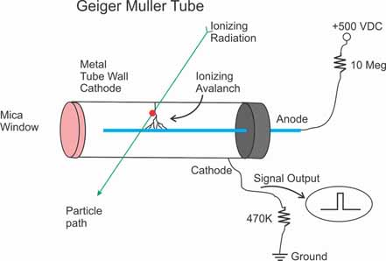
Quenching of discharge in
Geiger mode
( the same principle is now used in
some other detectors: resistive plate
chambers and in SiPM-a compact solid-
stae photomultiplier)

Slide 28
In Geiger mode the signal was few hundreds volts!
However, in this mode the detector does not record directly particle tracks:
the entire detector volume is under the corona discharge, so any position information is lost

Slide 29
Why even proportional Geiger detectors do not allow to measure the particle tracks in an easy way?

Slide 30
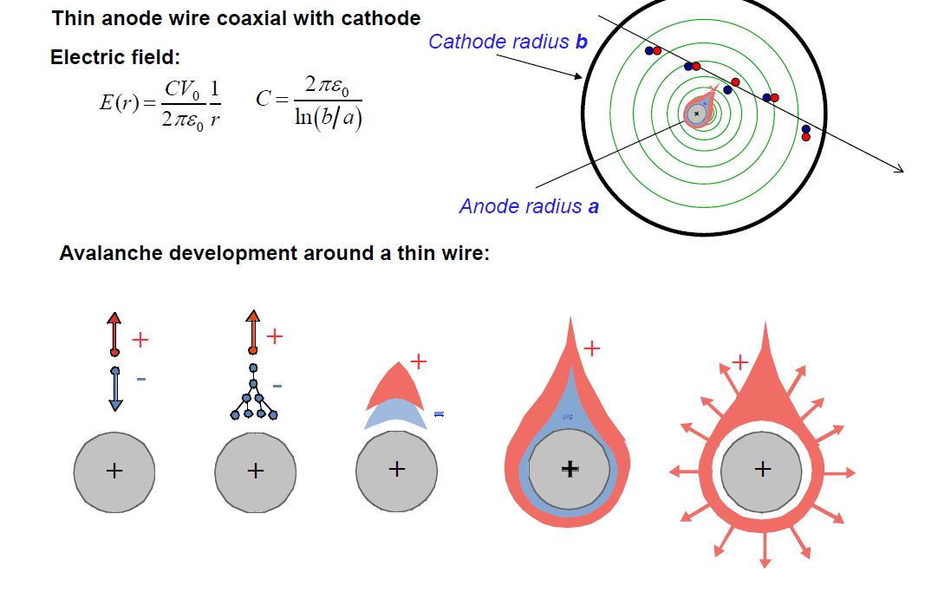
The first version of proportional counters has not any imaging capability
(Later one-dimensional single wire counters were developed)

Slide 31
For this reason for several decades cloud chambers, bubble chambers and spark counters were mostly used in various experiments

Slide 32
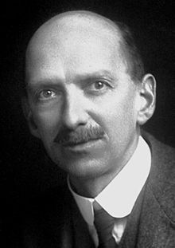
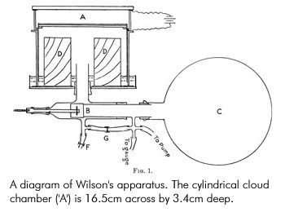
Tracks imaging device
Wilson
~1911

Slide 33
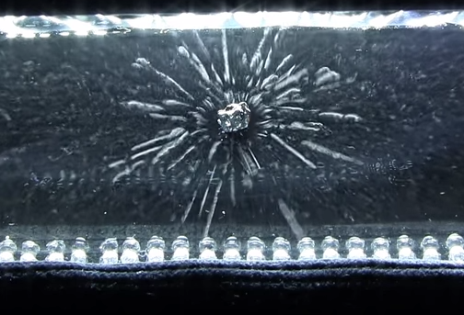
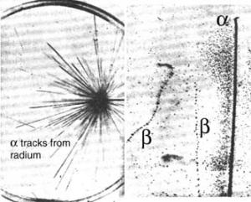
Images obtained with Wilson chamber

Slide 34
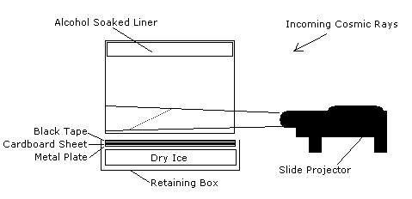
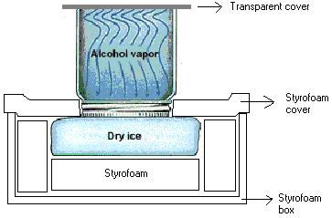
Home-made cloud chamber
(you can make it yourself)

Slide 35
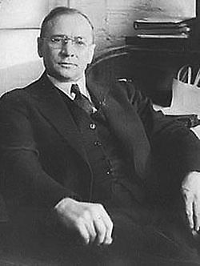
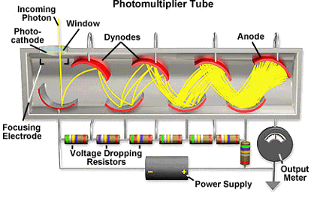
At the beginning of 30th last century another electron amplifier appear-PMT
Zvorykin
PMT is a great device, but was is not a position- sensitive

Slide 36
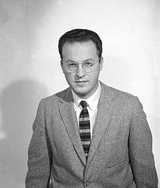
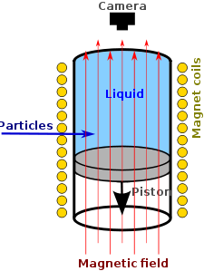
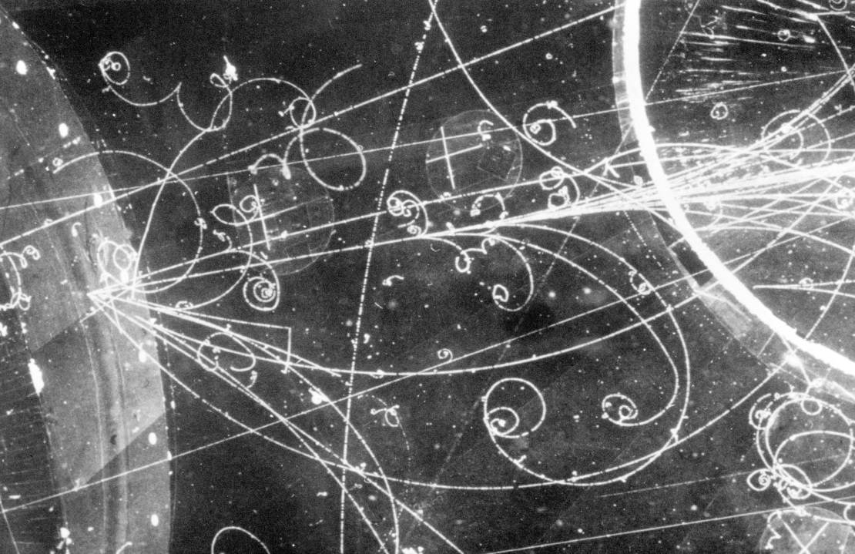
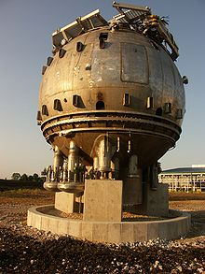
Bubble chamber (1952)
Glaser
most often liquid hydrogen

Slide 37
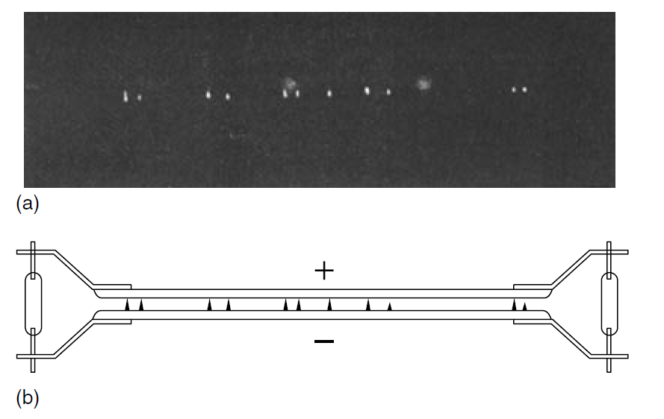
Single spark counters
(spark and streamer chambers were most widely used as research tools from the 1930s to the 1960s)

Slide 38
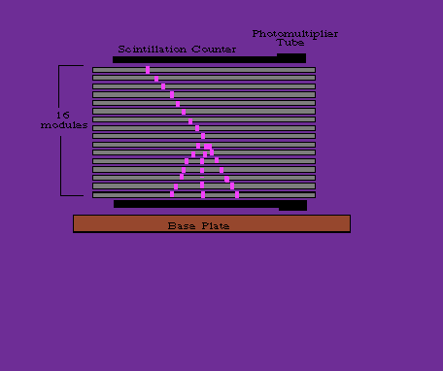
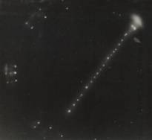
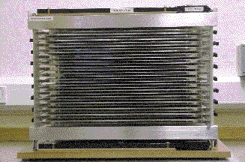
Stacks of spark counters
The most common way of track
detection was the photography
of sparks.
Later there were attempts to introduce electronic readouts

Slide 39
The main drawbacks of cloud, bubbler and spark chambers- low repetition rate of detection.
Moreover, spark chambers could not detect simultaneously many events
In one word: these detectors did not fit growing requirements of high-energy physics experiments and new applications

Slide 40
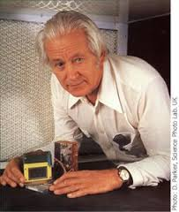
MWPC was the first high speed imaging electronic detectors capable recording continuously and simultaneously many particles or photons
G. Charpak

Slide 41
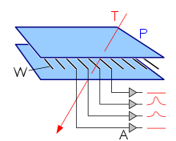
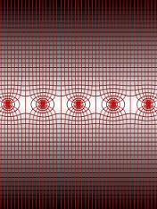
How MWPC operates?
Equivalent of an array of proportional single –wire counters .
Rate capability ~10⁵ count/sec per wire. 1-D pos. resol. 2.5 mm

Slide 42
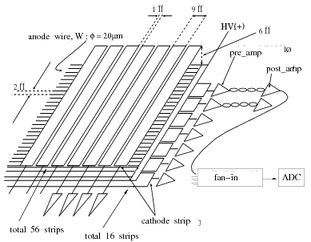
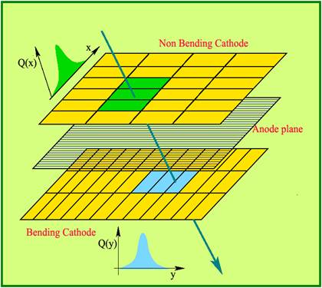
Modern sophisticated MWPC
Position resolution 0.1 - 0.3 mm
Position resolution approaching 0.2 X 0.2 mm

Slide 43
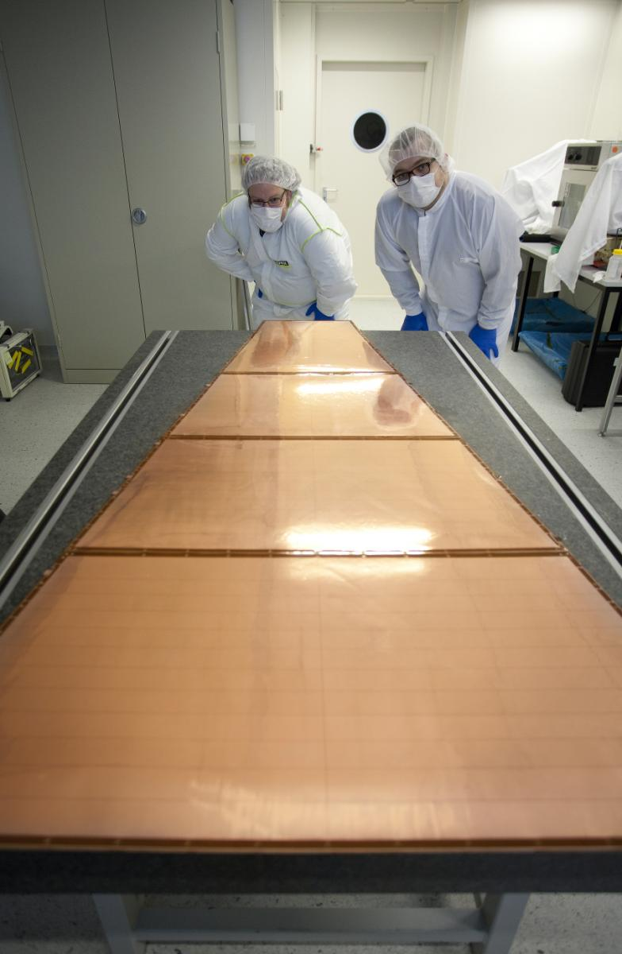
Photograph of a medium
size MWPC

Slide 44
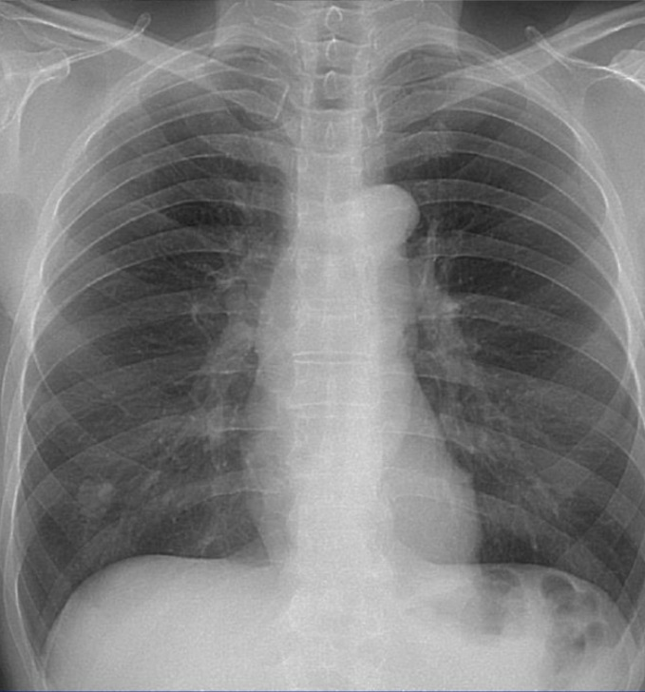
MWPCs open the era of modern high efficiency electronic imaging devices
Their use in medical and biological studies
will be reviewed in the second lecture

Slide 45

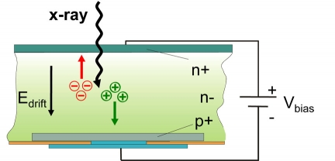
At this time it was a revolution in the detection technique
Of course, later solid state
and other competing
devices appeared

Slide 46
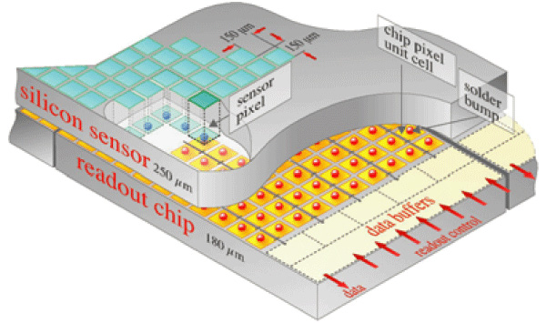
Solid-state micropattern detectors

Slide 47
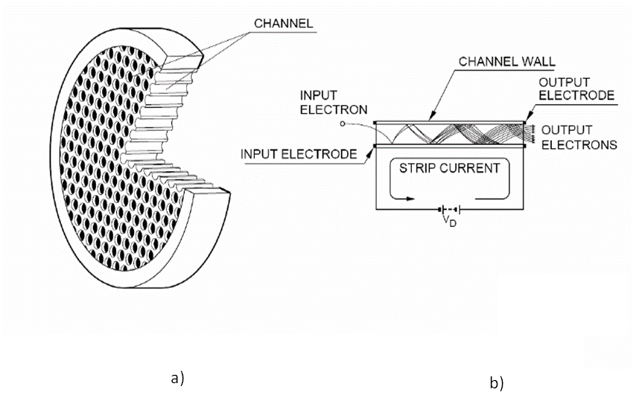
Microchannel plates

Slide 48
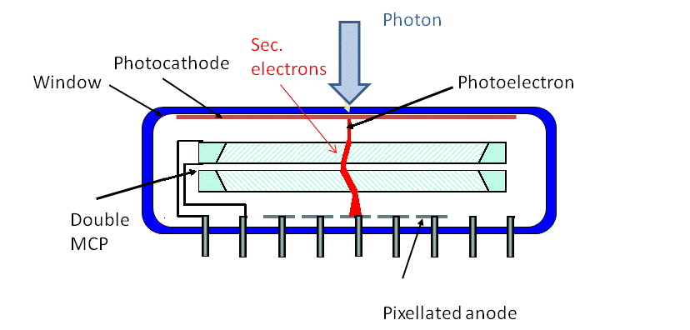
Space resolution ~10 µm, time rsolution <100 ps

Slide 49
8x8 inch
Vacuum PMT
Vacuum MCP
ALICE RICH-
each module
40x60cm2

Slide 50
Another example of large area gaseous detector-RPC

Slide 51


RPC
Main advantage - a continuously sensitive device having high time resolution ~1ns

Slide 52


These detector also can be build with large sensitive areas- in total thousands of m2!
To build them is much easier than MWPCs!

Slide 53


Microgap RPCs
The main advantage of microgap
RPCs is high time resolution- about
50-70 ps per passing particle and a very
high position resolution-better than 50 μm

Slide 54
Another recent revolution- micropattern gaseous detectors

Slide 55


At the end of the last century, or be more precise, at the end of 90-s a new revolution happens in gaseous detectors: micropattern detectors were invented
Their main feature is that they are manufacture by a microelectronic technology and this offers:
● Easy way of manufacturing
● Low cost
● High granularity-high position resolution

Slide 56


A. Oed

Slide 57
Micropixel gaseous detectors-something very promising!

Slide 58
High granularity pixelized readout
The latest tendency: a strip-type of the micropattern detectors readout is replacing by a pixel- type of the readout. This becomes possible due to the fast development of electronics

Slide 59




GEM and VLSI pixel ASIC @ INFN Pisa
Three ASIC generations of increasing size, reduced pitch & improved functionality
0.18 μm CMOS VLSI
Electron extraction from GEM to pixels
6 layers 0.18 μm CMOS technology
Self-Triggering capabillity
50 * 50 μm pixels (470 pixels/mm²)
Serial analog readout for each pixel
Noise ENC ~ 50 e⁻/channel
E .Costa et al., Nature 411 (2001) 662
R. Bellazzini et al., NIMA535 (2004) 477
R. Bellazzini et al., NIMA560 (2006) 425
R. Bellazzini et al., NIMA566 (2006) 552

Slide 60


MICROMEGAS+pixelized readout
Electron from traversing particle drifts towards Micromegas grid and is focused into one of the holes
Thereafter a gas avalanche is induced ending directly at the anode pad of the pixel chip ( no electron extraction from the multiplication structure)
~ -500 V
InGrid
Comparatively low drift field (100 -700 V/mm)
High amplification field (~ 10 kV/mm) to induce gas avalanche
Micromegas holes centred on pads pixel chip
F. F. Hartjes Report at Micropattern Conf.
Crete, June 2009
…
Comparatively low drift field (100 -700 V/mm)

Slide 61





“InGrid’ Technology and “Driving” Developments
2005: Single “InGrid” Production
2011: Major Step Forward →
InGrid Production on a wafer level (107 chips)
2009: “InGrid” Production on a
3 x 3 Timepix Matrix

Slide 62


"InGrid" Detector: Single Electron Response and Discharges
Observe electrons (~220) from an
X-ray (5.9 keV) conversion one by one and count them
in micro-TPC (6 cm drift)
→ Study single electron response
Provoke discharges by introducing small amount of Thorium in the Ar gas - Thorium decays to Radon 222 which emits 2 alphas of 6.3 & 6.8 MeV
→ Round-shape images of discharges
1.5 cm
Fe⁵⁵
source
P. Colas, RD51 Collab. Meet.,
Jun.16-17, 2009, WG2 Meeting
M. Fransen, RD51 Collab. Meet.,
Oct.13-15, 2008, WG2 Meeting

Slide 63
This is cutting edge of the technology!
(medical application of these novel detectors, probably , will come soon)

Slide 64


Liquid detectors and their combination with gaseous detectors-another promising direction
(to be discussed later)

Slide 65

History of gaseous detectors developments and their main designs
RPC

Slide 66
In the next lectures we will review the main designs of gaseous detectors:
Wire type
Parallel-plate type
Micropattern

